Slide 1

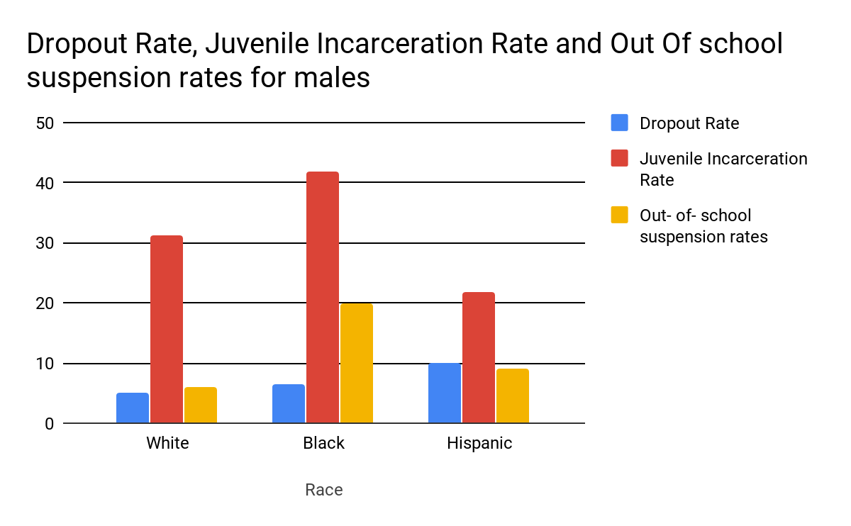
Poison in the School System
Tyreek Lloyd || Southern School of Energy and Sustainability
Introduction
Data and Results
Background Information
The suspension rate of black students has increased since 2000. It's not racially balanced, because the black students are more likely to get suspended or expelled than white students. Doing a crime and committing violent acts in schools led to states adopting policies that required students to be suspended. In the 1970s, keeping students out of schools as a punishment was very rare.
In this poster, the term “punitive disciplinary measures” are referring to Zero tolerance policies in schools. A zero-tolerance policy is a strict enforcement of regulations against undesirable behaviors. Ever since the 1970s the suspension rate for all students has doubled, but has increased even more for black students.
Percentage of Suspension Rates & Juvenile incarceration rates
Drop out rates do not follow the same trend as juvenile incarceration rates or out-of-school suspension rates
Juvenile incarceration rates and out-of-school suspension rates follow the same trend
Conclusion
Previous research shows that students who receive punitive disciplinary measures before the age of 12 are more likely to become incarcerated before the age of 16 compared to those who who had not received punitive disciplinary measures. This data shows similar trends in punitive disciplinary actions and incarceration rates. Law enforcement or juvenile court as a form of discipline are turning the students over to the juvenile justice system.
Research Question
How do the punitive disciplinary measures within the school system lead to schools pushing out African American males? How do the effects of schools pushing out African American males increase incarceration rates?
Methodology
I obtained data about suspension rate by race and gender from the U.S. Department of Education Office for Civil Rights. I was able to find data about drop out and incarceration from the Bureau of Justice Statistics. The chart was made using Google Sheets.
Notes:
Do you like the changes? Do you want to add anything? Alriiiiight it’s done! I sent it in! <3 THANK YOU <3

