Slide 1

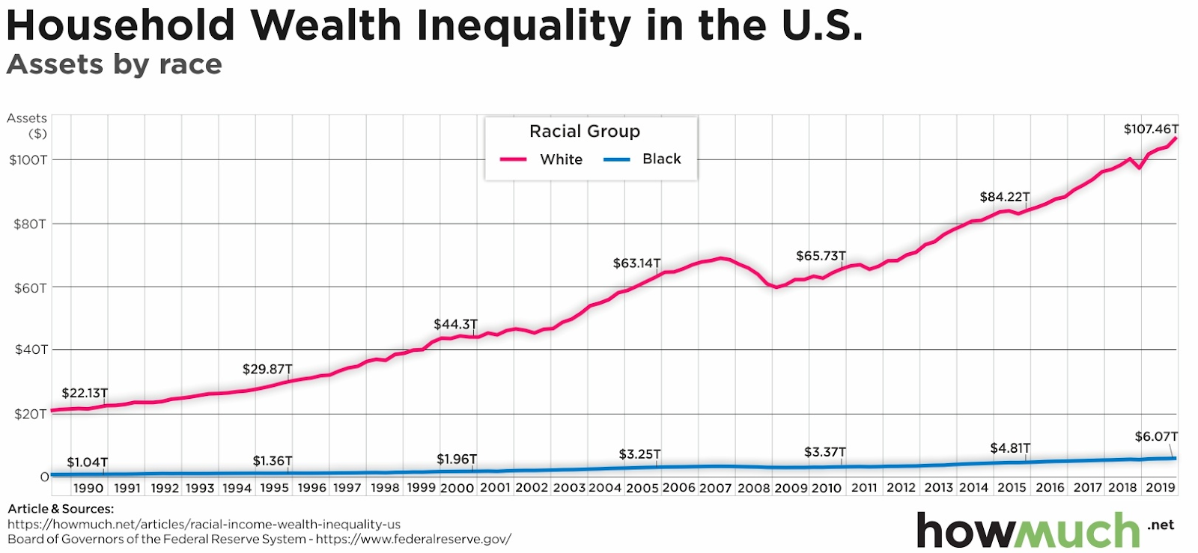
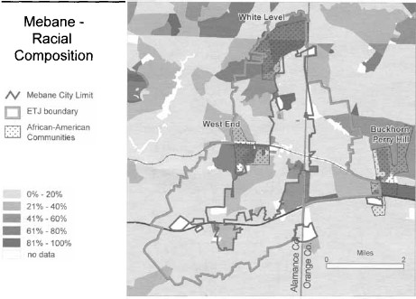
How do Discriminatory Policies Affect Black Income in North Carolina.
Ty’mir Bass
City of Medicine Academy
Introduction
Data Analysis
Jim Crow laws, both state and local, were introduced in the Southern United States to enforce racial segregation and have been deeply rooted in North Carolina since 1913. It commenced with Clarence Poe, who launched a “two-year crusade to establish rural segregation through the south”, similar to South Africa's apartheid. One of the first cities in North Carolina to adopt Jim Crow laws was Winston Salem as they integrated rural segregation, however the issue only continued to spread.
Research Question: What are the effects of Jim Crow laws and city planning in the Black communities of North Carolina?
Thesis Statement: Jim Crow laws and city planning affect Black communities by making it harder for them to grow by pulling resources to benefit other communities.
Methodology I used secondary data as I examined articles on Mebane, North Carolina which gave me quantitative and qualitative data as they used past data from the Census, the national economic association, and the records of the people that stayed there. How I found articles like this by reviewing literature from Google Scholar and JSTOR from 1900 to 2020. I struggled to find good articles in North Carolina
“These Visualizations Break down America’s Huge Racial Wealth Gap.” Edited by Irena, HowMuch, 15 June 2022, howmuch.net/articles/racial-income-wealth-inequality-us.
“Household wealth inequality in the U.S.” conveys the household wealth inequality gap between Black and white U.S. citizens. This graph consists of data from the years 1990 to 2019. During 1990, Black African Americans in the United States total assets were 1.04 trillion dollars while white Americans' total assets were 22.13 trillion dollars with a significant difference of 21.09 trillion dollars. over time, the wealth gap continues to increase. In the year 2019, the assets of White Americans were 107.46 trillion dollars and the assets of Black Americans were 6.07 trillion with a difference of 101.39 trillion.
Results
Jim Crow laws affect city planning in Black communities by rooting itself in rules and policies disallowing Black people from living in certain areas. Delgado "It seems conclusive that the city, under its police power, has a right—indeed, not only has the right, but should hold it as its bounden duty—to step in and, by the prohibition of a further influx of negro population into the white districts, prevent further destruction in value" (Delgado, 2018). Simply put, Jim Crow laws made it especially difficult for Black communities to thrive and grow. Jim Crow laws are responsible for pulling resources from Black communities and allocating those resources to mostly white communities.
Background
“The Jim Crow years from 1900 to the Civil Rights era and the abolition of segregation laws in the 1960s, segregated urban landscapes evolved in North Carolina…” Jim Crow laws have been a problem in North Carolina stripping Black people of their rights, opportunities, and wealth. (Ruth,1997)
Jim Crow laws have had a long-lasting impact on Mebane, North Carolina. As it is deeply rooted in their policies allowing for racial residential segregation coinciding with Mebane's town boundaries being strategically drawn to exclude African Americans. This is reflected by four of Mebane’s African American communities being located just outside of the city limits.
Since these communities are located outside the city limits the municipalities enforces “exclusionary zoning tactics that bar the African American neighborhoods from annexation in applications for Extra-territorial Jurisdiction", this strategy essentially gives the town's government control over property while denying African Americans of political representation and rights over property. This information demonstrates how unjust local governments can be especially in Mebane where there is a use of discriminatory policy. Further research revealed that Mebane, North Carolina hindered the development of the Black communities through discriminative policies and tactics (Jhonson,2004).
This is also tied to their health since most Black households in Mebane don't have sewer systems, if they do have sewage, Black families must personally fund it. This is at the fault of Mebane's racial policies and Black communities being outside of the city limits causing them to be denied of sewer services. If they don't pay these hundreds of thousands of dollars for the sewage systems upkeep they won't have it. Since most Black households in Mebane don’t have financial stability they resort to throwing their washing machine, and bathrooms, and sinking water into ditches nearby in turn the sewage would seep into the ground decreasing the property value and it also brings about health risks like viruses, bacteria, and parasites. (Jhonson,2004)
Conclusion
In conclusion, these issue's affect not only cities in North Carolina but the entirety of the United States. These policies affected by the Jim Crow laws are corrupted and still prevalent today, hindering Black people and communities from achieving success. We can solve this problem firstly with the help of the government to uproot these discriminative polices and attain funding for community led development. The community would come together to address issues in order to achieve Sustainable Development Goals (SDGs).
According to a study by the National Economic Association, “The median income for white households in Mebane, North Carolina, is 55,795, compared with 22,672 for Black households. What's crazy about this information is that 77% of Mebane’s population is Black while 22% of Mebane’s population is White”. This is a problem because it goes to show how big the wealth gap in a smaller perspective.

Slide 2
The history of Jim Crow laws has been deeply rooted in North Carolina since 1913. It all started with Clarence Poe who launched a “two-year crusade to establish rural segregation through the south”, similar to South Africa's apartheid. One of the first cities in North Carolina to adopt Jim Crow laws was Winston Salem as they Integrated rural segregation.
According to” The Other Side of the TracksTheMiddle-ClassNeighborhoods That Jim Crow Built in Early-Twentieth-Century North Carolina “The Jim Crow years from 1900 to the Civil Rights era and the abolition of segregation laws in the 1960s, segregated urban landscapes evolved in North Carolina…” Jim Crow laws have been a problem in North Carolina stripping Black people of their rights, opportunities, and wealth. (ruth,1997)
Jim crow corelating with wealth gap
https://northcarolinahistory.org/encyclopedia/residential-segregation/ use these articles the make the paragraph
https://www.cityofws.org/ArchiveCenter/ViewFile/Item/512

