Slide 1
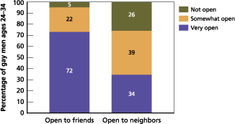
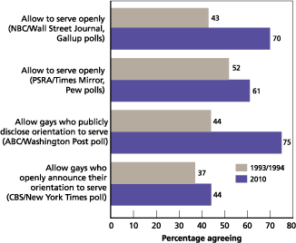
“Semper Fidelis,” but to whom?
Thomas Bennett || Hillside High school
Introduction
Data results
Results
From “Don’t Ask, Don’t tell” to being dishonorably discharged for being openly gay, the United States Armed Forces have supported policies that discriminate against memebers of the LGBTQ+ community for many years.
My research question is: How does the discrimination faced by LGBTQ+ military personnel of color within the United States Armed Forces affect their income earning power?
How many Lgbt are open to their friends and neighbors
LGBTQ+ individuals can still be fired, simply for being who they are. LGBTQ+ individuals are still denied basic public accommodations because of their sexuality or gender identity. Individuals are still denied basic public accommodations because of their sexuality or gender identity.
Conclusion
The discrimination has not stopped against the LGBTQ + of color community. While the percentage of LGBTQ+ survey participants that agreed about serving openly increased from the 90’s, it is still not one hundred percent. The results of this study show that getting rid of discriminatory policies such as “Dont ask Dont tell” and dishonerable discharge for identifing as LGBTQ + dont solve the problem completely.
Background Information
Discrimination is the unjust or prejudicial treatment of different categories of people or things, especially on the grounds of race, age, or sex. Earnings power is the ability of an individual or business to generate profit from conducting services.
Percentage of LGBTQ Opinions about Serving Openly
Reflection
This research has been one of the most frustrating and stubborn projects that I’ve done so far in my academic career. This has been a great year even with my hard topic. My findings have astonished me and it opened my eyes to the true nature of the armed forces.
Method
I conducted my research by using history.com and other scholarly sites. I obtained data for my charts from thebattlecontinues.com.

