Slide 1
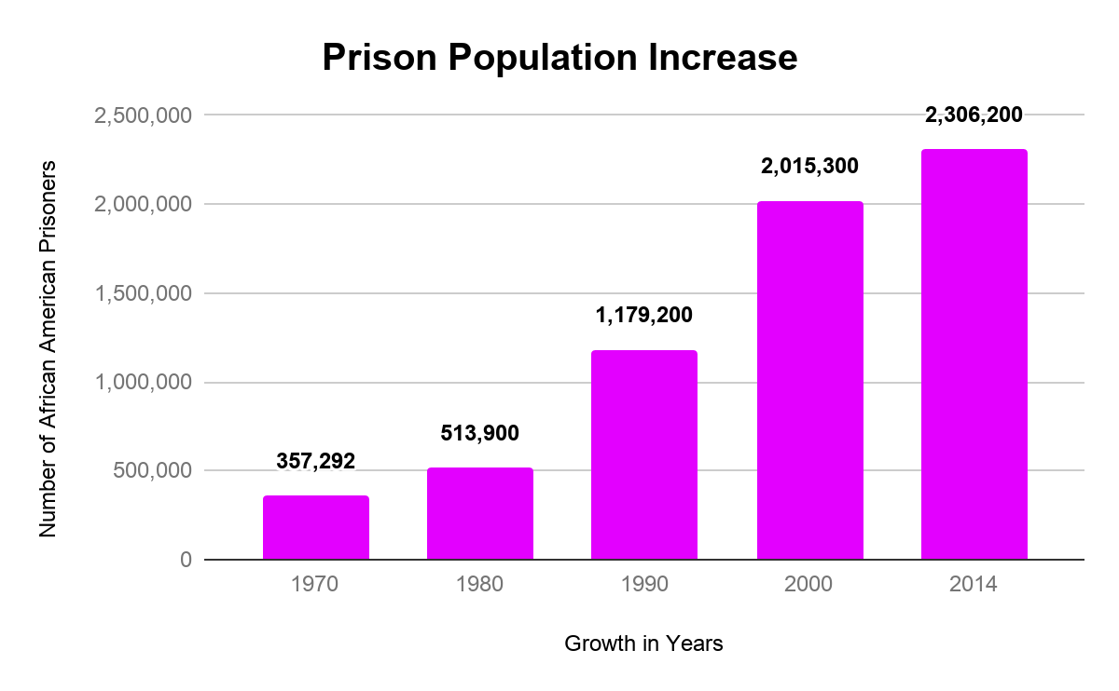
Stolen Role Models, Lost Childhood
Syniaa Pace || J.D. Clement Early College High School
Research Question
Data and Graphs
Methodology
How does the incarceration of a household role model affect the mental health of the household from which they were removed? How does this vary with the child’s gender identity?
There were about 878,400 African American people within the prison system in 2001
In 2007, 52% of state and 63% of federal inmates reported being parents to an estimated 1.7 million children
The number of children under the age of 18 with a mother in prison more than doubled since 1991
I compiled my research by analyzing statistics and studies that focused on the mental health children with an incarcerated parent/guardian. I found my sources using Google Scholar and the Duke library online search engine.
Background
Mass Incarceration has increased since 1970 due to political and economic changes in society. From 1970 to 2014, the prison population has doubled. There is not a lot of research about parental incarceration specifically, because it is not documented and observed by federal, state, or local agencies. Research about parental incarceration mainly focuses on the mental and physical behaviors of an offspring of an incarcerated parent. It has been concluded from prior research, that both young men and women are 62% more likely to fall into the same lifestyle and behaviors of an incarcerated parent/guardian.
Results & Conclusion
Children of incarcerated parents are more likely to be incarcerated themselves. They are also at a higher risk of developing PTSD and other mental health issues. These effects vary by gender, with stress being more associated with girls than boys.I will further my research by looking deeper into the financial impacts and effects of an incarcerated household family member and programs and policies that could possibly lessen the negative impact of having an incarcerated parent. My research leads me to investigate the long-term effects of incarceration on families and how the cycle of poverty and incarceration is continued.
“Parents of Minor Children held in the nation’s prisons has increased by 79% between 1991 and midyear 2007”

