Slide 1

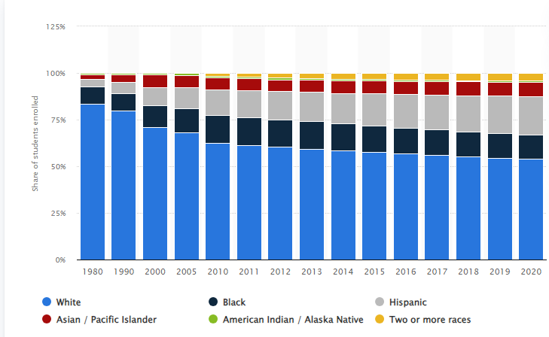
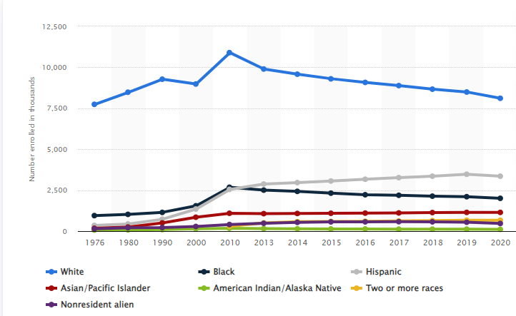
Effects of Affirmative Action on Post Secondary Applications
Samuel Asher Nguyen
Durham School of the Arts
Introduction
Data Analysis and Findings
Affirmative Action is a policy to increase the chances of people of color, and women to get equal opportunities. Post secondary education in universities and colleges have historically been high income white students. Affirmative Action is in place to encourage more applications from students of color.
Research Question: How have students of color applying for post secondary education been influenced by Affirmative Action and how will this impact any future applicants?
Thesis Statement: Affirmative action has increased diverse applicants and the number of college graduates by encouraging more applications of people of color, along with affected mental health and performance of students.
Methodology: When researching this project, I utilized resources I could access from the Duke Library. I found my articles using the Duke Library or by using Google's library of scholarly articles. I used articles from universities and research centers. There were many articles looking at college admissions based on race and the effects of Affirmative Action. I found most articles talk about how Affirmative Action affected students, not only quantitative data in their admissions but also qualitative data in how they felt about college. Many of them wrote about how students felt more comfortable with Affirmative Action in place. Some articles wrote about the admission rates in colleges where Affirmative Action was in place and others wrote about admission rates where there was not Affirmative Action.
Affirmative Action influences students of color admissions and their mental health and experiences when at school.
Mental:
Students of color in campuses with Affirmative Action are often more satisfied with their schools. The general increase of students of color, especially of students' own race can make them feel more accepted. “Not surprisingly, at these predominantly white institutions minority students who felt more socially distant to whites expressed lower levels of college satisfaction at these predominantly white institutions” (Fischer, et al, 2007). Schools without Affirmative Action can make students feel isolated and unwanted. They can affect students' satisfaction and performance.
Performance:
Students of color in schools with Affirmative Action often perform better because of the feeling that they got an opportunity. This ranges from better performance on tests to lower dropout rates. “The degree of an individual’s likely benefit from Affirmative Action is negatively related to the likelihood of leaving school, and the effect is highly significant” (Fischer, et al, 2007). In most cases, dropout rates can decrease by 20%-30% along with graduation rates.
Applications and Admissions:
Affirmative Action encourages the applications of people of color. A recent study stated, “that the practice of Affirmative Action by elite colleges increases enrollments of disadvantaged students” (Mello, 2022). When Affirmative Action was banned, it caused a 40% decrease in students of color applications as written by Peter Hinrichs in his 2012 article, “The Effects of Affirmative Action Bans on College Enrollment, Educational Attainment, and the Demographic Composition of Universities” and admissions dropped around 50%. This shows the effects of the ban in numbers.
Additional Details:
A large factor in applications for more competitive colleges is legacy applicants, which is held by majority white households. Along with the fact that white households usually have enough money to send their kids to college and the wealth gap, you have mostly white students applying.
(Statista, 2023)
Background
(Statista, 2023)
Conclusion
The purpose of Affirmative Action is to make sure people of color and women can have the equity they have been historically been denied. This applies to universities because it diversifies campuses and applications. The further diversity encourages more people of color to join and creates a safer space for non-white students. It also shows people of color that they belong in these places of higher education which before were reserved for privileged white students. This is represented in the paper on “Socioeconomic Status, Race/Ethnicity, and Selective College Admissions,” where white high-income students get accepted more than lower income students of color without Affirmative Action (Carnevale, et al, 2013). This shows the inherent biases toward these groups. The ban of Affirmative Action caused a 40% decrease in students of color being accepted as written by Peter Hinrichs in his 2012 article, “The Effects of Affirmative Action Bans on College Enrollment, Educational Attainment, and the Demographic Composition of Universities.”
College admissions and students in America are largely affected by Affirmative Action. The number of applications to colleges from people of color have been growing but that may change due to the ban on Affirmative Action. Affirmative Action makes students of color feel more accepted and welcomed on campuses. However, with the ban on Affirmative Action students can feel unwanted and isolated. This can show in the number of applicants and people accepted. So, in the end, Affirmative Action is an important part of making sure people of color apply to higher education. With the recent Supreme Court decision, many students will be reconsidering how they are valued in the school system, specifically students of color. The US Government expresses how they feel on Affirmative Action and towards students of colors with this ban.

