Slide 1
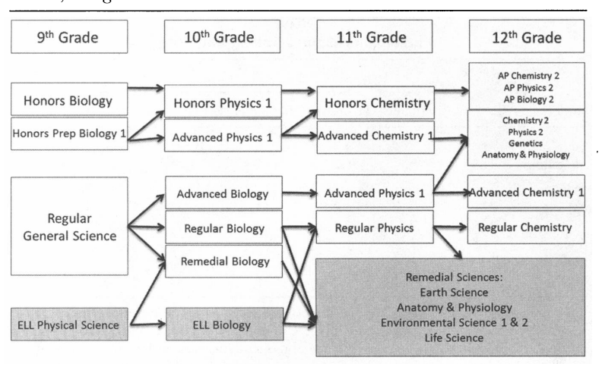
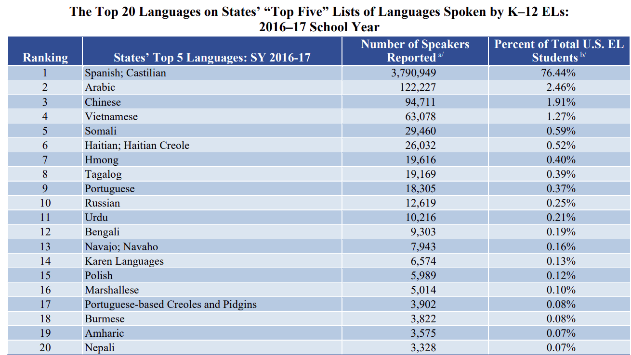
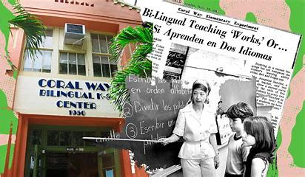
Education Inequality: The Impact of Academic Implicit Biases from Teachers Against English Language Learners in American High Schools
Rafia Ansari, Charles E. Jordan High School
Abstract
Data
Methodology
Through my quantitative research, I discovered teachers express implicit biases toward ELL students by favoring students who are already fluent in English. They put less effort into encouraging English learners to excel in school because they perceive them as less smart academically. Due to this, students performed worse than their peers in high school. In this study, I look in-depth at the negative academic effects that hold back ELL in America. My research addresses the question, How Can Academic Implicit Biases From Teachers Impact English Language Learners in American High Schools?
FIGURE 2. States in Southwest have largest shares of ELL students
My research was primarily quantitative data. I began by conducting background research from 2012-2022 via databases like
● Data Collections and Graphs
US Department of Education
Pew Research Center
National Education Association
National Clearinghouse for English Language
Acquisition
My previous experience as an English Learner from kindergarten through third grade was the main inspiration for this research. My experience led me to have a lack of self confidence due to my teachers doubting my ability to do well in school
Arrows represent science course pathways. The shaded area represents the most common course selections for ELL (Kanno 2014)
Background
Definitions
English-language learners (ELLs) are students who are unable to communicate fluently or learn effectively in English. ELL typically requires specialized or modified instruction in school (Kanno, 2014).
Implicit Bias: “unconscious favoritism toward or prejudice against people of a certain race, gender, or group that influences one’s actions or perceptions.” (Lowe 2014)
Historical Background
The high school graduation rate for English learner students was 61% in 2012-13, compared with an overall US graduation rate of 81%. Using decennial Census data and age at arrival in the United States, a person who speaks English poorly earns roughly 33% less than one who speaks English well. The majority of the earnings gap can be explained by lower levels of educational attainment. That is, people with greater English proficiency get more education, explaining a large share of the gap in earnings (Barrow 2016).
1923: Supreme Court invalidated a Nebraska law banning the teaching of foreign languages to schoolchildren.
1920-1960: Students were held at the same grade level until enough English was mastered to advance in subject areas.
After the supreme court ruled in Brown V.S Board that school segregation based on race was unconstitutional in 1954, Cuban immigrants who were fleeing their country in 1960 requested bilingual schooling for their children. The First program was open to both English and Spanish speakers at Coral Way Elementary School.
1968: The Bilingual Education Act was the first legislation that recognized ELL children and supported bilingual education.
Equal Educational Opportunities Act, No Child Left Behind Act (NCLB), and Every Student Succeeds Act (ESSA) benefited ELL students with school funds and new programs. (U.S. Department of Education )
Findings and Solutions
When ELL students are new to a school, administrators must immediately choose a grade to place them in. These grade placements are usually lower than the average grade level for their age (Conger, 2013). Along with this, there is a stigma around placing ELL in high-track classes because they will not be able to keep up. Teachers and counselors believe the amount of reading and writing would overwhelm ELL. These students in high school are not motivated to reach higher-level classes such as Advanced Placement or Honors because teachers and counselors don’t expose them. High-track teachers also expect their students to be motivated and independent inside and outside of school and believe ELL are incapable of keeping up. (Kanno 2014).
Solutions
More funding for ESL programs that can help teachers gain extra training
Hire teachers of similar background to match their school's population of ELL students
Raise awareness to change laws about hiring certified ESL teachers
FIGURE 3. Percentage distribution of ELL students languages 2016
Top 20 most commonly reported home languages of ELL in American Schools from 2016-2017 school year ( National Clearinghouse for English Language Acquisition 2016-17)
Conclusions
This research is significant since high school prepares students for college or their future occupation since English is the lingua franca, a common language. Teacher biases shield ELL from experiencing new opportunities with peers that can help them grow academically and culturally. Being bilingual can lead to more job opportunities, connecting easily with friends and family, and expanding personal identity through perseverance and self-discipline.
Limitations
No differentiation between race, sex, gender, etc.
Qualitative research may have brought more accurate data results
Areas for Future Research
Study if there are other implicit biases on ELL due to their identity? (race, sex, gender, etc.)
Explore the difference between ELL and their experiences in public and private schools
Study implicit biases on ELL in Elementary and Middle school students in America
FIGURE 1. Coral Way Elementary School (Elementaryschools.org 2015-16)
Notes:
Research what the acts did
Find good results of solutions (and examples)
Define High-track
Whats happening in Duhram?
TESOL Teacher certification?
Define ELL and ESL
lEARNING DISABILITIES
students disabilites

