Slide 1
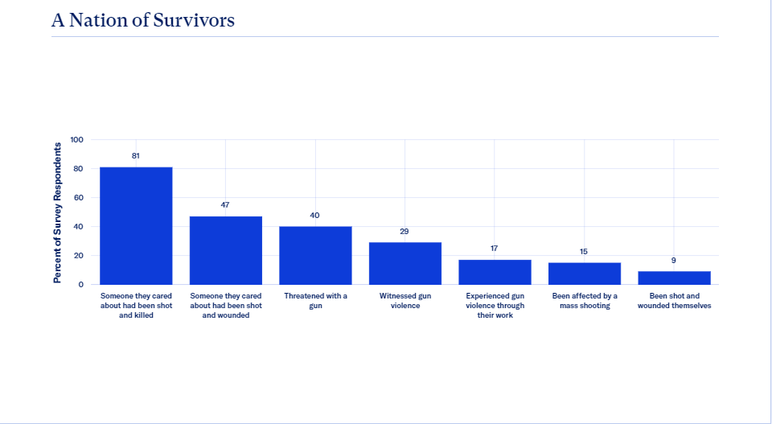
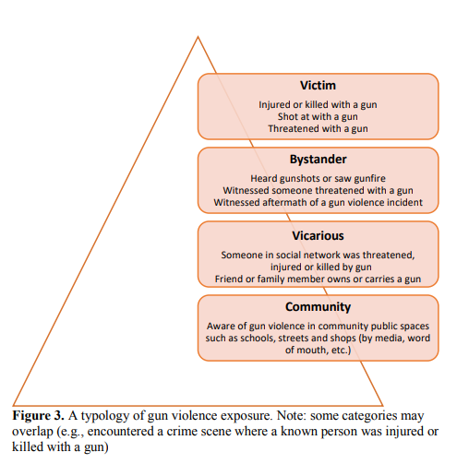
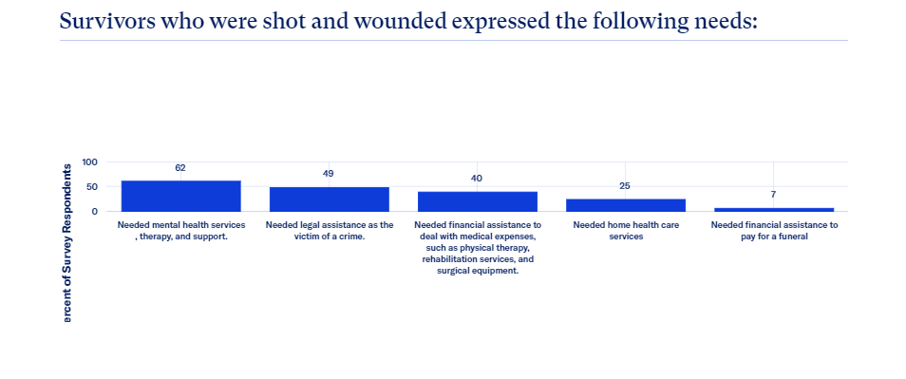
The Long Term Psychological Effects of Gun Violence
Rafaela Drake || Riverside High School
Introduction
Data
Methodology
Gun violence continues to increase daily and create a more profound issue in our society. Living around violence or hearing about it from friends, loved ones as well as the media emphasizes how prevalent the issue is. This rise in gun violence must be addressed through increased legislation and regulation. However, as our society finds how to provide these solutions in a manner that works for everyone it is also important to acknowledge the effects of what can not be undone and has already occurred. In doing this I also hoped to find what solutions there are to mitigate these traumatic after effects and also to end the cycle of violence. Living in an area, Durham, where gun violence is not an insignificant threat, I wonder how other people in my community respond to it. More importantly, what ways as a community we can come together to alleviate their pain and prevent future violence.
Figure 1: Chart illustrating occurrence and type of gun violence reported by survivors (Everytown, 2022).
Figure 2: Pyramid showing how gun violence impacts different levels of people affected (Bancalari, 1970).
Figure 3: Chart showcasing the needs expressed by survivors of gun violence (Everytown, 2022).
To find information I used Duke library resources for scholarly articles, Everytown For Gun Safety data, and literature from psychologists. I used more qualitative resources however, most of them had supporting quantitative data. I faced the most challenges with narrowing down my research question and deciding whether to use local or nationwide data.
Findings
When the psychological effects of gun violence go untreated and unacknowledged they can worsen, and in some cases lead to more violence. Separate studies done by the Educational Fund to Stop Gun Violence (EFSGV) and The CWLA found some of these psychological effects to be;
Depression, Insomnia, PTSD and Anxiety
Antisocial Behavior
Inhibited brain development (cognitive & emotional)
Desensitization and lack of nonviolent methods to resolve conflict
Need to arm themselves for protection, this can perpetrate more violence
Mental health (stigma around it can limit access to needed services/counseling for healing)
High stress rates leading to chronic disease
Unsafe uses of alcohol and substance
(EFSGV, 2021) (CWLA, n.d.).
Background
According to data from the Center for Disease Control and Prevention (CDC) homicides and suicides are the most common uses of guns which contribute to gun violence statistcs (2022).
A growing number of studies, specifically one study done by the Journal of Social and Health Behavior, demonstrate that mental illness is not the sole answer for increased gun violence, and it has been proven that those with mental illness are in most cases non-violent (1995).
Additional studies done by Society for Research in Child Development point out that exposure to violence such as witnessing someone being chased, threatened, wounded, attacked, or killed, is consistently a predictor of future use of aggressive behavior and violence (2005).
More than 25% of children have witnessed an act of violence in their homes, schools, or community over the past year, more than 5% witnessed a shooting (Collins, n.d.).
According to The Child Welfare League of America (CWLA) gun violence “becomes not just an issue of gun regulation, but also of addressing the impact on those who have been traumatized by such violence” (Collins, n.d.).
Conclusions
Solutions to this research problem would ideally include complete extinction, or at least reducement, of gun violence as a whole. However, as gun violence is still all too prevalent in society it is important to give solutions to what has already happened and left a mark on children, families, friends and community. Some strategies to combat these responses and cure them before they manifest into more harm are as follows:
Education and mental health services (beyond just for intervention, also prevention measures)
Parental monitoring and targeting services to youth at risk of violence activity
Community bonding
Prosocial behaviors
(Brookmeyer, 2005)
Notes:
Works Cited

