Slide 1
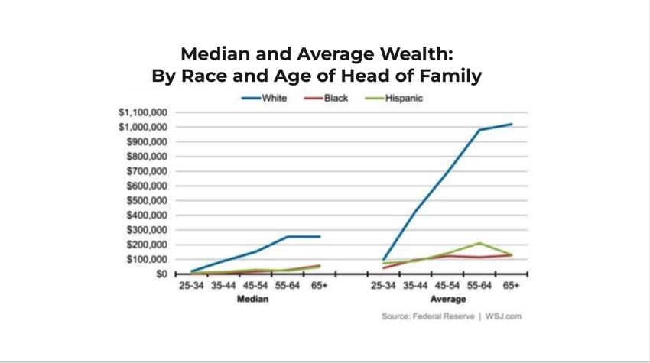

Closing the Racial Wealth Gap Through Government Policies
By: Payton Patterson
Research Triangle High School
Introduction
Data
Analysis: Continued
In 1865, following the death of President Abraham Lincoln, the Emancipation Proclamation went into effect freeing “all persons held as slaves”. Ironically ending slavery did not end the struggle for Blacks in American society. The era of Jim Crow created a system of complex racial inequalities for African Americans that still impact their lives today.
One key area that continues to plague black people is generational wealth inequality. By the year 2064, white families will possess $2,782,727 in wealth while African American families may only have $789,164. This is a 70% disparity (Fox 2020). This disparity will be devastating to blacks families because the price of living will also increase and likely limit extra income in black households. Ultimately, this will continue the trend of inequality for years to come.
This work aims to educate readers about the impact of financial inequality and how the Government can help close the gap to provide economic equity for black people.
“Affordable housing does not just mean just development of new housing, but also shifting the tax incentives that currently prioritize wealthy homeowners over low-income renters and first-time home buys” (Collins 2019).
The report furthermore mentions a joint study from the Institute on Assets and Social Policy (IASP) and the National Low-Income Housing Coalition found that the loss in housing is estimated to be $4.8 billion for black people.
In a 2010 article, “The racial Wealth Gap and the Borrower’s Dilemma”, writer N.S. Chiteji mentions that a “household’s wealth status is affected by both the value of its assets and its outstanding debt” (Chiteji 2010). Another significant way to close the intergenerational wealth gap could be eliminating all student debt.
Analysis
Conclusion
Question
In accordance the the research, the writer found that providing minors with a guaranteed income, investing in affordable housing , and eliminating student debt are clear ways the government can close the racial wealth gap.
This graph shows white people in America have a significant advantage as they advance in age. In the report “Ten Solutions to Bridge the Racial Wealth Gap”, writer, Chuck Collins and others, discuss possible solutions the government can implement to assist African Americans with closing the wealth gap.
The first possible solution is baby bonds. Baby bonds will provide every child at least $1,000 at birth. The government would add an additional $2,000 annually until their adulthood. This money can be used for education, purchasing homes, or even starting a business.
What can the government do to close the racial wealth gap?
Methodology
This work is derived from qualitative and quantitative research found in scholarly journals and reports. Search topics include generational wealth gaps, government solutions to close generational wealth gap, etcetera. A few primary sources stemmed from Chuck Collins’ “Ten Solutions to Bridge the Racial Wealth Divide”. Some secondary sources include “The Gender Wage Gap By Occupation 2017 : and by Race and Ethnicity” and “The racial Wealth Gap and the Borrowers Dilema” by N.S. Chiteji.
Another government consideration could be investing in affordable housing.
Notes:
fenaba addo
things you can put in:
- search engines/data basis you used
- search terms
- is it qualitative or quantitative?

