Slide 1
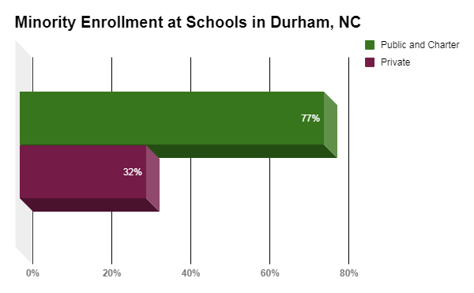
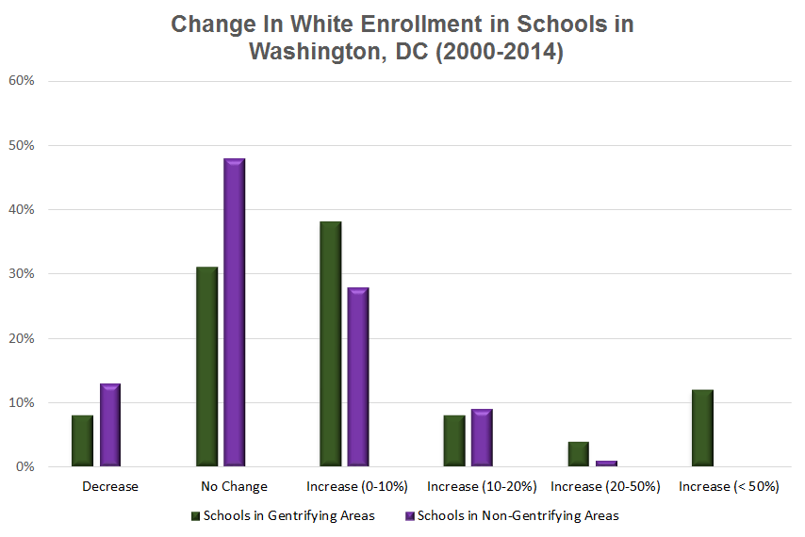
Desirable Homes, Undesirable Schools:
Gentrification and Education
Oyinkan Ajasa II Durham School of the Arts
Research Question
How does gentrification impact the access to education of low-income students of color?
Background Information
Gentrification
Movement of affluent people into low-income neighborhoods of color.
Results in the increase of the economic investment and share of the neighborhood.
Outprices and displaces the current citizens in the neighborhood.
Low- Income
The Federal Poverty Level in 2017 on average for a family of four, $24,600.
Students of Color
Students of color in this study refer to non-white students.
Results
Conclusion
Children succeed when their parents are capable of providing for them.
Middle-class families bring enrollment dollars associated with their own child’s attendance, along with the influence of other middle-class families to follow suit.
The expansion of school choice policies aid the likelihood and extent to which disinvested urban neighborhoods experience gentrification.
Schools with a high percentage of students in poverty tend to have less experienced staff and higher staff turnover.
Population shifts due to gentrification result in a new wave of segregation. Since public schools struggle to draw in a wealthier white population because parents of a gentrified population usually choose to place their children in private schools, gentrification negatively affects school funding. Due to displacement families of color face, students are unable to experience the benefits of going to a school in a gentrified area.
Next year, I plan to hone in on gentrification and education by looking at North Carolina specifically instead of the entire United States.
Methodology
To obtain information for my research, I critically analyzed scholarly articles using the Duke Library and Google Scholar search engines. To create the data graphs, I visited the Durham Public School's website and compared the number of minorities in public and private schools, and compiled this data using Google Sheets.

