Slide 1

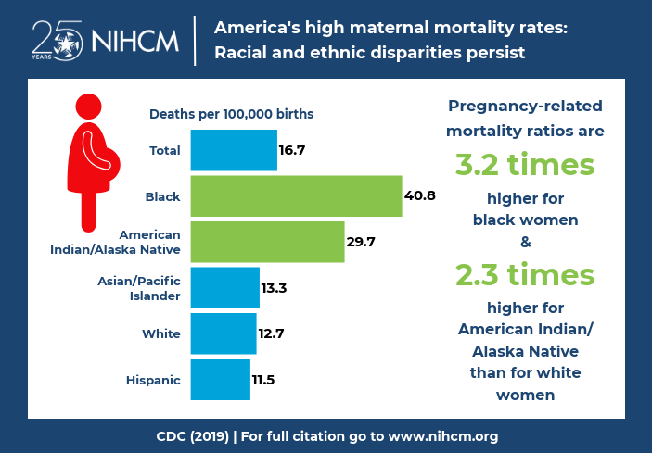
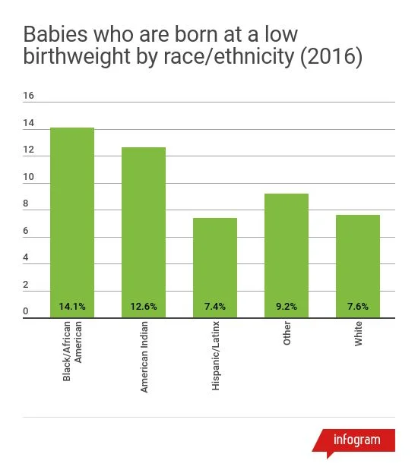
Social Stigmas within Black Maternal Health
Olaitan Ajasa
Durham School of the Arts
Introduction
Data Analysis
Findings
For years, African American women have struggled to get the adequate help they need in maternal healthcare. Many obstetrics and gynecology (OBGYN) doctors have deemed African American women's self-advocacy as ignorant, disrespectful, and dramatic. This project will expand on the effects that these claims can bring to the African American female community.
Research Question
How do social stigmas in healthcare impact maternal health for African American women?
Thesis Statement
The social stigmas in healthcare impact maternal health for African American women by increasing maternal mortality rates, mood and anxiety disorders (pre and postpartum), and higher risk of complications with their infants.
The infographic showcases the racial and ethnic disparities that occur in America’s high maternal mortality rates. In 2019, black womens mortality rates were at 40.8% while their white counterparts were at 12.7%. According to the Centers for Disease Control and Prevention (CDC), “Pregnancy related mortality ratios are 3.2 times higher for black women & 2.3 times higher for American Indian/ Alaska Native than for white women”. This shows how badly systemic racism affects a black women’s experiences in the hospital.
(Health Equity 2019)
The prevalent social stigmas that Black mothers face is common in maternal health. However, the most commonly used phrase to describe social stigmas is “The Stereotype Threat Theory” (STT). Stigmas are negative stereotypes, which means that the application of STT in maternal healthcare would provide a better understanding of how deleterious the African American women experience is in maternal healthcare. According to Blanton, “In fact, Black women report worrying about stereotypes and feeling like doctors and other medical professionals treat them differently because of their race or ethnicity.” This is similar to Black women in maternal health when they feel the social stigmas whilst they are in prenatal care (Lillie-Blanton et al., 2000).
Methodology
Background
To gain the information needed, I examined secondary resources such as JSTOR.org, Google Scholars, and publications from Harvard's school of Public Health. A significant amount of my research was qualitative, based upon several stories from Black women's experiences in maternal health. My quantitative research examined the statistics and data that conveyed the increase of Black mothers’ mortality and low infant birth rates. I found it difficult to rely completely on qualitative research as I wanted to find credible stories that weren’t biased.
The preconceived bias towards black women's maternal health has stemmed all the way back to 1884. When an inhumane gynecologist unfairly tested female black slaves and used them as animals to be tested upon. (Owens p.43-48
According to Owens, James Marion Sims (father of modern gynecology), performed numerous experiments on enslaved women in Alabama. The goal of these experiments was to be the first to repair the vesicovaginal fistula. A vesicovaginal fistula is an abnormal opening between the bladder and the vaginal area, which causes urine to leak excessively through the vagina. This complication can be an issue after vaginal surgery or complicated childbirth. After about thirty or more surgeries on numerous slave patients, Sims was able to solve this complication. Unfortunately, while Sims was solving the impediment, he came up with a misogynoir conclusion; that black women could withstand pain better than white women. (Owens p.43-48)
These misconceptions have been the reason as to why doctors believe pregnant African American women, “exaggerate their pain”. Which then results in poor prenatal healthcare among Black women. Leading to poor maternal health outcomes in prenatal and postnatal care, such as infants with low weights, higher infant and maternal mortality rates, and increased mental health issues.
Conclusion
African American women's complications during or before childbirth have increased drastically each year. This problem isn’t easy to solve but it doesn’t mean we should give up without trying. There are many effective practices that prenatal healthcare providers can do to solve this dilemma. Fundamentally, doctors should detect and eliminate any sign of bias towards any patients. Healthcare providers should come in with an openview towards individuals. It is imperative that doctors listen to Black women when they advocate their problems. When a patient expresses they are feeling immense pain after birth, they need to trust and believe them, quickly find out the problem, and take accountability. Another effective way is to know more about your patient and see what struggles they may go through. These are the first steps to take to try and reduce the complications African American women face in maternal health.
This graph portrays the percentage of low birth weight infants by race and ethnicity in North Carolina. The occurrence of low birth weights is 14.1% among infants of NC- born black women which is almost twice the rates of Latino (7.4%) and white (7.6%) infants. Black women disproportionately have low birth weight infants due to the stress of the discrimination and systemic racism in maternal healthcare. According to Duke University School of Medicine, “Non-Hispanic Black and Latina women experience higher rates of depression and anxiety during pregnancy and are at greater risk of poor pregnancy outcomes”. This is crucial to black women and their infants. (NC Early Childhood Foundation 2016)

