Slide 1

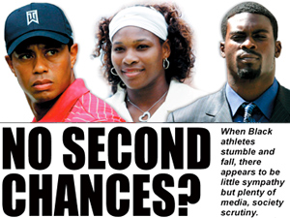
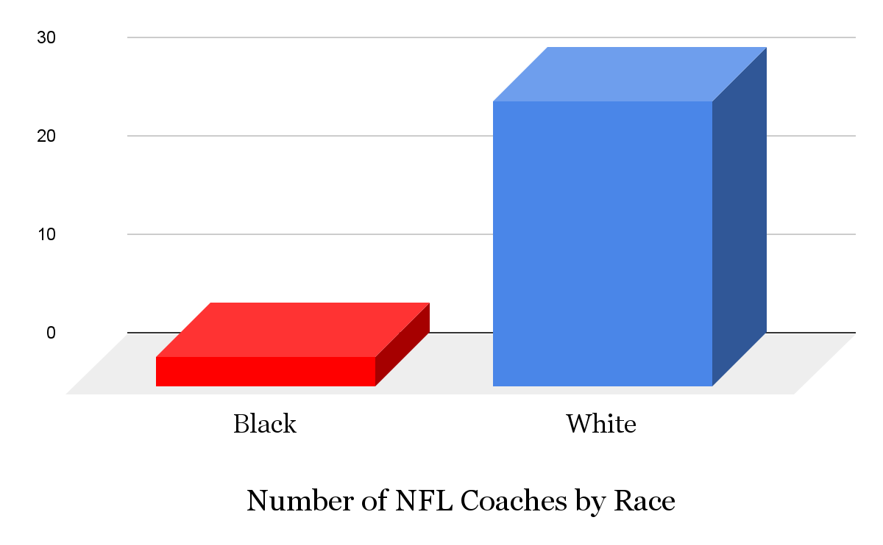
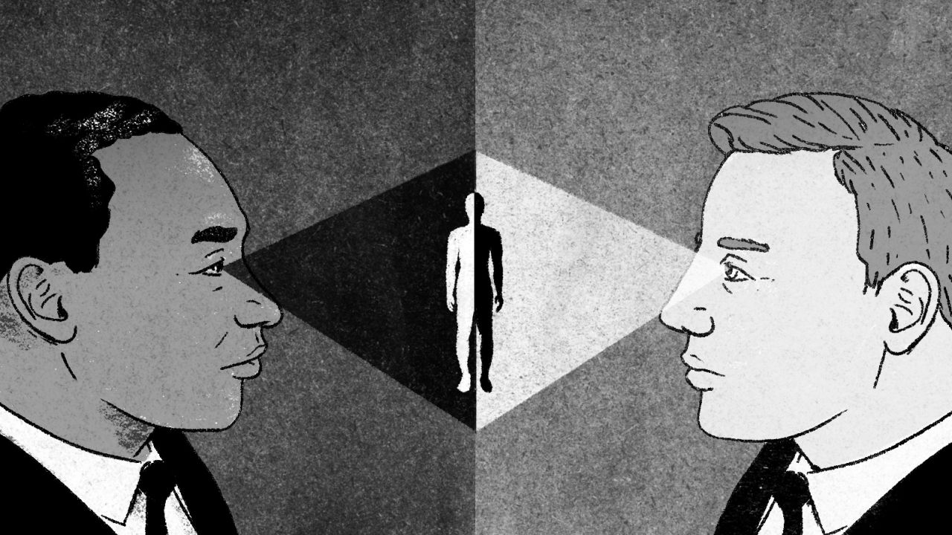
Disparities within Professional Sports in America
Noah Louesy
Trinity School of Durham and Chapel Hill
Introduction
Data & Statistics
Findings
Despite undeniable progress towards inclusivity and diversity, the world of sports still has deep-rooted unfairness and inequities. The context of this discrimination also combined with biases results in a clear and noticeable divide within the way Black athletes are viewed compared to whites with regard to multiple aspects including media representation, public perception, and more.
Research Question: What unfairness and inequities exist within the way Black vs white American professional athletes are viewed within professional sports?
Thesis Statement: In professional sports, racial bias impacts representation in staffing, sponsorship opportunities, and media portrayal.
Current Black NFL Coaches:
  Mike Tomlin of the Pittsburgh Steelers
  Todd Bowles of the Tampa Bay Buccaneers
  DeMeco Ryans of the Houston Texans
Black athletes may often face barriers in accessing opportunities for coaching, management, and executive positions despite their expertise and qualifications (Myler, Spencer, 2023).
The lack of representation in these leadership positions continue to imbalance and reinforce racial biases within the industry. For example, there are only three black head coaches in the NFL, which is a sports league predominantly consisting of black athletes where there is a deficiency in their capacity to appoint head coaches who look like themselves or have similar personalities and backgrounds.
Also, studies have shown black athletes have frequently received different coverage in the media compared to white athletes within the same field as them (Myler, Spencer, 2023).
Lastly, public perception plays a significant role in shaping an athlete's career and personal brand. Black athletes are more likely to face harsher criticism and negative portrayals in the media, affecting their marketability and endorsement opportunities (Schlerf, Jeffrey, 2022). In contrast, white athletes may receive more favorable treatment, which can positively impact their public image and financial prospects.
Background Information
(1990s)
  Jim Crow laws and racial segregation significantly impacted sports, leading to the establishment of Black athletes-only leagues, teams, and facilities in many places (Youth Civil Rights Academy, 2023).
(Late 1940s)
  When Jackie Robinson joined the Brooklyn Dodgers in 1947, he broke the color barrier in Major League Baseball by becoming the first Black player to compete in the league in the modern era (Youth Civil Rights Academy, 2023).
(1980s-21st Century)
  More Black Athlete icons are becoming more famous and looked up to to future generations such as Michael Jordan and Tiger Woods. As well as social media and technology continuing to play a significant role in highlighting racial inequalities and discrimination within sports (Youth Civil Rights Academy, 2023).
(Ongoing)
  Lack of Diversity in Leadership: Black athletes continued to face barriers when seeking positions in coaching, front-office management, and ownership within professional sports organizations (Youth Civil Rights Academy, 2023).
When Black athletes stumble and fall, there appears to be little sympathy but plenty of media, society, and scrutiny (Muhammad, James, 2023).
Conclusion
(ESPN, 2023)
Despite progress in racial equality, these disparities in sports continue to shape the treatment and opportunities afforded to athletes of African-American decent. Also, media portrayal, endorsement deals, and fan perception are influenced by deeply ingrained racial biases, perpetuating an unequal playing field. Sports organizations, media outlets, and fans must actively challenge and deconstruct these biases. Embracing diversity, and promoting fairness are essential steps toward creating a more equitable and just sports landscape, where athletes are valued and celebrated based on their talents and achievements, not their race.
Methodology
Throughout my research of the information I located, I proceeded to use a literature review of websites and sources such as Google Scholar, Duke Library, and inside ESPN a specific source in relation to the NFL.
(Struyk, Ryan, 2017.)

