Slide 1
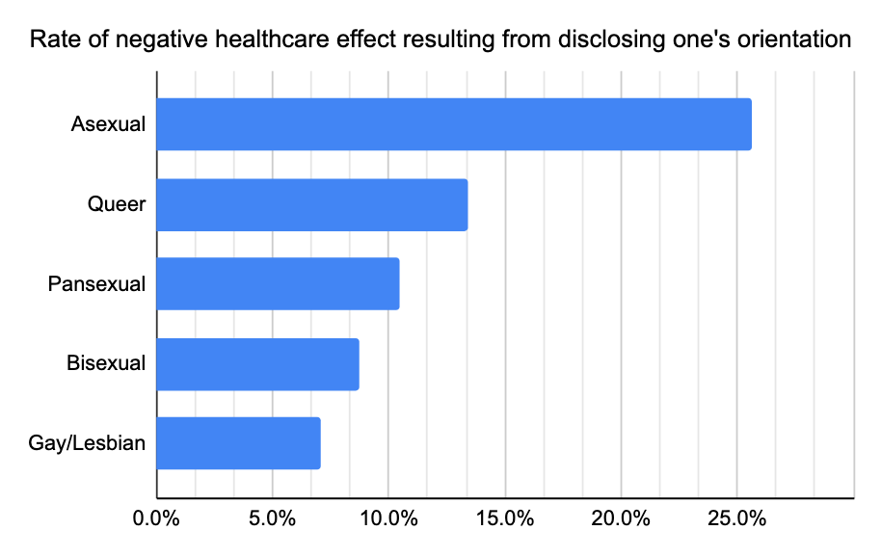
Asexuality: Common Stereotypes and How They Affect the Asexual Community
Natalie Courliss - New Tech
Introduction
Methodology
Conclusion
The asexual community is often overlooked and underrepresented, and there are many harmful and inaccurate steterotypes about asexuality that exist, in a few different communities, like the medical community, mass media (films/books/TV shows), and within the LGBTQ+ community itself. Some common misconceptions about asexuality include that asexual people never have or enjoy sex, that they don’t have romantic relationships, or that they are unfeeling and cold-hearted towards others, which is known as the robot stereotype. What effects do harmful stereotypes and misconceptions about asexuality have on the asexual community and what can be done to combat or prevent these effects?
The data is a mix of quantitative and qualitative data, because it is drawn from statistics about asexualtiy, as well as blogs and articles about it. A variety of sources were used, including the Asexual Visibility and Education Network (AVEN), the largest asexual online community in the world that includes lots of resources and many different forums for different aspects of the asexual community, and the Trevor Project, a program that focuses on suicide prevention in LGBTQ+ youth.
It is important to combat these stereotypes because they cause the asexual community to be portrayed negatively and misunderstood in many communties. We need to raise awarenes about the asexual community and its many different facets. Some ways that you can raise awareness are celebrating Asexual Awareness Week, respecting asexual people’s boundaries and privacy, supporting asexual people’s sexual orientation, and not trying to persuade them to not be asexual.
Results
The main effect of stereotyping on the asexual community is a negative reputation, or lack of a reputation, because the asexual community is not well known. Some other effects are poor-quality treatment from medical services, or discrimination in healthcare, because asexualtiy is sometimes assumed to be a disease and not a sexual orientation.
Background Information
The concept of asexuality was first mentioned by German sexologist Magnus Hirschfeld, in 1896, and was described as people who did not experience sexual desire. (Timeline of asexual history, n.d.)
In the 1940s-50s, the Kinsey Scale, a scale ranging from 0-6 that describes one’s sexuality, included the category of X, describing someone who had “no socio-sexual contacts or reactions”. (Kinsey scale, n.d.)
in 2003, New York published the Sexual Orientation Non-Discrimination Act, which was the first, and currently the only piece of legislation that mentions asexuality in the world. (Timeline of asexual history, n.d.)
The asexual flag, which consists of black, white, grey, and purple stripes, was created in 2010 by AVEN user standup. Black represents asexuality, white represents sexuality, grey represents the grey area between asexuality and sexuality, and purple represents community. (Murray, 2020)
Asexuality is on a sexual orientation where a person experiences no sexual attraction to others. (The Trevor Project, 2022)
There are a spectrum of different a-sexualities that fall under the asexual umbrella, such as demisexual and grey-sexual. (Asexuality Archive, 2012)
Demisexual - when a person only experiences sexual attraction to another person when they have a strong emotional bond to that person
This strong emotional bond does not have to be love, it can be an emotional bond with a friend, or with a coworker. Not everyone is demi-sexual.
Grey-sexual - when a person only experiences sexual attraction under certain circumstances or only experiences sexual attraction on occasion
Sex-favorable - open to having sex, may enjoy it (Asexuals and Attitudes Towards Sex, n.d.)
Sex-indifferent - no strong feelings towards sex, not enthusiastic and not disgusted by sex (Asexuals and Attitudes Towards Sex, n.d.)
Sex-repulsed - feeling physically sick or disgusted when having sex, talking about sex, or thinking about sex (Asexuals and Attitudes Towards Sex, n.d.)
Sex-averse - not interested in having sex, may find it unappealing or off-putting (Asexuals and Attitudes Towards Sex, n.d.)
Asexual people can also be gay, lesbian, straight, bi, or pan. You can be attracted romantically to people but not sexually. This is called romantic orientation.
Aromantic is a romantic orientation sometimes confused with asexual. An aromantic person experiences no romantic attraction to other people. (Romantic Orientations, n.d.)
This graph shows how negative stereotypes have led to homophobia, and particularly acephobia, in the medical community. It shows, that with the simple act of revealing their sexuality, people in the LGBTQ+ community receive a more negative effect from their healthcare due to discrimination. (Australian Human Rights Commission, 2017, as cited in Gompertz, 2022)

