Slide 1
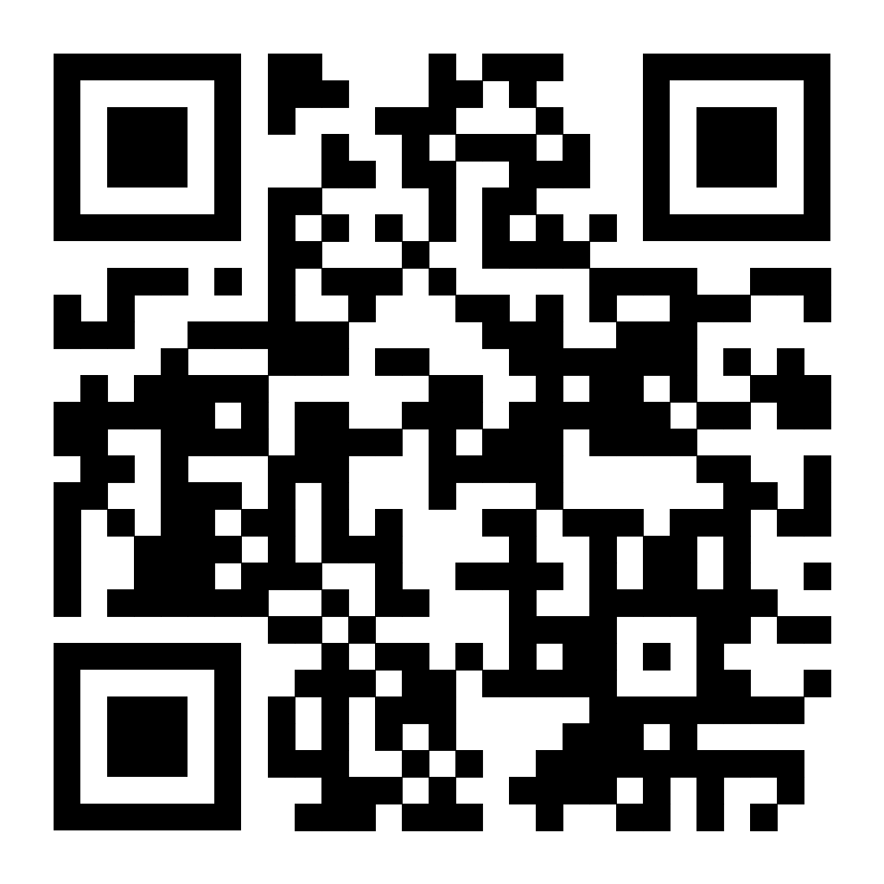
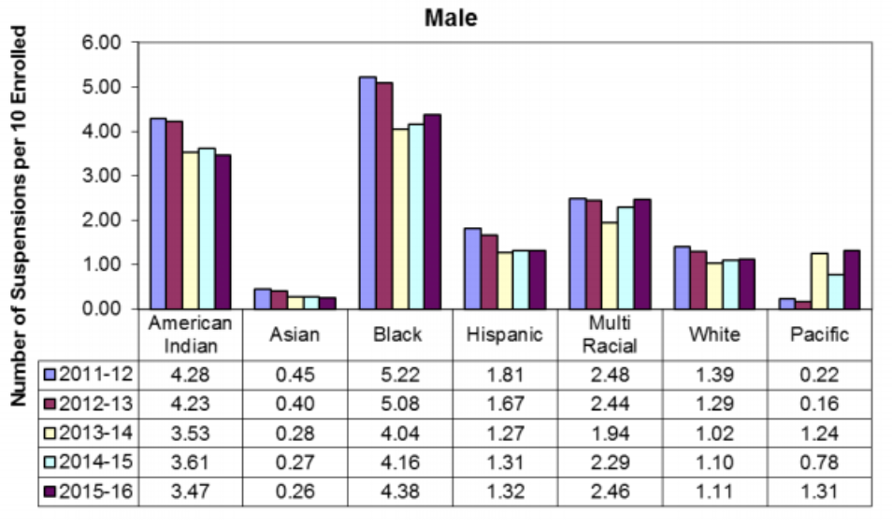
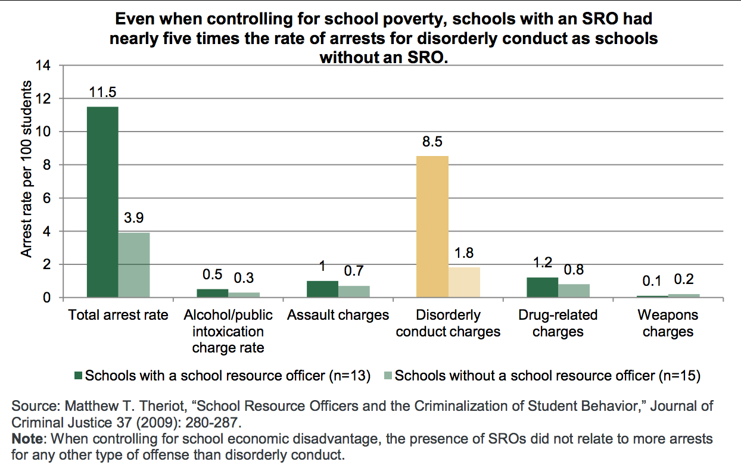
The School-to-Prison Pipeline in North Carolina & Its Impact on Minority Students
Mina Zuhair
Charles E. Jordan High School
Introduction
Background
Results
Black and Hispanic students are more likely to be targeted in harsh discipline practices causing them to be sent out of classrooms and into the criminal justice system. When it comes to deciding if a student's behavior is bad enough to be referred to the juvenile criminal justice system, there is an inequity between how White and minority students are treated. Studies show that the effects of severe punishments on students of color lasts through their lifetime and can result in them being arrested or jailed as adults.
Research Question: How do punitive discipline practices increase the likelihood of student-to-inmate status for Black and Hispanic students in the North Carolina public school system?
Thesis Statement: Studies show that there is correlation between harsh discipline practices and punishments in the public school system and the pipeline-to-prison for students of color.
Methodology: For my project, I conducted research on the school-to-prison pipeline in North Carolina. I used secondary data such as articles and studies from Duke Libraries and governmental articles from North Carolina. I analyzed the research through statistical and quantitative data. It was difficult to find data from the last five years; however, finding data about how minority youth were at a higher disadvantage than white youth in schools was less of a challenge.
According to the Southern Coalition, in the state of North Carolina 36.4% of juvenile court referrals came from schools. However, while Black students make up a fourth of the population, they account for 48.4% of all juvenile complaints. In the years 2021-22, Black students made up 52.4% of short-term suspensions, again, only making up 24.7% of the student body (2021-2022 Racial Equity Report Cards).
Recently, it was decided that putting School Resource Officers (SRO) in schools would be a beneficial way to prevent major tragedies. In agreement with NCCHILD, when it comes to School Resource Officers approaching misbehaving students, they tend to control students as if they were actual adult criminals, and not teens that could be acting out for underlying reasons. SRO's have little to no knowledge and training on how to effectively constrain students from their uncivil behavior and are more prone to unrecognize the signs of trauma, mental health symptoms, and disabilities, in comparison to teachers and school staff that are trained to know how to deal with these situations. For example, physical altercations in schools are usually dealt with by SROs rather than school administrators, often by policing the students involved.
Research shows that students that misbehave in underfunded schools are more common as underfunded schools don't have the resources to manage them (Golann, 2015). A student arrested in high school is twice as likely to be pushed out or leave school early, while a student that has been involved in court is four times as likely to completely drop out of high school (Casey, 2013). Lastly, situations that would’ve been dealt with effectively by school administrators, are now being dealt with by School Resource Officers that will criminalize students, therefore exaggerating the issue, and sending them off to the criminal justice system.
In comparison to the rest of the nation, which handles their adolescents in the juvenile justice system, North Carolina counts all adolescents over the age of fifteen as an adult, and treats them as such in the criminal justice system. The major differences between these processes is that the while the juvenile justice system provides rehabilitation services and treatment, the criminal justice system sends the convicted straight to court, prison, and with a permanent criminal record. Mistakes caused by common youthful behavior are now the reason teens are out of schools and on their way to prison (Casey, 2013).
School discipline practices such as suspensions, juvenile referrals, and expulsions are punishments that could be factors in a student making their way to the prison pipeline. According to the North Carolina Judicial Branch, a total of 40% of referrals to the juvenile justice system are school-based for non-violent offenses and misdemeanors (Gaskin, 2021). It is also presented that students that are repeatedly getting disciplined are more likely to be involved with the juvenile justice system (Marchbanks III and Blake, 2018).
According to a study done by the Cambridge: Education Next Institute, it was found that students enrolled in a middle school in the 84th percentile, which is above the average standard deviation in strictness, increases the likelihood of being suspended by 7%. The Institute conducted an experiment in Charlotte-Mecklenburg schools in the years 2001-02 and 2002-03 which discovered that 48% of students that were suspended were Black, 39% White, and 8% Hispanic. A mean of 23% students are suspended at a minimum of once a school year with the average duration being 2.3 days. Suspended students in such schools are found to be 17% more likely to be arrested and 20% more likely to go to jail. However, it’s crimes such as possession of illegal drugs, arson, fraud, burglary, and non-serious crimes (Bacher-Hicks 2021).
Effects of School Strictness - Through the analysis, there was no evidence found of a correlation between school strictness and overall achievement. In addition, it has also been established that one standard deviation stricter schools expand the likelihood that a student drops out of high school by 15%, as well as decreasing the likelihood of the student attending a four-year college by 11%. When it comes to Black and Hispanic students, the average number of days suspended in school increases each year by .43 days and .21 days for non-minority students (Bacher-Hicks 2021).
Rates of Arrest - For Black and Hispanic students, a stricter school increases the chances of being arrested by 3.9 percentage points, compared to 2.7 percentage points for non-minority students. As adults, this leads to negative effects such as minorities being 5.4 percentage points likely to be arrested and 4.4 percentage points more likely to be incarcerated as adults. Misbehaving students also affect their peers as it causes distractions in the classrooms (Bacher-Hicks 2021). This information leads to questioning principals and school administrators that act on strictness without thinking of long-term outcomes for students.
Data Analysis
Image 1 (Johnson, 2018)
This graph depicts that from 2011-2016, Black male students in North Carolina have the highest number of suspensions ranging from 5.22 to 4.38 per ten students enrolled. The rate of Black males being suspended is higher than the other ethnicities.
Conclusion
The school-to-prison pipeline in North Carolina and all over the United States has been a growing issue for a long time, and it will continue to grow the longer that there is no push-back against it. Where children go to learn, develop, and understand themselves is now the place where they are discriminated against and sent into the juvenile criminal justice system. It must be understood that when students are incarcerated in school, it affects the student for the rest of their life as they are more prone to going to prison if they were incarcerated in their school years. Probable solutions for the school-to-prison pipeline could be educating school staff and School Resource Officers on mental health problems that students are likely to face and how to handle them, how to facilitate misbehavior in a tranquil way, reducing school arrests and juvenile referrals to court, and increasing social workers in schools that can manage students’ feelings and emotions in an impactful way. The more we try to attempt change in the school-to-prison pipeline, the more we will achieve and the rates of youth going into the pipeline will decline.
Image 2 (Nelson and Dara, 2015)
This graph portrays that in North Carolina in 2009, it was found that schools that had School Resource Officers had almost five times the amount of school arrests that schools with no School Resource Officers had.

