Slide 1
Excluded from Education:
The Impact of Socioeconomic Status on Suspension Rates
By: Michael Jennings

Slide 2
Research Question
What impact does socioeconomic status have on suspension rates for high school students?

Slide 3
Thesis Statement
High school students belonging to families or communities of lower socioeconomic statuses than their peers have a higher rate of being suspended due to the environment in which they grew up, teacher biases and expectations, and their history of being suspended.

Slide 4
Key Terminology
Exclusionary Discipline:
Methods of punishment that remove a student from the classroom, including suspensions and expulsions
Zero-Tolerance Policies:
Disciplinary policies in schools that encourage more severe punishment for minor misbehaviors

Slide 5
Introduction
Students of lower socioeconomic status are more likely to be suspended
Exclusionary discipline, including suspensions and expulsions have been rising in schools
Suspensions can cause future academic and personal issues in students

Slide 6
Key Findings
The childhood environments of lower SES students and their records of suspensions before high school impact their future suspension rates
Negative teacher bias against students of lower SES is linked to an increase in suspension rates
Race and gender were two other very significant factors in predicting suspension rates

Slide 7
History of Suspensions
Students of lower SES are more likely to be suspended in general, but in that, they are less likely to be suspended for violent infractions
Students suspended in middle school are more likely to be suspended again in high school

Slide 8
Teacher Bias
Staff in schools aren’t always sure how to interpret zero-tolerance policies
Teachers take into consideration the student’s record of suspensions and the identifying characteristics of the students

Slide 9
Exclusionary discipline is “most commonly used for more interactive day-to-day disruptions, especially defiance and noncompliance”

Slide 10
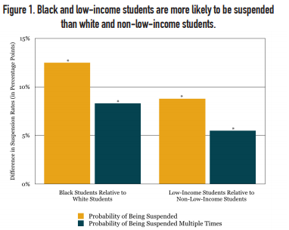

Slide 11
Race & Gender
Male students are more likely to act out than female students
There are no clear differences in behaviors between different races

Slide 12
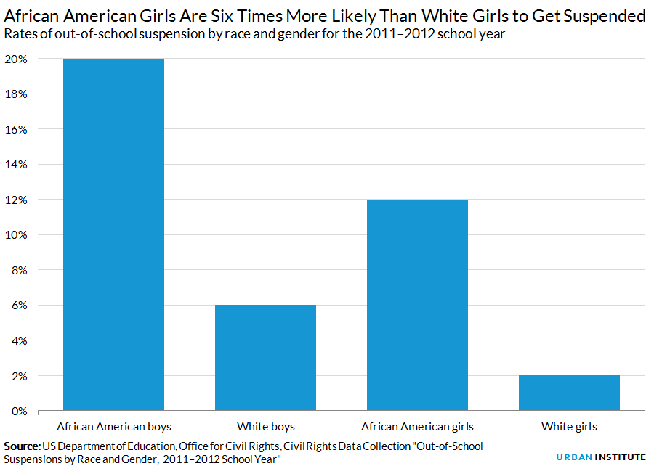

Slide 13
Solutions
Programs focusing on:
  decreasing violence
  increasing positive relationships between teachers and students
  Increasing perceived support by students
Restorative practice programs

Slide 14
Thanks!

Slide 15
https://www.google.com/url?sa=i&url=https%3A%2F%2Fwww.urban.org%2Furban-wire%2Fafrican-american-girls-and-school-prison-pipeline-who-are-our-sisters-keepers&psig=AOvVaw3EcDuBbHDQ2SL_PO9NTOoh&ust=1627058622694000&source=images&cd=vfe&ved=0CAwQjhxqGAoTCNjx2euP9_ECFQAAAAAdAAAAABCNAQ
https://educationresearchalliancenola.org/files/publications/111417-Barrett-McEachin-Mills-Valant-What-Are-the-Sources-of-School-Discipline-Disparities-by-Student-Race-and-Family-Income.pdf

