Slide 1
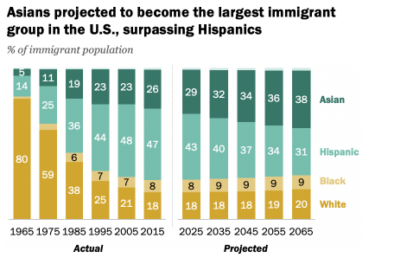
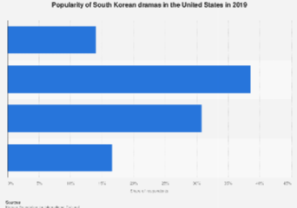
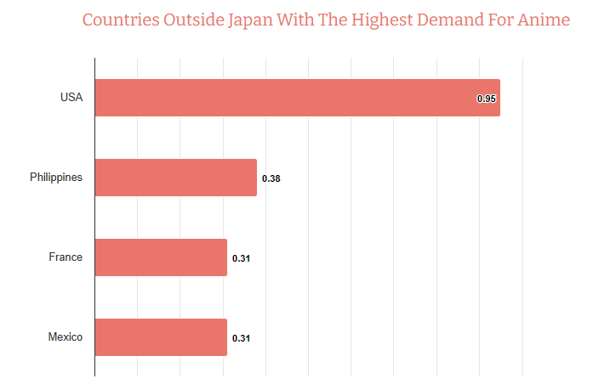
Orientalism and Fetishization of East Asian People on Social Media
Maya Lewis
C E Jordan High
Introduction
Data & Statistics
Findings
In the era of over-consumption of short-form content and instant communication, entertainment and social media have become essential parts of our lives, influencing our understanding of other cultures and communities. Rising along with this is the concern that the perpetuation of harmful stereotypes and fetishization will increase. By examining the views of both non-Gen Z and Gen-Z individuals, this observation serves to shed light on which platforms encourage this content the most and how they contribute to the way young people view East Asian peoples and cultures.
Research question: How do social media platforms influence the perpetuation of orientalism and fetishization of East Asian people among Gen Z?
Thesis statement: Online communities perpetuate orientalism and fetishization of East Asians through cultural appropriation, stereotypes, sexualization, and obsession with East Asian celebrities.
Orientalism, a term coined in 1978 by Edward Said, is used to depict how societies in the west have regarded the people and cultures of the Middle East and Asia.
To fetishize is to make something the object of a sexual fetish.
The objective of this paper is to conduct a complete examination of the complex phenomenon of orientalism and fetishization of East Asians, especially on social media and other online communities. Online communities and social media platforms enable these behaviors as the process of spreading these stereotypes and misinformation has become easier; forming an environment where cultural appropriation, sexualization and idolization of East Asian celebrities are normalized and encouraged. The quick spreading of Orientalist media on social media only reinforce these tropes, influencing the young Gen Z population and contributing to the objectification and exoticization of East Asian cultures. In order to combat this issue, it is essential to study how social media has impacted and globalized this phenomenon.
The objectification of East Asian women has ties to misogyny and racism, going way back to the trend of white men going to Asian countries like Thailand, the Philippines, and Singapore for ‘innocent, submissive wives’ (Stewart, 10). These women usually lacked education and knowledge of English, and were treated as childbearing maids. This practice is still observed today online; social media sites like TikTok and Instagram have contributed to the romanticization of going to Thailand to find a gorgeous ‘Thai queen’ to take on cheap dates and marry.
The other side of this fetishization is the fetishization of East Asian cultures. The popularity of K-pop, anime, and other East Asian media has caused some obsessors to participate in the phenomenon of culturally identifying as Korean or Japanese, listening to subliminals to get monolids and pale skin, and even getting surgery to achieve the look (Han, 1). On social media sites like TikTok, this phenomenon is known as Race Change To Another, or RCTA.
At the height of hate crimes against Asian Americans during the Covid-19 pandemic, both hate and fetishization took violent roots. Former president Donald Trump’s multiple comments about Covid-19 being a “Chinese virus” didn’t go unnoticed by Americans, resulting in a rise in anti-Asian sentiments. These sentiments resulted in hate crimes against Asian-Americans that weren’t even Chinese. On Twitter, these anti-Asian hashtags, posts and ideas were circling around rapidly (Wen, 191).
The 2021 Atlanta spa shootings are a tragic example of fetishization resulting in violence, with six of the eight victims being Asian-American, and seven of them being women. The shooter saw these Asian spa workers as temptations for his sex addiction (McLaughlin et al., 1).
The idea that Asian women are hypersexual and immoral also had historical impact with the Page Act in 1875, banning the “importation of women for the purpose of prostitution”. (Wen, 190). In actuality, the bill was also supposed to stop the spread of “eastern prostitution culture”, with many fearing that “Asian prostitution” was going to destroy families and the idea traditional marriage.
Conclusion
Methodology
In order to stop the perpetuation of orientalism and fetishization among Gen Z, there needs to be more promotion of education and awareness about the effects of orientalism on Asian communities, which includes raising awareness on the negative consequences of fetishizing East Asian peoples and cultures. Additionally, advocating for more diverse media representation, diverse representation in leadership, discussion about cross-cultural understanding, and empowering East Asian voices will be needed to decrease the encouragement of the perpetuation of orientalist stereotypes, both online and in real life.
Social media companies still need to take responsibility for enforcing guidelines to prevent orientalist content from appearing and gaining popularity on their platform, but change begins with us.
I reviewed literature like news articles and scholarly papers to find reliable information. With it being a very specific and new topic, there weren’t many good sources and even less with data and statistics I could actually use, so that’s why they were omitted. I also collected opinions from my friends and family using a survey, but it wasn’t good research so I could not include it.
(Source: Pew Research Center, Statistia)

