Slide 1

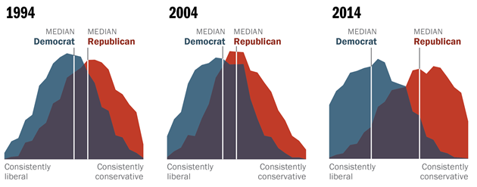
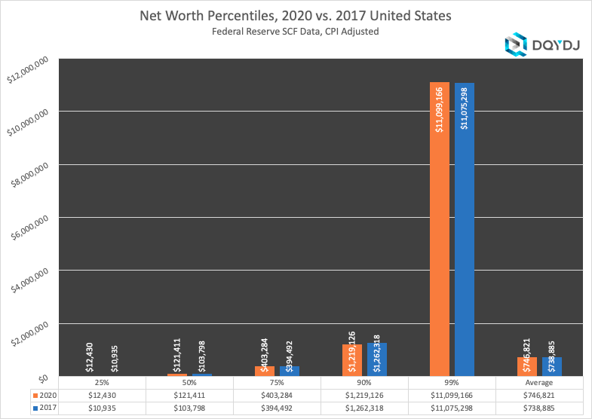
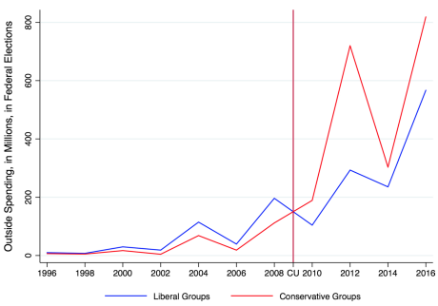
The Wealth Gap Our Government Won’t Close
Maxwell Guo
Durham School of the Arts
Introduction
Data & Statistics
Findings
As of December 31, 2022, the top 1% in the US has around 68% of the nation’s total wealth, while the bottom 50% only own about 3% (Kent and Ricketts). There are several questions about how such a thing could’ve even happened, let alone be allowed to stay this way. Shouldn’t our system of government, meant to let the people have a voice and represent the interests of the majority, try to reign in these wealthy few while propping up the poor? While there certainly are other factors at work, the US government has had a hand in causing and continuing this inequality.
Research Question: How does the US’s political system impact the nation’s wealth gap?
Thesis Statement: The US political system contributes to the wealth gap through division in legislation, fostering generational wealth, and over representing the wealthy.
• The two parties in the US have become increasingly separated along party lines by ideology. During 2014, 92% of Republicans were more conservative than the median Democrat, up from 64% in 1994, and 94% of Democrats were more conservative than the median Republican, up from 70% in 1994 (Geiger).
• Political polarization between the two parties results in more gridlock, with voting often split down party lines. This fact makes it so that laws and policies must be more moderate to gain bipartisan support to pass in Congress. Any bill that proposes drastic changes to solve the wealth gap will face steep opposition, especially from the more conservative Republican party.
• Federal tax policy has introduced several tax deductions in 2016 alone, 9 of them coupled together saved US households 626 billion dollars from taxation by the government (Williams 141). Most of these tax deductions aid the already wealthy rather than those in need, and several require households to surpass a certain wealth threshold to qualify for them.
• Generational wealth gives families with more several advantages over those who don’t. It provides economic security from potential shocks such as losing a job or getting ill, allows for more political influence, and provides opportunities for pursuing higher education or getting a better job.
• Despite all citizens in the US above the age of 18 being eligible to vote, not everyone is registered or turns up. Income-wise, the groups with the lowest turnout are usually the poorest, with the reverse for the wealthiest groups. For example, during the 2008 presidential election, people from households whose income was between $0-25,000 had a voter turnout of less than 50%, while those with $150,000 or more had a voter turnout of around 75% (Bonica et al. 110).
• Wealthy people have more capital to lobby for their goals in Congress, giving them an outsized voice. It doesn't help that many politicians are well-off individuals who may act out of self-interest (Carnes 114). Big corporations also can gain the favor of politicians by using their money to fund candidate election campaigns pressuring politicians to vote in the interest of these corporations.
Graph illustrates the two parties moving towards the extremes of the political spectrum over the span of 10 years (Geiger).
Background
• The current economic model practiced by the US government advocates for tax cuts to the wealthiest people. This model allows the richest to stay rich while also reducing the amount of tax revenue the government has to spend on social welfare, and causing a snowball effect that makes it near impossible for the poorer segments of society to catch up (Williams 141).
• The political structure of the US has resulted in the emergence of a two-party system that dominates the legislative system. The two main political parties in the US have seen greater political polarization in the past few decades, with the Democrats moving further to the left of the political spectrum and the Republicans to the right. Political polarization is the shifting of political attitudes towards the political extremes and can cause gridlock, which is when the government is unable to pass laws due to division in legislation (Carnes 114).
• Generational wealth is defined as the passing down of wealth or assets such as properties, cash, or family businesses from one generation of a family to another and can be built for periods spanning decades or even centuries. (Williams 131)
• Voter turnout among different groups is uneven, with wealthier voters being more likely to vote than poorer ones and white people more likely to vote than any other race. Additionally, noncitizens are unable to vote, meaning many immigrants don’t have a voice to express their political positions. (Bonica et al. 111)
• In the Supreme Court case Citizens United v. FEC (2010), the Court’s ruling allowed corporations to spend vast sums of money on political advertising for politicians’ election campaigns. In the following 2012 election season, federal candidates and their supporters spent over $6 billion on campaigning (Carnes 112). This indirect funding can lead to politicians being biased toward supporting these wealthy corporations when voting or deciding on economic legislation.
Graph illustrates the disparity between wealth of the top 1% and wealth of other groups as well as the average (Pk).
Conclusion
It’s reasonable to conclude that our government and its system are helping cause the nation’s wealth gap. From the internal division and indecision caused by the two-party system to the blatant favoritism of our economic system towards the rich, to how wherever you look, the wealthy have an overbearing influence on our policy. Even if this was not the intent of the people involved, the outcome is apparent and saddening. There is no easy way to solve this problem without a drastic overhaul of our political system or a sudden shift in public attitude. However, an increase in public awareness of our government’s role, both complicit and direct in the wealth gap, may spur people to vote more for liked-minded politicians and lobby the government to pass laws that would redistribute wealth. It is necessary to understand the causes of the wealth gap so that we may close it in the future.
Methodology
My method of research for this project was a literature review. I used the search engines Political Science Complete and Google Scholar. I looked for sources with the keywords: wealth gap, income gap, wealth inequality, generational wealth, tax cuts, political polarization, and campaign finance. I filtered through the results by looking for articles written between 2012-2023 and tried to use peer-reviewed articles and academic journals.
Graph illustrates the amount of money spent by outside groups on federal elections before and after FEC v Citizens United (Harvey et al.).

