Slide 1

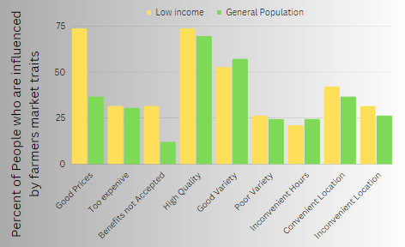
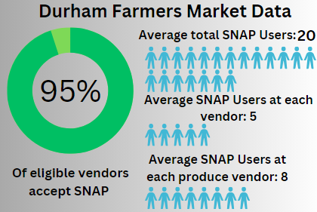
Farmers Markets and Fresh Produce: Observing Nutrition in Low Income Communities
Matthias Mathieu
Northern High School
Introduction
Data Analysis and Findings
Graph of Issues
In the US, Low-income Americans suffer from many health and social issues caused partially by a lack of access to fresh produce. But as the Federal Government has spent 500 million on supermarket intervention between 2011 and 2016, policy makers should put the cost and effectiveness of supermarkets into question and consider alternatives such as farmers markets. This poster will show how government and other organizations can provide fresh produce to a low-income and largely non-white community by using farmers markets.
Research Question: What effects do farmers markets have on nutrition of low-income communities in the US? How can farmers markets be optimized to support the nutrition of low-income people.
Thesis Statement: Low-income people are more likely to shop at farmers markets and farm stands when those markets are locally available, affordable, and accept food assistance programs.
There is not a significant correlation between the location of supermarkets and the consumption of fruit and vegetables. The location of supermarkets may account for only less than 10% of current produce inaccessibility, as about 90% of SNAP recipients and food insecure people already shop at supermarkets. (USDA, 2016).
The public cost required to build a grocery store in a low-income community outweighs the nutritional value provided to those communities. (USDA, 2016)
People who live in low-income communities reported large increases in consumption of fruit and vegetables with the introduction of farmers markets and farm stands (Evans, et al., 2012).
In North Carolina, Programs such as farm stands, farmers markets, and pick-your-own-produce farms are estimated to have 18% lower costs than conventional stores, (McGuirt, et al., 2014).
There are proven health benefits for individuals who frequent farmers markets such as lowered Body Mass Index (BMI) and a lower obesity rate for people living near farmers markets. This is an important indicator of nutrition.
Although farmer markets and other CSAs have a proven record of improving customers’ health, only 10 percent of customers are making below 25,000 a year. White people are also 80% more likely to shop at farmers markets than the average. In addition, farmers markets are typically presented as "white spaces" where people of color as vendors and customers are uncommon (Taylor, et al., 2022). And although there are exceptions such as the black farmers market in Durham, farmers markets tend to have mainly white vendors which can be a deterrent for the 42% of SNAP recipients who are Black or Hispanic (Alkon, et al., 2010; USDA, 2019). Whether or not low-income people use farmers markets is affected primarily by cost and distance. In one study 73% of low-income participants claimed they shopped at farmers markets because of competitive pricing while 31% still saw price as a barrier. In one study among WIC users in Charlotte, 25% percent of participants cited not living near a farmers market as a reason for not using them and an additional 9% cited not knowing where any were located (Racine, et al., 2010). The acceptance of SNAP and other government benefits, the variety of foods available in farmers markets, and what respondents described as food quality are also additional reasons that affect farmers market usage in minority and economically disadvantaged communities (Freedman, et al., 2016).
Methodology
I reviewed the secondary sources on co-operatives, and Community Support Agriculture (CSA), but I focused on farmers market because they are widely researched. I found my sources through Google Scholar. Those sources were: Science Direct, the United States Department of Agriculture (USDA), the Center for Disease Control (CDC), and AgEcon, among others. Most of these sources are surveys of low-income people and farmers market customers. These surveys include customers’ demographics, perceived benefits of farmers markets, and their concerns. I also interviewed vendors at the Durham farmers market regarding both their acceptance of the Supplemental Nutrition Assistance Program (SNAP), and the Farmer's Market Nutrition Program (FMNP), and those programs usage among their customers.
Background
Food insecurity is defined by the Food Research and Action Center as “Households [that] were, at times, unable to acquire adequate food for one or more household members because they lacked the money and other resources for food.” By this definition low-income people suffer from food insecurity at seven times the rate of affluent Americans (35% compared to 5%) (Frac, 2020). Additionally, people under the federal poverty line are also more likely to have diabetes (14% compared to 11% of the general population) (CDC, 2019). These issues are historically caused by "grocery redlining" that led to the abandonment of dense urban, low-income, and minority-majority areas to predominately white suburbs by many grocers and the continued refusal to move into marginalized communities (Ruelas, et al., 2011). Fresh produce is also expensive for families on a limited budget. This makes eating healthy a luxury for many low-income people (Daniel, 2022).
Conclusion
Farmers markets have untapped potential to combat food insecurity, poor nutrition, and health complications. Community food organizations and programs can effectively connect low-income individuals with fresh food and vegetables if policy makers make access to fresh fruits and vegetables readily available, accessible and affordable. When created with low-income people in mind, they can reduce costs and allow people to use food programs easily. There are solutions that local governments and other organizations can take to increase access to fresh produce and farmers' markets. The USDA cites, accessible and inexpensive public transport connecting low-income communities to existing farmers' markets is a less expensive and more impactful solution. The Supplemental Nutrition Assistance Program (SNAP), which helps low-income people buy food, is essential to maintaining food security. FMNP also makes fresh produce readily available to young children and the elderly.

