Slide 1

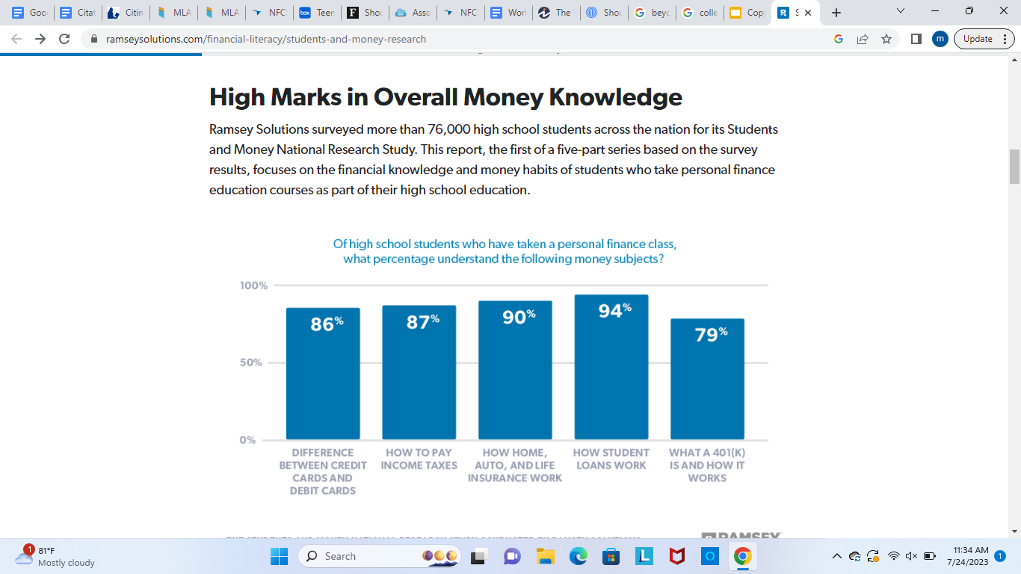
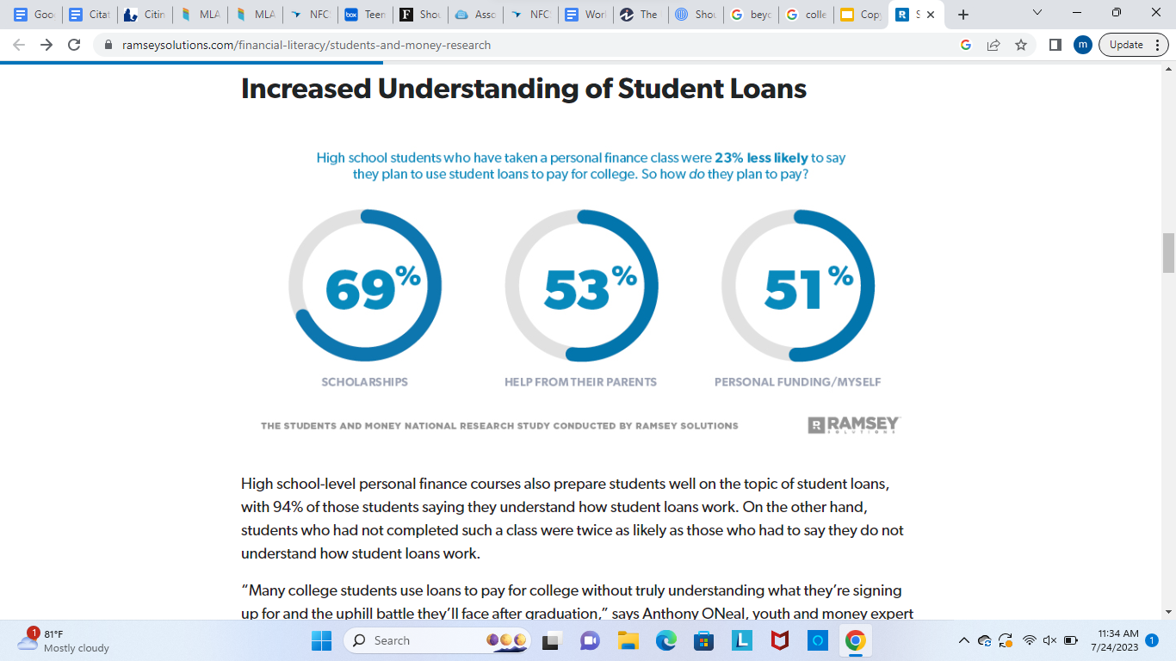
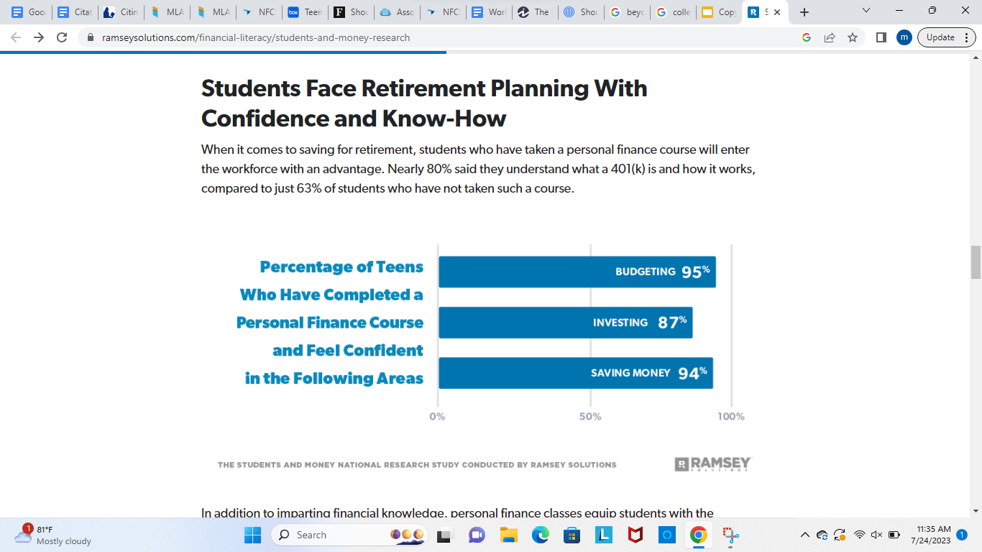
Financial Literacy in High School
Matthew Louesy
Trinity School of Durham and Chapel Hill
Introduction
Data & Statistics
Findings
Research Question
Upon completing high school, many students find themselves lacking essential knowledge in financial education. One way to assist high school students with real-life situations is through financial literacy, which can impact them in many ways.
How can gaining financial literacy knowledge improve young adults' understanding of real-life situations like taxes, credit cards, etc.?
Thesis Statement
Engaging in a financial literacy program, college debt classes, and real-world applications can help students learn more about financial education and how to apply it in real-life situations.
Graphs of Findings from Ramsey Solutions
The survey measured students’ understanding of several financial topics ranging from the basic, such as the difference between a debit and credit card, to more complex concepts, like income taxes, insurance, and student loans (Ramsey Solutions 1).
Not only did students who had taken a personal finance course score higher in every topic than students who had not taken such a course, but they also scored extremely high in each category.
On the second graph, Students who had completed a personal finance course appear to agree with Oneal that student loans are to be avoided. They were 23% less likely to say they plan to use student loans to pay for college than students who had not taken a personal finance course. Their top college funding sources include scholarships (69%), help from their parents (53%), and personal funding (Ramsey Solutions 1).
In the third graph, it talks about imparting financial knowledge and how personal finance classes equip students with the confidence they need to put that know-how into practice. Nearly all students who have completed a personal finance course report high confidence levels in several money skills: 95% of students are confident about budgeting, 87% about investing, and 94% about saving money (Ramsey Solutions 1).
Background
Understanding and using different financial abilities, such as investing, budgeting, and personal financial management, successfully is referred to as having financial literacy. The basis of your relationship with money is financial literacy, which you acquire throughout your whole life. People who are financially literate comprehend fundamental financial ideas and are capable of using such abilities in their own lives. These are some subjects (by Caleb Silver, page 1).
Establishing a bank account
paying bills on time
Establishing and controlling a household budget
The principles of credit and methods for raising credit scores
Making wise use of debt
Retirement fund savings
Conclusion
High school students should take financial literacy courses. Before making important decisions, young individuals should have a basic understanding of how to manage money. Because engaging in a financial literacy program, college debt classes, and real-world applications can help students learn more about financial education. The class should be changed rather than abandoned if the existing education programs are ineffective.
Notes:
Establishing a bank account.
paying bills on time
• Establishing and controlling a household budget.
The principles of credit and methods for raising credit scores
Making wise use of debt
Retirement fund savings.
According to the Financial Industry Regulatory Authority (FINRA), 53% of
individuals with a higher financial literacy spent less than their income, and 65% had set aside a three-month emergency fund.
In comparison, 35% of individuals with lower financial literacy spent less than they earned, and 42% had a three-month emergency fund set aside
0 Finally, those with higher financial literacy appear better able to avoid some of the pitfalls associated with managing financial products. – They were less likely to report engaging in credit card behaviors that generate sizeable interest or fees (paying the minimum due, paying late fees, paying over-the-limit fees, or using the card for cash advances) than those with lower financial literacy levels.

