Slide 1
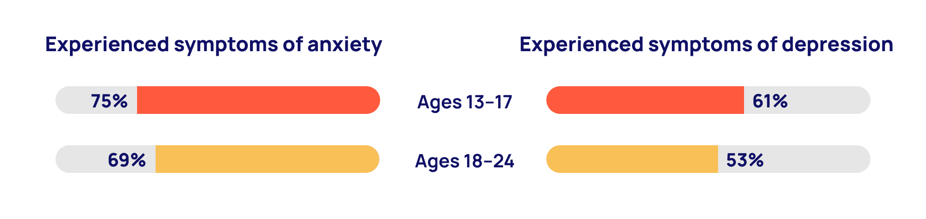
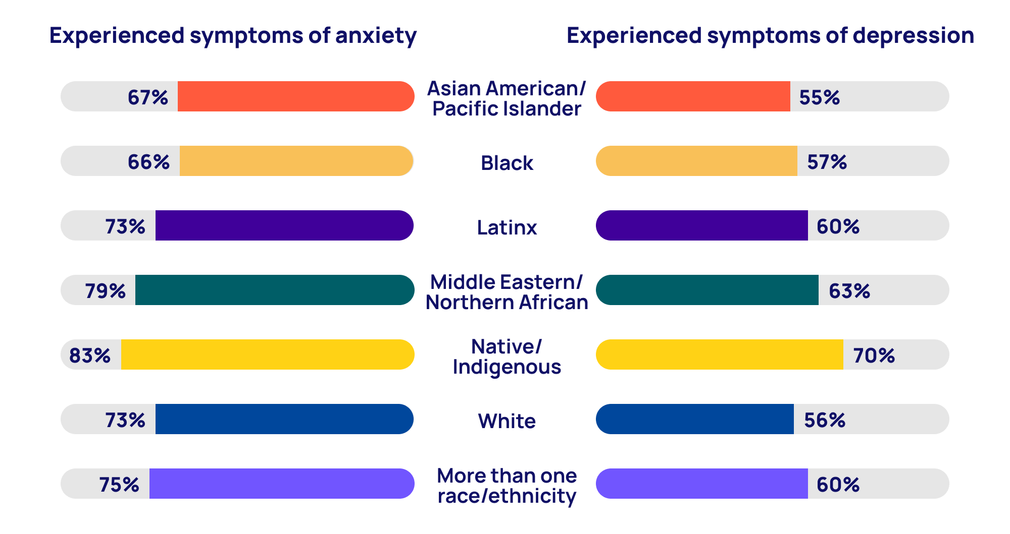
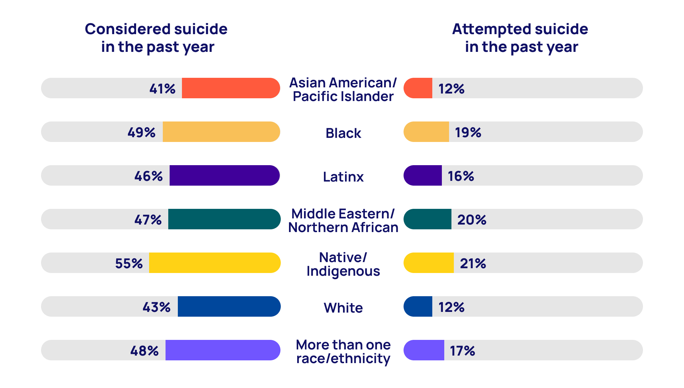
MENTAL HEALTH IN THE LGBTQ+ YOUTH COMMUNITY
By: Maria Hester
Creative Studies
Research Question: How does the lack of interpersonal relationships and medical support impact the mental health in LGBTQ+ youth ?
INTRODUCTION
Data and Findings
Interpersonal Relationships
The LGBTQ+ community has faced discrimination for as long as history has talked about it. In the early European colonies in the Americas, one could be fined, whipped, banished, or even executed as punishment for queer behavior. Mental health also has a complicated history in this county and still is an issue we face. According to the Center for Disease Control, more than 50% of people in the U.S. will be diagnosed with a mental illness at some point in their lives, with 50% of mental illness occurs before 14 years old. You can imagine how the combination of being LGBTQ+ and negative mental health can lead to a complicated situation for one to be in when both still have stigma and are treated as something irredeemable.
This lack of support that has been discussed is inexcusable. This graph above from the previously mentioned Trevor Project study shows that 82% of the surveyed LGBTQ+ youth said they wanted support for their mental health. 60% of that group that wanted help, though, said even though they wanted it, they weren't able to get that care. The top three reasons for not getting care (whether medical or emotional) were "fear of discussing concerns, concerns with parent permission, and fear of not being taken seriously" (Trevor Project, 2021).
Interpersonal relationships are defined as the social connection between two people.
Sexual minority individuals face high rates of mental health problems. There is a link between the quality of interpersonal relationships and mental health. A researcher named, Hazenbuehler, found that the disruptions of important social or interpersonal relationships one of three mechanisms by which experiences of stigma result in mental health disparities for sexual minority populations. That study concluded that the well-being of adolescents come from meaningful and quality attachment relationships.
How a family functions can also impact the emotional adjustment an adolescent experiences. How a family functions also comes from the type of parental attachments exist, which can be a significant predictor of emotional adjustment among adolescents.
Background Information
The age group of 13-17 in a Trevor Project study on mental health in LGBTQ+ youth was shown to have the highest rates for considering suicide, attempting suicide, having symptoms of depression, and of anxiety. Transgender and nonbinary youth had the highest rates of these out of various gender identities. The study also shows intersectionality between how different races are affected which is shown through a graph below.
Medical Health
An article from the National Library of Medicine says that LGBT+ youth find it difficult to talk about their sexual identity to their clinicians. Sexual orientation and the attitude of the provider influences the youths’ experience and quality of care.
A study by the American Psychological Association showed that despite improvements for recognizing diversity as a society, there is still "considerable variability in support across communities" (APA, 2021). Other studies from Duke Libraries show that the reinforcement of homophobic ideologies and stigmas can continue to contribute to negative mental health despite being in a supportive community. Therefore we need to address and not ignore these issues while still giving as much emotional and social support as we can to LGBTQ+ youth.
CONCLUSION
A study by PubMed reported that “family acceptance predicts greater self-esteem, social support, and general health status” which essentially means that family acceptance of LGBTQ+ youth correlates with positive mental and physical health.
This graph shows that LGBTQ+ youth racially identifying as Native/Indigenous had the highest rates of considered and attempted suicide. This is a racial group that has historically been ignored already, and still here they are with the highest suicide rates for their LGBTQ+ youth. This is just one of my findings that I found appalling and is desperately needing awareness.
Another solution is making resources more available for youth. Things like crisis hotlines and text/call services are good places to start, but we also need to push for more accessible medicine that can treat mental illness and in-person counseling.
Have conversations about these issues!
METHODOLOGY
References
While researching for this project, I utilized documents and scholarly articles from Duke Libraries, JSTOR, and Google Scholar. One of my main statistical sources was a study from the Trevor Project which gave a multitude of results about the correlation between LGBTQ+ youth mental health and age and race.
Starks, Tyrel (2015) A longitudinal study of interpersonal relationships among lesbian, gay, bisexual adolescents and young men
https://www.ncbi.nlm.nih.gov/pmc/articles/PMC4831206/
Cherry, Kendra (2021) How to maintain interpersonal relationships
https://www.verywellmind.com/how-to-maintain-interpersonal-relationships-5204856

