Slide 1
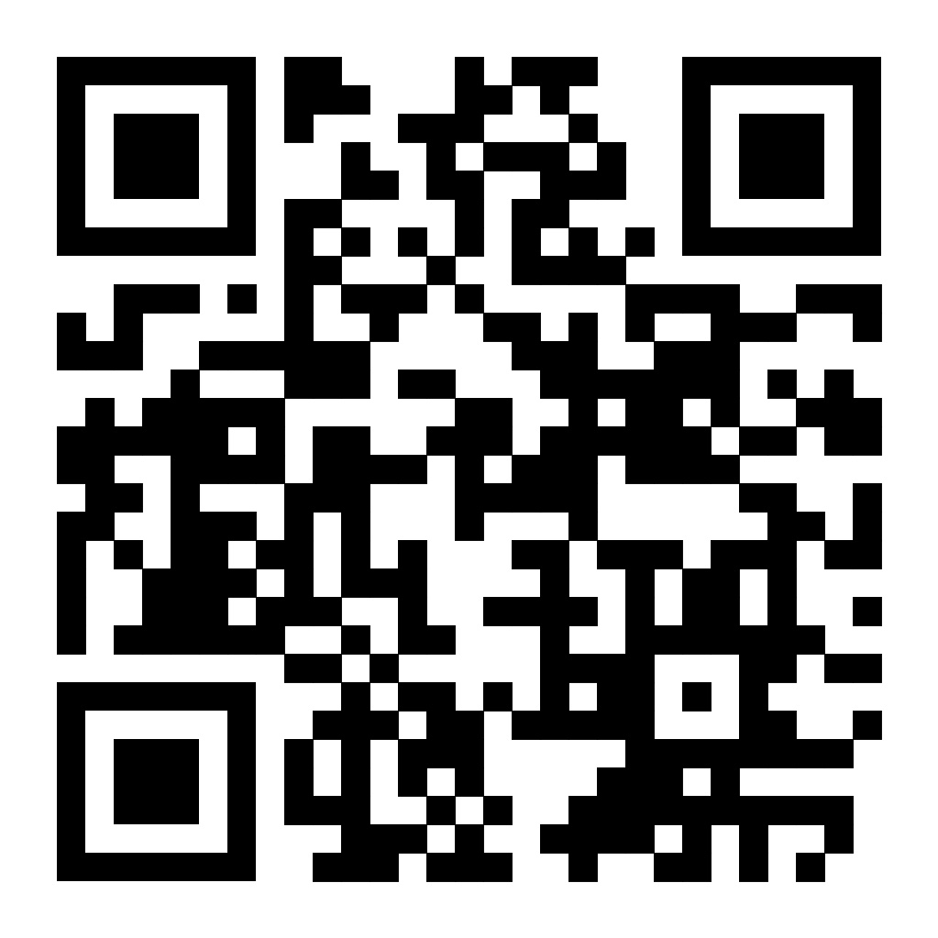
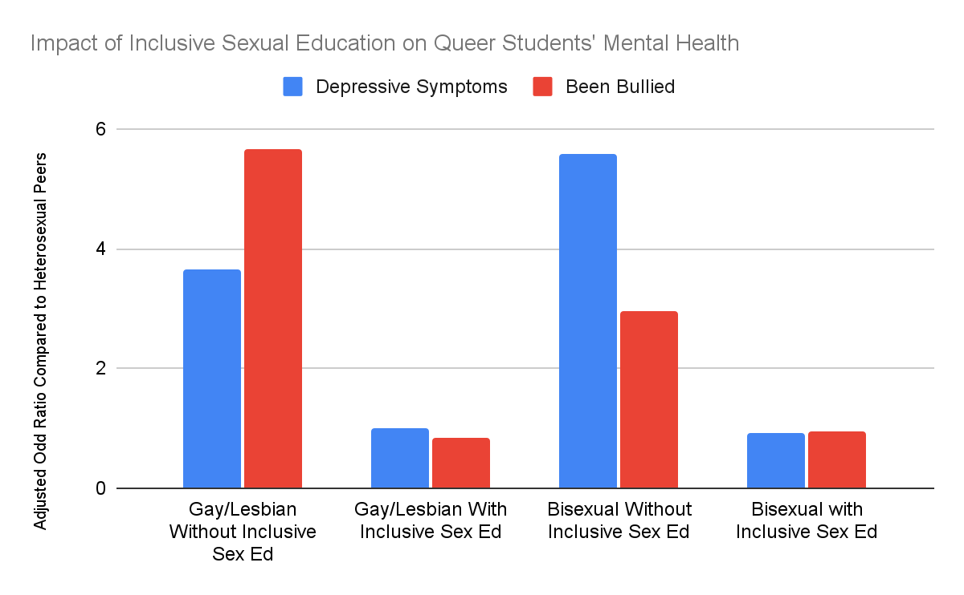
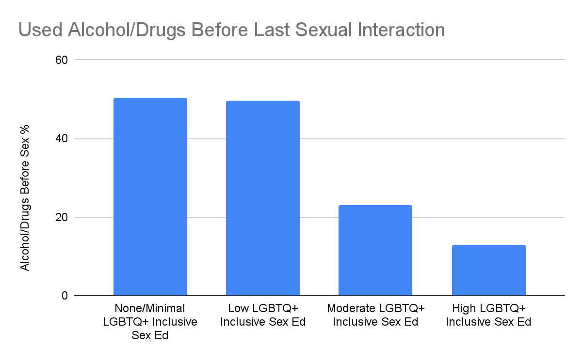
Queer Inclusive Sex Education
Maira Magwene Muñiz
C.E Jordan High School
Introduction
Data & Statistics
Findings
Out of 12,000 LGBTQ+ students across the United States, only 12% reported receiving information about safe sex practices that were relevant to them (Kahn, Ellen, et al. 8). This exclusiveness of comprehensive sex education is a disservice to LGBTQ+ students, who are already more likely to engage in sexually risky behavior and have greater odds of being victims of sexual violence (Kann et al. 17-18, 46-53). LGBTQ+ inclusive sex education is an important step in helping queer students feel safe in their schools and reduce the stigma surrounding queer identities and sexual practices.
Research Question: How does having inclusive sex education in secondary schools influence the mental and physical health of the queer community?
Thesis Statement: Queer-inclusive sex education helps promote safer, and more supportive school environments which help lower the rates of depression, sexual health disparities, and harassment that affect queer teenagers and young adults.
Methodology: I performed a literature review by searching the Duke Perkins Library database and Google Scholar, with the keywords: “Sex education, LGBTQ, Queer youth, comprehensive, heteronormative, mental health”
Sexual Risk Behaviours:
Queer youth have been shown to have increased sexual health risks. Such as substance use, getting someone or becoming pregnant, and not using contraception (Blake et al., 942-943). Queer women, are more likely to engage in sexual intercourse before receiving sex education, mitigating the effectiveness of the curriculum. When queer women receive education before their first sexual interaction there is an increase in birth control usage (Bodnar & Tornello, 13).
Sexual/Dating Violence:
Queer students have higher rates of being victims of sexual and physical dating violence compared to their heterosexual peers (Kann et al., 16-18). However, education about domestic violence primarily assumes the gender-based power dynamics of heterosexual relationships. Nevertheless, power dynamics within a relationship are not exclusively centered around gender. Domestic abuse can be emotional, financial, psychological, and sexual (Donovan and Hester, 286). Queer students who are not part of the conversation involving domestic violence are at a higher risk of being underprepared to avoid and navigate unsafe same-sex relationships (Donovan & Hester, 281-285).
Continued Stigmatization:
Participants across many studies found for SBSE curriculums where LGBTQ+ people are mentioned they are often paired with shame, and fear-mongering about HIV/AIDS (Naser et al. 42, de Heer et al. 710, Roberts et al. 274). This perpetuates negative stereotypes about queer people that further stigmatize them. As well as creates assumptions about who can contract STDs and HIV.
This graph represents the differences in the mental health of queer students in schools with and without LGBTQ+ inclusive sex ed compared to their heterosexual peers. This illustrates that queer students experience less harassment and depression with LGBTQ+ curricula. (Proulx et al. 612)
Background
School-based sex education (SBSE):
SBSE is the sexual education class that students are provided at any of the schools they attend. In the U.S. states that do mandate that public schools teach sex ed, there are many discrepancies in what is taught. For example, abstinence education is required in 42 states, contraception education in 27 states, and sexual harassment and dating violence education in 39 states (Garg & Volerman, 165).
Comprehensive Sex Education (CSE):
CSE focuses on the cognitive, emotional, physical, and social aspects of sexuality. It addresses sexual and reproductive health, which includes but is not limited to puberty, pregnancy, STDs, and contraception. This is taught in order to improve a young person's understanding and ability to navigate interpersonal relationships, cultural/social norms, consent, bodily self-autonomy, gender-based violence etc (UNESCO, 2018, 16-18).
Heteronormativity in Sex Education:
Sex education has historically been rooted in an emphasis on monogamous heterosexual marriage in the context of abstinence, this is referred to as heteronormativity. In SBSE heterosexual and cisgender identities are the assumed standard, meaning the curricula is one-size fits all and often limiting.
LGBTQ Inclusive Sex Education:
LGBTQ Sex Ed acknowledges the spectrum of sexual and gender identities that students may identify with and their resulting sexual interactions. Queer Inclusive sex ed broadens CSE, by discussing multiple forms of contraception, such as dental dams, teaching accurate information about gender-affirming care, and defining sex in the context of queer relationships.
Conclusion
Queer youth and students are frequently affected by stigmatization in schools and the greater society, LGBTQ+ inclusive sex education is just one step in cultivating acceptance and understanding. Going forward, LGBTQ+ inclusive school-based sex education must be implemented nationally to help all queer students understand themselves, their bodies and mind, as well as their interpersonal relationships.
Topics to focus on include domestic violence, the multiple forms of contraception, reaching a queer audience before they have their first sexual interaction, and talking about all people in non-discriminatory ways.
This graph represents the percentage of queer students under the influence of alcohol or drugs before their last sexual interaction depending on how inclusive the sex education in their schools is. This illustrates that queer students are less likely to engage in sexual risk behavior if they are exposed to higher amounts of LGBTQ+ sex ed. (Blake et al 943.)

