Slide 1

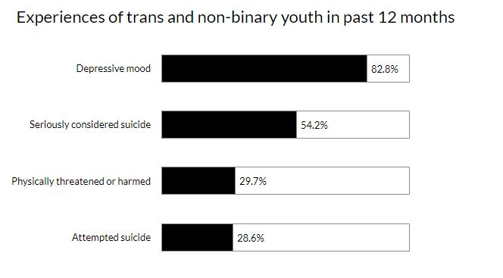
Stress Fractures: The Effects of Stigma on the Health of Transgender Youth
Leander Shindell
Durham School of the Arts
Introduction
Data Analysis
Results
In my research, I examined how societal stigmatization and medical erasure of the transgender community affect the mental and physical health of transgender youth. Many transgender individuals choose to postpone or avoid formal healthcare settings due to past or anticipated experiences of violence and discrimination. Transgender youth are disproportionally affected by adverse health conditions, which may worsen due to avoidance of professional healthcare settings.
Research Question: How does the lack of visibility in the healthcare system and societal stigmatization of transgender individuals affect the mental and physical health of transgender youth?
Thesis Statement: Societal stigmatization and erasure of transgender individuals in the healthcare system leads to adverse effects on the mental and physical health of transgender adolescents. Chronic stress caused by fear of rejection, harassment, discrimination, and violence can culminate in anxiety, depression, suicidality, and avoidance of professional healthcare settings.
Methodology: I chose to research this topic due to its lack of visibility, my own personal connections, and the rising number of anti-trans bills in the United States. I used google scholar to begin my research, where I found several articles related to transgender health in relation to stigma. I then searched through mainly PubMed, ScienceDirect, and the National Library of Medicine (nih.gov).
Negative Media Messages
Exposure to media sources depicting transgender people in a negative light has been associated with symptoms of depression, anxiety, and PTSD, even after controlling for other factors such as childhood and/or adulthood physical or sexual abuse.
*(Hughto, 2021). * N=545 refers to the total number of participants in the study
The overwhelming majority of participants in this study report exposure to several types of media depicting the transgender community in a negative light. Exposure to multiple social oppressions can lead to or worsen poor mental health condition and negate coping strategies. Chronic stress derived from long-term exposure to discrimination and stigma can cause allostatic load. (Hughto, 2021).
Medical Violence
One MTF patient reported being forcefully injected with testosterone by a physician with her mother's approval. Another transgender patient reports being forced to show their genitalia to an provider after accidentally scheduling an appointment with a urologist instead of an endocrinologist (Velasco, 2022).
HIV Stigma
A MTF patient recalls that, when her provider found out she was transgender, the provider insisted that the patient's pneumonia was actually HIV, which was not the case. Another report tells of how a nurse refused to inject a transgender patient with their medicine, assuming the patient must have HIV without even looking at their medical record (Velasco, 2022).
Discomfort in Professional Healthcare Settings
A transgender patient reports feeling unsafe in the hospital after having to remove their gender-affirming clothing for a chest x-ray. Another transgender patient reports their provider asking very personal questions, such as what kind of sex they prefer. The patient felt these questions were quite inappropriate and intrusive, but that they had to answer in order to get the care they wanted (gender-affirming surgery) (Velasco, 2022).
Lack of Visibility in the Healthcare System
A 2011 study of deans of medical education across North America found that the average time devoted to LGBTQ+-related care was only 5 hours. Due to insufficient medical education on their needs, transgender individuals are often forced to travel long distances in order to find safe and adequate care (Hughto, 2015).
Mental Health and Suicide
In a national survey of over 6000 respondents, over 50% of
respondents who reported lifetime suicide attempts also reported being
harassed or bullied at school (Grossman, 2016).
(Duffy, 2020)
Avoidance of Professional Healthcare Settings
Despite knowing its high-risk and life-threatening implications, many transgender people prefer accessing informal care due to the stigma they experience(d) in professional healthcare settings. 23 of 28 participants in a study of Colombian transgender women reported having accessed hormone replacement therapy (HRT) from unlicensed providers. Over half of the responders reported life-threatening consequences of unprofessionally administered silicone injections, and an additional 71.4% knew another transgender person who had died due to accessing gender-affirming care unsupervised by a medical professional.
Almost 33% of young transgender Australians (14-25yrs) chose not to see a mental health professional due to past negative experiences.
25% of transgender Americans postponed medical care due to discrimination. 29% of young transgender Australians avoided professional healthcare settings due to their gender-identity (mja.com.au, 2020).
A transgender patient reports that having to explain their needs and identity deterred them from wanting to seek professional healthcare again.
The pathologizing of the transgender identity by medical professionals led to many transgender patients avoiding formal healthcare settings (Velasco,2022).
Chronic Stress
The Minority Stress Theory is a likely explanation for adverse health effects experienced by transgender individuals. Long-term exposure to several stressors, such as enacted stigma and exposure to negative media messages can engender allostatic load. The presence of this condition in transgender youth can significantly cause anticipation of experiences of transgender-related stigma and contribute to declining mental and physical health (Hughto, 2015).
Transgender-related media messages—past 12 months (N=545)**
Exposure to any negative media messages | Mean | %
No | 13 | 2.4
Yes | 532 | 97.6
Exposure to negative print media (newspapers, magazines)
No | 33 | 6.1
Yes | 512 | 93.9
Exposure to negative TV media
No | 34 | 6.2
Yes | 511 | 93.8
Exposure to advertisements and signage
No | 92 | 16.9
Yes | 453 | 83.1
Background
Key Terms
Transgender: Transgender is an umbrella term denoting or relating to a person whose sex assigned at birth differs from their gender identity. This includes female to male (FTM), male to female (MTF), female to non-binary (FTNB), male to non-binary (MTNB), and certain intersex individuals.
Stigma: a mark of disgrace associated with a particular circumstance, quality, or person. Stigma operates on three levels: interpersonal, institutional, and individual.
Visibility: refers to the degree to which something/someone is seen by the public. In the transgender community, examples include the inclusion of transgender people in education, specifically biology and medicine, examples of transgender characters or actors in television, etc.
Depression: a mood disorder that causes persistent feelings of sadness and
hopelessness and loss of interest in previously enjoyable activities. It is often treated with psychotherapy and medication.
Anxiety: Generalized Anxiety Disorder is a mood disorder characterized by chronic excessive anxiety and worry about daily events. It is often treated with psychotherapy and medication.
Post-Traumatic Stress Disorder (PTSD): A mental health condition that develops following a traumatic event characterized by flashbacks and avoidance of similar situations, intrusive thoughts about the event, and recurrent anxiety/distress.
Provider: healthcare provider/physician
Minority Stress Theory: high levels of stress faced by members of stigmatized minority groups. The theory suggests that discrimination and lack of social support can cause a number of stress responses that culminate in poor mental and physical health (Witcomb, 2018)
Allostatic load: the cumulative burden of chronic stress. Symptoms include diabetes, hypertension, heart disease, insomnia, nervousness and anxiety, headaches, gastrointestinal complaints, aches and pains, fatigue, difficulty concentrating, decreased energy, feelings of helplessness or loss of control, disorganized thinking, overproduction of cortisol, irritability, restlessness, change in appetite, muscle tension, emotional withdrawal, drug/alcohol abuse, expedited ageing, and change in social behaviors (Hughto, 2015).
Conclusion
Transgender youth are a minority group especially vulnerable to adverse health
effects stemming from discrimination and stigma. Due to barriers and stigma
Within the formal healthcare system, transgender individuals may choose to avoid
or postpone professional care, resulting in untreated injuries and illnesses and the
use of unprofessionally administered gender-affirming care. Societal stigma
experienced daily by transgender contributes greatly to depression, anxiety,
suicidality, and chronic stress.

