Slide 1
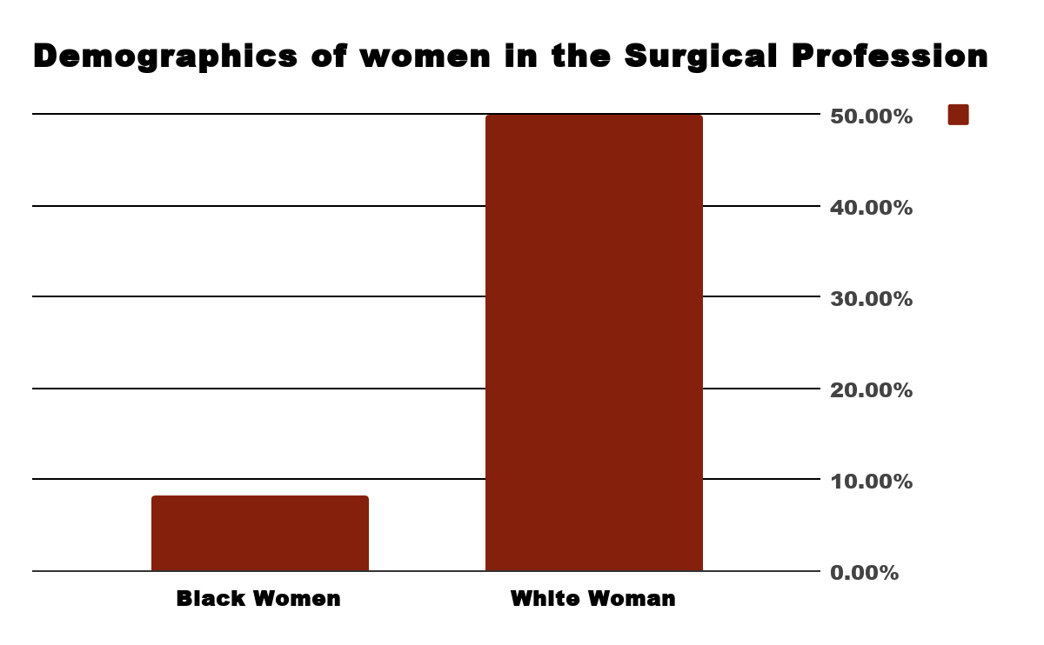
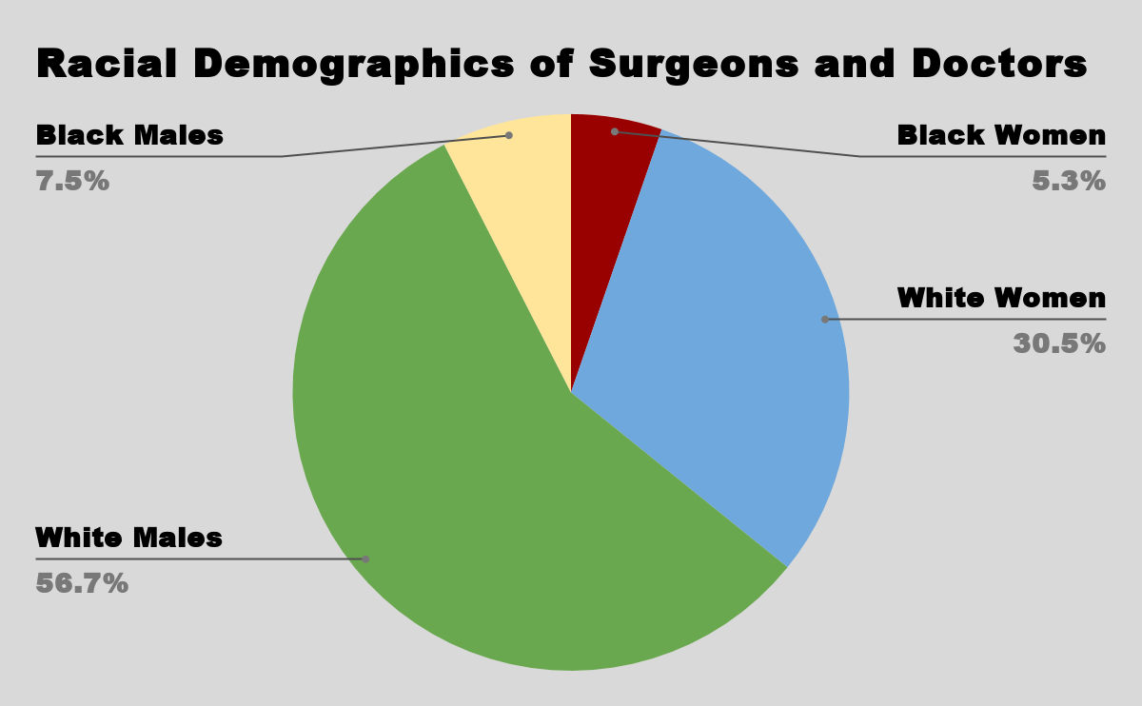
Healing The Disparities
Lauryn Futrell City of Medicine Academy
Introduction
//
Data and Results
Background Information
How does the bias of undergraduate education and MCAT testing affect black women in the surgical profession?
When beginning their education Black Women have faced challenges such as:
Discrimination
Racism
Self-efficacy
Gender biases also play a huge role that can change the way women choose their pathways. Black women especially may feel a threat for even entering a career with male dominance.
Research shows that black women in science and surgical professions have decreased since 2002. In result:
1 out of 5 Black women are Surgeons or Doctors
2% of Black Women are Physicians or Surgeons
Biases in undergraduate studies for black women according to Science Direct
Black women can’t pass the tests (MCAT)
Black women don’t have the resources or standards of a “Surgeon”
MCAT testing:
MCAT stands for Medical College Admissions Test, which must be completed in America for students who desire going into the medical field. This test is highly important and is a main ranking factor for entry into the medical school.
For black women, this test is an aspect of underrepresentation
Black women tend to perform significantly lower than their white counterparts on the MCAT.
These graphs show the racial differences of surgeons and doctors in the U.S in 2017
Methodology
Conclusion
In my research I examined the differences for blacks and whites and the percentages of how many actually become surgeons. I found differences between black women and white women and their MCAT results.
When creating my charts, I used resources such as Google Sheets and Color Combos to make graphs and color schemes. I was given a poster planning document and other resources to help me mirror for my presentation. I was able to look at last year’s cohort posters to get an idea of what to use.
In conclusion, black women face biases from their peers and professors in their undergraduate careers which cause them to change their career paths and opt out of becoming surgeons or doctors. While black women do have high GPAs compared to their white counterparts, factors outside of the MCAT itself have also contributed lower representation of black women.
Overall, black women have been subject to discrimination and disadvantage regarding their faced gender and race.

