Slide 1
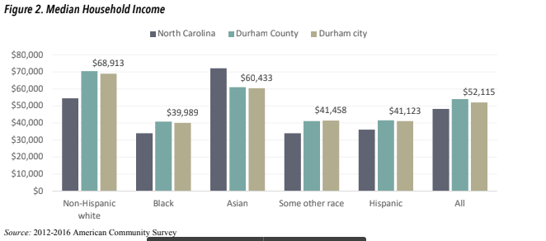
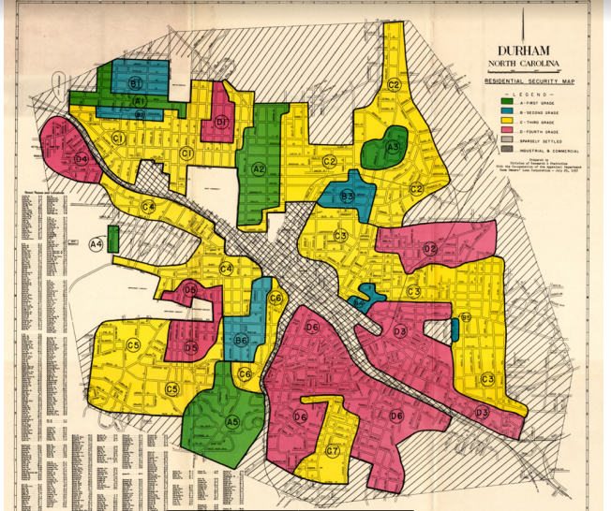
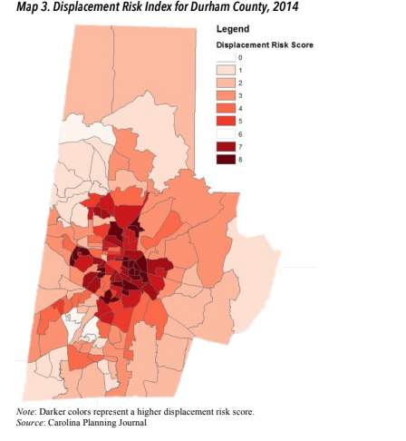
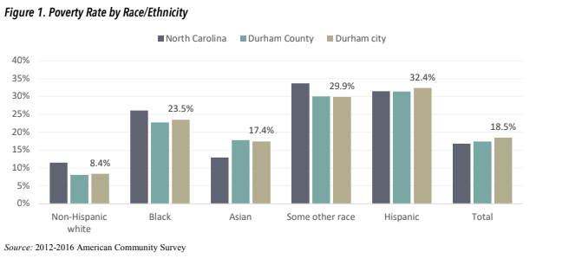

THE REPERCUSSIONS OF REDLINING IN DURHAM N.C.
Kristopher Smith | Durham School of The Arts
INTRODUCTION
Redlining is a discriminatory practice in which financial organizations create maps marked with red sections to indicate that they are “hazardous” neighborhoods to invest in. Most of the neighborhoods that were redlined are made up of racial and ethnic minoritized groups, as well as low income residents. Credit denial, denial of healthcare, and insurance are some contributors to redlining. In 1937, roughly 35% of Durham was redlined. Walltown, Hayti, and Old East Durham were all places that were redlined, which made it difficult for Black and hispanic families to build their wealth. The goal of my research is to dig deeper into what redlining is and its impact on how it has affected communities of color.
How has redlining influenced wealth and inequality in Durham?
Gentrification and Displacement
Although redlining is not legal anymore, gentrification is another problem that low income residents are facing. Gentrification is when wealthier people buy out property from poor homeowners and flip it to make it attractive to other wealthy buyers, while displacing those who originally inhabited the house. This is displacement, which is the effect of gentrification.
This graph shows the average household earnings of families of color compared to Whites.
BACKGROUND
According to Conley, the average white family holds assets of more than 15 times those of the average Black family. Conley asserted that there was a significant wealth gap between white and minoritized families. This is evident in the fact that minoritized families who earned less than $20,000 per year and those who earned at least $100k per year still did not compare to the average white family making more than $350k per year.
METHODOLOGY
These two pieces of data show how much of a difference there is in earnings between white and minoritized people in Durham. Blacks and other races experienced poverty and have much lower income rates than caucasians. Caucasian people also experience poverty at a much lower rate. According to the North Carolina Poverty Research Fund, “past race-based policies on the federal, state and local level undergird economic disparities and gentrification today. Two such policies with a long reach in Durham are redlining and urban renewal.” The areas in Durham that were historically redlined are places that still face economic disadvantage today.
I researched various types of data and records of redlining, poverty rates between people of color and white as well as housing income rates. These show a visual representation of the difference in white vs. communities of color using percentage, graphs, and a map. I used credible sources and articles to find my data such as Bull City 150. I have both quantitative and qualitative data shown.
The map above is Durham in 1937 and areas received letter grades, which corresponded to colors that represented their level of safety, green being the highest,A,and red being the lowest,D. This map shows which parts of Durham were marked red. All of these red areas were considered too dangerous to reside in and were cut off by the state. This led to many people not being able to afford their mortgage. These actions were a direct contribution to people of color losing their homes because this was a way the government legally neglected marginalized people. When an area is redlined it is avoided by the state and these places were not even dangerous to live in. They were communities of color, trying to build a foundation and have something to pass down from generation to generation. Unfortunately, due to these areas that were designated as redlined districts, it was extremely difficult for this to happen.
CONCLUSION
Our city of Durham is constantly changing. Our economy continues to grow and thrive, yet there are still prevalent consequences of redlining and gentrification. Historical redlining, economic standing and gentrification are all causes of wealth inequality in Durham. Although we still experience these issues, Durham also has organizations and initiatives like the Durham Preservation Project, Unlocking Doors Initiative and The Self Help Credit Union who are all working and fighting for Black homeowners to get rid of home loans, keep those who earn less in their houses, and house the homeless.
DATA & RESULTS
RESOURCES
Huunt, H., Author Profile(s) Allison C. De Marco, &amp; Marco, A. C. D. (1970, January 1). Racial Inequality, Poverty and Gentrification in Durham, North Carolina. Frank Porter Graham child development institute. Retrieved July 19, 2022, from ttps://fpg.unc.edu/publications/racial-inequality-poverty-and-gentrification-durham-north-carolina
Addy, S. (2018, October 1). Redlining: Institutional racism in lending. Bull City 150. Retrieved July 19, 2022, from https://www.bullcity150.org/uneven_ground/invisible_walls/redlining/
Gallup, J. (2022, February 23). Historic redlining and discriminatory policies have had lasting effects on black homeowners in the Triangle. INDY Week. Retrieved July 19, 2022, from https://indyweek.com/news/durham/mapping-inequality-redlining-discriminatory-housing-practices/
This a map of Durham County and its displacement since 2014. The color scale represents the displacement score. The darkest, is a score of 8 which means these areas are where people are displaced the most. Up to 90% of residents that were in the dark areas were either Hispanic or Black.
This graph entitled, The Poverty Rate By Race and Ethnicity. As you can see, Whites have a much lower poverty rate than those of the minoritized groups.

