Slide 1
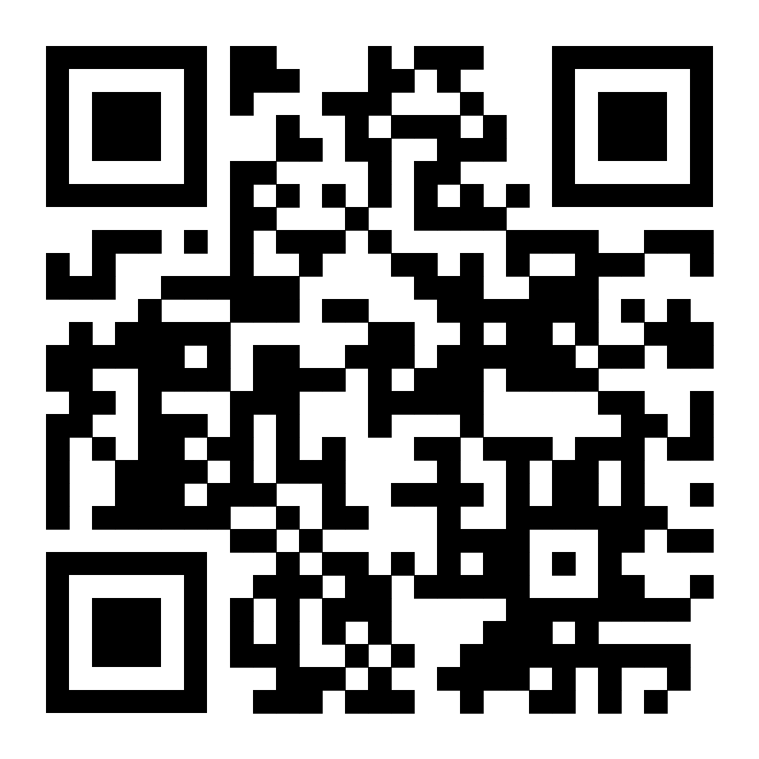
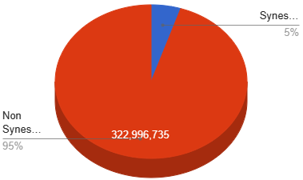
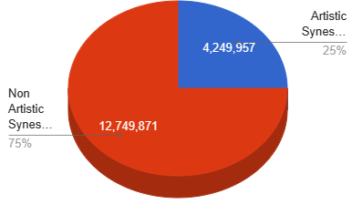
Artistic Synesthetes: A New View of the World
Khamani Johnson
Durham School of the Arts
Introduction
Data Analysis
Results
Synesthesia is a genetic condition present in 3%–5% of the population in which a sensory stimulus presented to one modality elicits concurrent sensations in additional modalities. Synesthesia is uncommon, occurring in only about 1 in 2,000 people, according to the American Psychological Association (APA). The condition is more prevalent in women than men and in artists, writers and musicians; about 20 to 25 percent of people of these professions have the condition (Psychology Today, 2023).
Research Question: Why is synesthesia more common in Neurodivergent people, specifically artists?
Thesis Statement: Synesthesia is more common in artists because it is associated with differences in brain structure, function, and greater aesthetic sensitivity. People who experience synesthesia are usually born with it or develop it very early in childhood. It’s possible for it to develop later. Research indicates that synesthesia can be genetically inherited.
Methodology: I compiled my research by analyzing statistics and studies that focused on artists that have synesthesia. I studied this topic because this is not only a debate in the US, but also that the US has the highest neurodivergence rate, meaning that the US must put the most effort in finding different learning styles to make learning more equitable for all American students. Many of the studies I've found consisted of qualitative data through observation. Many of the sources I reviewed described the effects of synesthesia on artists. Throughout the process of collecting sources, many articles addressed certain limitations. One of the main limitations is the difficulty of measuring the prevalence of synesthesia in artist because it is measured by word of mouth.
Types of Synesthesia:
Chromesthesia-a type of synesthesia in which sound involuntarily evokes an experience of color, shape, and movement.
Grapheme-color synesthesia, where certain letters or numbers are associated with specific colors.
Sound-to-color synesthesia, where certain sounds cause you to see shapes of different colors.
Americas with Synesthesia vs. Americans without Synesthesia
American Synesthetes, Johnson (2023)
Famous Artists with Synesthesia:
A study was conducted by Vilayaynur S. Ramachandran and Edward M. Hubbard in which they tested two groups of people, one group being synesthetes and the other group being nonsynesthetes (Ramachandra and Hubbard, 2003).
They found that the synesthetes correctly matched 90% of the numbers to the correct color, which demonstrated that “the induced colors are genuinely sensory and that the synesthetes are not making things up” (Ramachandran and Hubbard, 2003).
Ramachandran mentions an area in the brain (known as V4, the area of the cerebral cortex that processes visual information) often associated with synesthesia tends to “activate” in fMRI scans (Ramachandran, 2003).
In addition to neuroimaging, though, a variety of behavioral tests can confirm whether someone in fact has synesthesia (Hubbard, 2003).
A researcher might quiz a potential synesthete about what color associations they have with specific letters of the alphabet. “Then you ask them two years later about the same letters,” Dr. Cytowic says. “Synesthetes are remarkably consistent over very long periods of time.” (Cytwoic, 2005).
Dr. Cytowic adds that the difference between synesthetes—versus those who only claim to be—is that while individual experiences may be quite specific, in general “synesthetes all basically tell the same story” as others who share their version of synesthesia (Cytowic, 2005).
        Tori Amos-Musician
        Duke Ellington- Musician
        Pharell Williams- Musician
        Vincent Van Gogh- Painter
        Vladimir Nabokov- Author
        Mary J. Blige- Musician
        Billie Eilish- Musician
Background
Conclusion
Synesthesia- As defined by Dr. Dillon Browne, synesthesia is a neurological condition in which information meant to stimulate one of your senses stimulates several of your senses. People who have synesthesia are called synesthetes (Browne, 2021).
Artist- An artist is a person with the talent and the skills to conceptualize and make creative works (Sachant et al, 2022)
Neurodivergent- Any person whose thought patterns, behaviors, or learning styles fall outside of what is considered "normal" (Rudy, 2023).
Each one of your five senses stimulate a different area of your brain. Looking at a bright neon yellow wall, for example, will light up the primary visual cortex, at the rear of your brain. If you have synesthesia, you may also feel like you can taste the flavor of honey while you look at it. So not only will your primary visual cortex be stimulated by the color, your parietal lobe, which tells you what something tastes like, is stimulated, too. That’s why researchers believe that people who have synesthesia have a high level of interconnectedness between the parts of the brain that are tied to sensory stimuli (Psychology Today, 2023).
Synesthetes that become artists vs. Synesthetes that don’t become artists
Thus, there is some indication that synesthesia may be associated with artistic careers and hobbies; however, this does not provide evidence of whether synesthesia is directly linked with enhanced creativity. Meaning, that none of these synesthetes are born an artist, many of these synesthetes use their unique abilities to stand-out in the artistic field. But regardless of all the advances over the last 40 or so years, “the study of synesthesia,” is still in its infancy. There is much more to be done and to uncover, and opinions often differ. Research has come a long way, but the conception and definition of synesthesia is constantly evolving, and researchers still have a lot to discover in the relatively young field.
Artistic Synesthetes, Johnson (2023)

