Slide 1
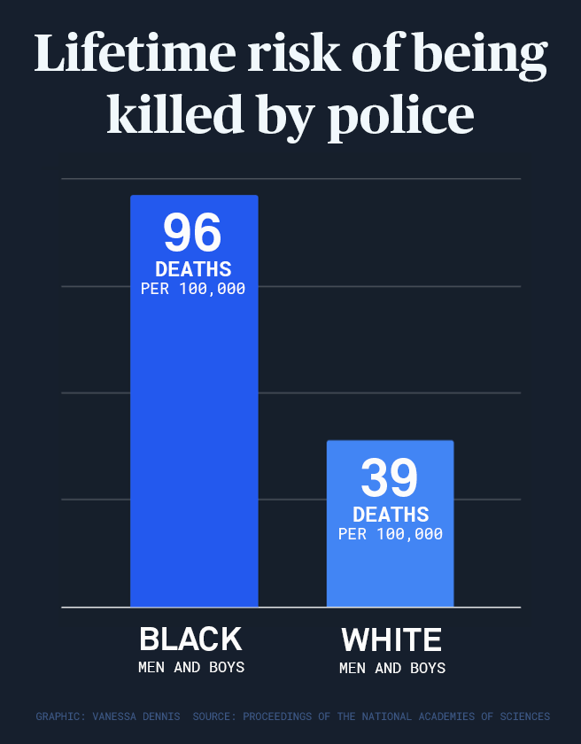
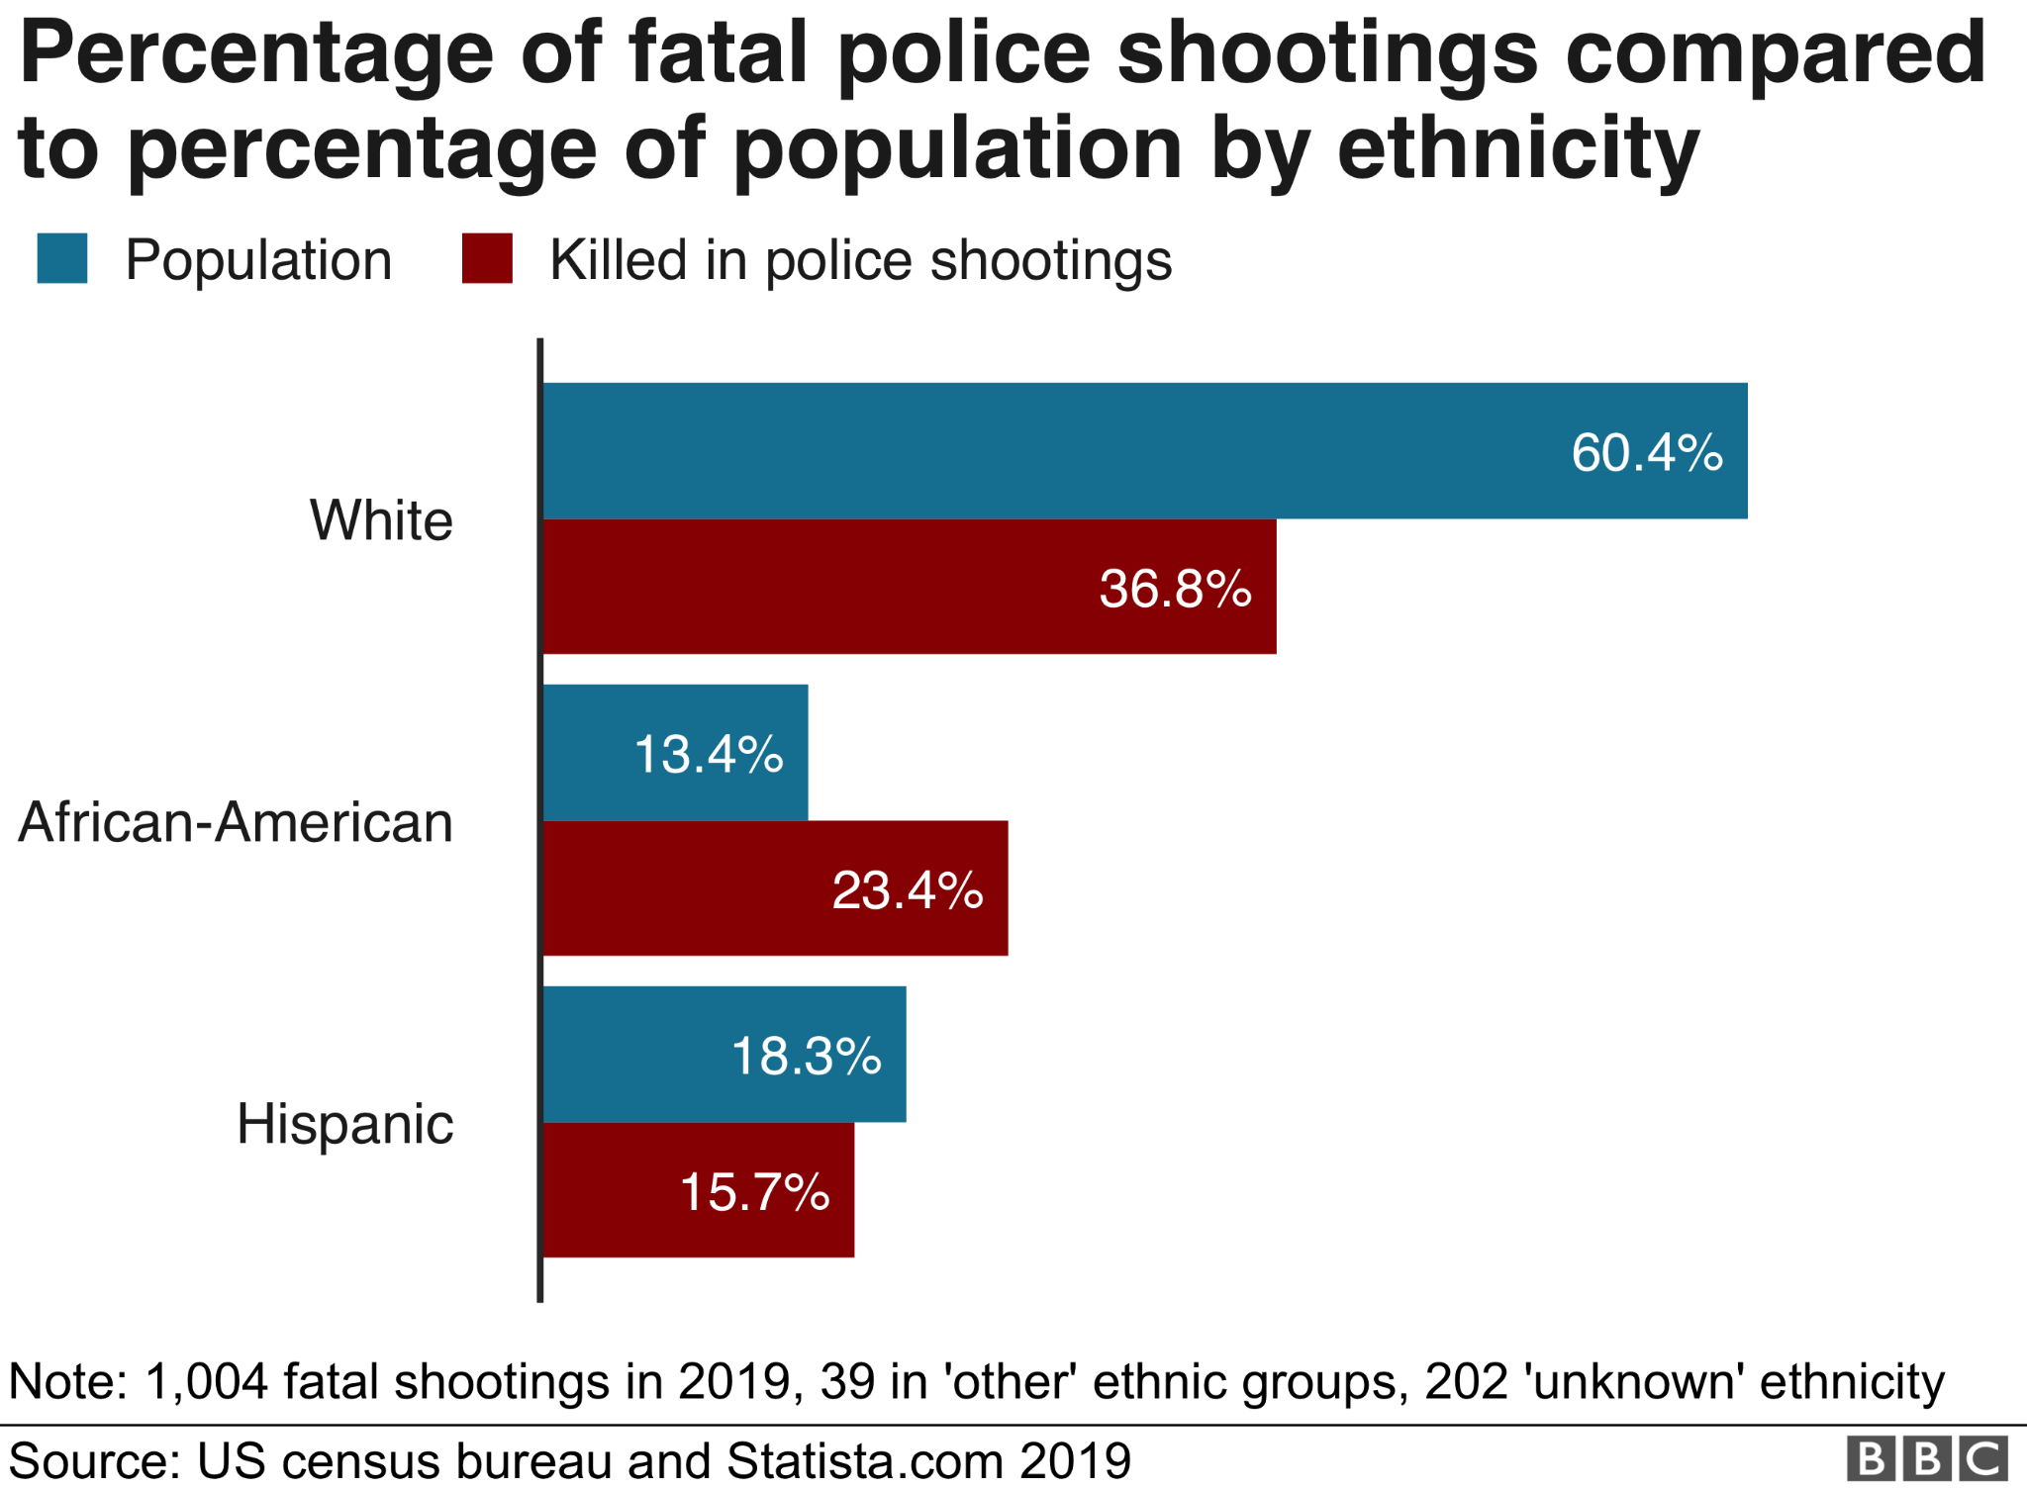
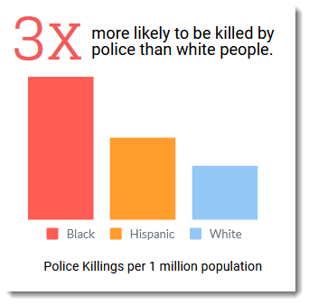
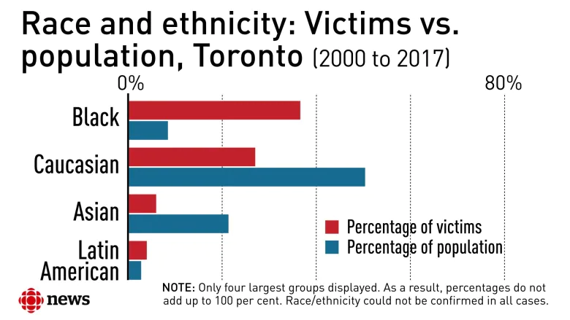

Police Brutality in America
Research Question: What are the rates of police brutality in America by racial background?
Khaleel Jackson | Northern High School
INTRODUCTION
Data Charts
Research
Police brutality is an excessive use of force and shown by research often depends on your race. As shown by the Impact of Police Violence on Mental Health: A Theoretical Framework police brutality also results in different outcomes including “increase the likelihood of overall exposure, increase the psychological impact of police violence, and impede the possibility of coping or recovery from such exposures.” Reports of police abuse were associated with lower public regard beliefs like society views Black Americans as less favorably .Between the years 2011 and 2016 there are cases that consist of police officers who were cleared of all criminal charges stemming from the deadly encounters with unarmed African American males.The impacts police brutality may have on the nation may include Mental Health, Physical Safety, Economics, Community Relations, Riots, and Looting.Police brutality is a problem all over the U.S. which consequences are negative, research shows disproportionally affects people of color. A piece of evidence that proves this is a study by researchers from Harvard T.H. Chan school of Public Health which found Black Americans are 3.23 times more likely to be killed by police officers than white Americans.
In the last few years, police violence has been more evident to the nations eyes. My research breaks down brutality rates between races and killings of unarmed black men,women, and sometimes even kids. 69% of the victims of police brutality in the U.S. who are African American or black were suspected of a non-violent crime and unarmed. The goal of my research is to convey the prevalence of police brutality and the solutions to eradicate the problem. Police brutality is an unnecessary force used to control citizens. It can range from killing, beating, and using excessive force to detain individuals to saying racial slurs, and harassing minorities. My focus has been from 2010-2020 which is where more data and media coverage is more recent.
Methodology
I gathered my research by using Google Scholar. It gives great articles, where I found all my information that I was able to present. I read through articles and books very carefully to find the best and most meaningful data to use for my poster.
CONCLUSION
Police brutality is a forceful thing that should not happen. It is a serious problem that some people take lightly when they should not. To bring this to people’s attention, activists have started protests that turned into riots, sent letters, and sharing the vision of “Black Lives Matter. Opposers don’t like it and say how can you just say black lives matter, in response to that activist say “For all lives to matter Black lives have to matter first”. This is something that needs to change years ago not now, not later and not tomorrow .Some things we could do to change this is give consequences because when they commit these incidents they get off with a slap on the wrists. Someone should not be judged off of their skin tone, we all bleed the same blood we are all human this needs to be changed now.
Background Information
In the years 2015 and 2016, police violence in the U.S generated a national conversation about the nature of America’s law enforcement. Whites have traditionally enjoyed the privileges of higher income and are treated as the more privileged and dominant racial group. Most of these incidents of brutality may go unreported and generally afraid to report it because police officers are the ones who investigate complaints regarding violence and disorderly conduct.
Data and Results
In 2019 alone, 24% of all police killings were black Americans when just 13% of the U.S. population is black, which is an 11 point discrepancy.
Nearly half of surveyed liberals (44%) estimated roughly between 8,000-10,000 unarmed black men were killed by police officers.
In Utah, African Americans makes up just 1.06% of the population but they accounted for 10% of police killings over the past seven years.
Also, 69% of the victims of police brutality in the United States who are African American or black were suspected of a non-violent crime and unarmed.
References
Holmes, M. D., & Smith, B. W. (2008). Race and police brutality: Roots of an urban dilemma. Amazon. Retrieved July 18, 2022, from https://www.amazon.com/Race-Police-Brutality-Dilemma-Deviance/dp/0791476200
The trauma lens of police violence against racial and ethnic minorities ... (n.d.). Retrieved July 19, 2022, from https://spssi.onlinelibrary.wiley.com/doi/abs/10.1111/josi.12251
B;, D. V. J. F. L. L. (n.d.). Impact of police violence on mental health: A theoretical framework. American journal of public health. Retrieved July 18, 2022, from https://pubmed.ncbi.nlm.nih.gov/32941068
Angus, J., & Crichlow, V. (n.d.). A race and power perspective on police brutality in America. FAU Undergraduate Research Journal. Retrieved July 18, 2022, from https://journals.flvc.org/faurj/article/view/106404
Schwartz, Gabriel L., and Jaquelyn L. Jahn. “Mapping Fatal Police Violence across U.S. Metropolitan Areas: Overall Rates and Racial/Ethnic Inequities, 2013-2017.” PLOS ONE, vol. 15, no. 6, 2020, https://doi.org/10.1371/journal.pone.0229686.
Notes:
Diffe

