Slide 1

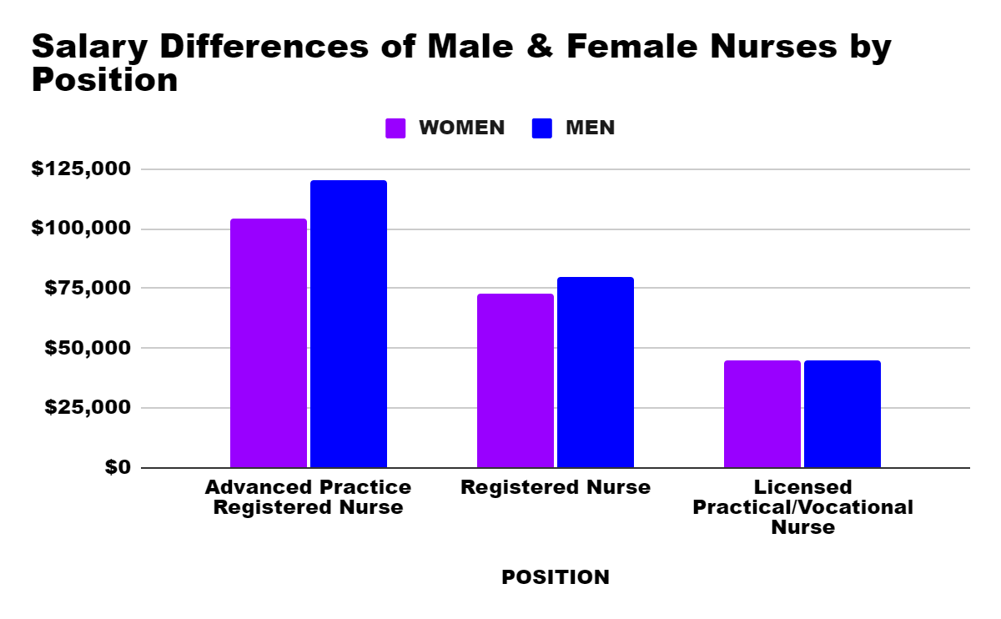
Discrimination In Nursing Salary
Kelci Lucas
Durham School of the Arts
Introduction
Data & Statistics
Findings
There are about four million nurses in the United States, but they are not all compensated the same way. This compensation revolves on race and gender. This sort of problem leads to a gap in pay, and discrimination.
Research Question:What relationship can be made about the income gap between gender and white and black nurses?
Thesis:A relationship that can be made about the income gap between gender and white and black nurses is data collection on wage outcomes.
The gender gap reveals large inequalities between female and male RN’s. Women comprise more than 87% of the RN workforce but generally earn about $7,300 less a year than men(NurseJournal, 2023).
In 2020, the US Bureau of Labor Statistics, or BLS, reported that women earned only 82.3% of men's earnings, compared to 57% in 1973.
There is research that suggests the presence of a white-black wage gap in nursing. Bhur (2010) found that immigrant nurses from Africa and the Caribbean received a 9% wage penalty in Canada.
Black RN’s do not make as much as White RN’s, they earn about .97 cents less per hour than white RN’s
Women chief nursing officers make $127,050 while men in these same positions earn an average of $132,700.
The pay differentials have grown even wider between male and female ARPNs, with men earring $16,000 more annually
Two studies examining racial or ethnic bias in RN promotions found evidence of discriminatory practices that limited advancement opportunities for minority RN’s. (Moor, Racial/Ethnic Pay Disparities among Registered Nurses (RNs) in U.S. Hospitals: An Econometric Regression Decomposition, 2016).
Women with advanced degrees earn less than white males with only a bachelor’s degree. Black and Latina women with bachelor’s degrees earn 65% of what their white counterparts earn (Nurse Journal, 2023).
Background
Definitions
Registered Nurse (RN): Coordinate patient care and provide help
Advanced Practice Nurse (APRN): Physical exams, ordering and interpreting lab tests, etc.
Vocational/Licensed Practical Nurse: Basic patient care(ex: checking blood pressure, recording vitals, monitoring patient needs)
Context
19% of nurses are people of color while 81% are white or Caucasian (Karam, Diversity In Nursing,2022).
Women outnumber men in nursing jobs because of ideas of masculinity, like nursing is a women's profession because it’s dominated by females
Conclusion
Staff, NurseJournal. “The Gender Pay Gap in Nursing.” NurseJournal, 23 Mar. 2023, nursejournal.org/resources/the-gender-pay-gap-in-nursing/.
A relationship that can be noted about the salary gap between gender and white and black nurses is wage outcomes. Issues that I noticed in my research is women in the nursing field take up 87% of the field but earn about $7,300 less a year than men. The pay differential has grown wider between male and female APRN’s, with males earning $16,000 more annually. Women are only making 82.3% of men's earnings, while black RN’s make .97 cents less per hour than white RN’s. A solution we can purpose is to create fair pay scales based on position and experience. An area for further research is the other races in pay, not just blacks and whites.
This graph shows the salary differences between male and female nurses based on position and gender
The only one that has equal pay to both genders is a Licensed practical nurse.
Advanced practice registered female nurses make $104,000 while a male nurse of the same position makes $120,000.
A female registered nurse makes $72,700 while a male of the same position makes $80,000
For a Licensed Practical or Vocational Nurse, both male and female nurses make $45,000.
Methodology
Research format: literature review
Searched for articles on Duke Library and in Google Scholar.
Narrowed results by using the keywords: nurse, wealth gap and gender.
Information dates include the latest from 2013 to 2023

