Slide 1

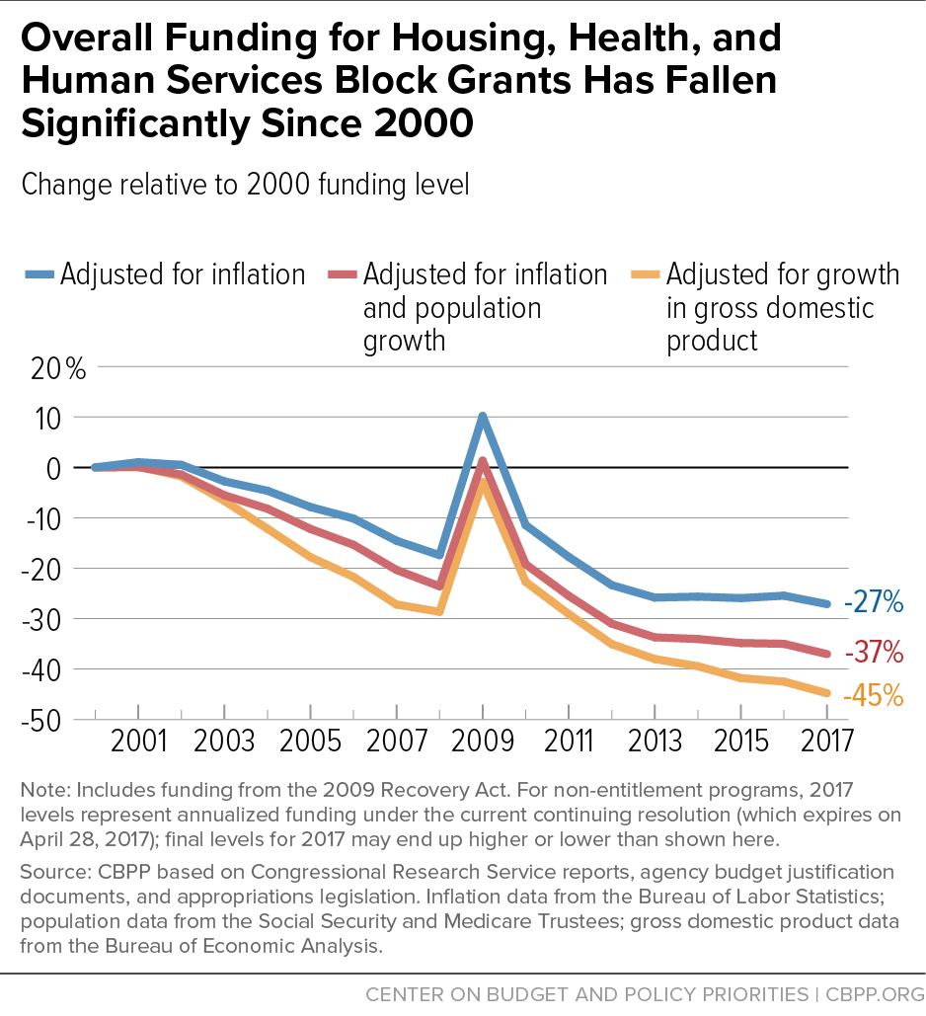
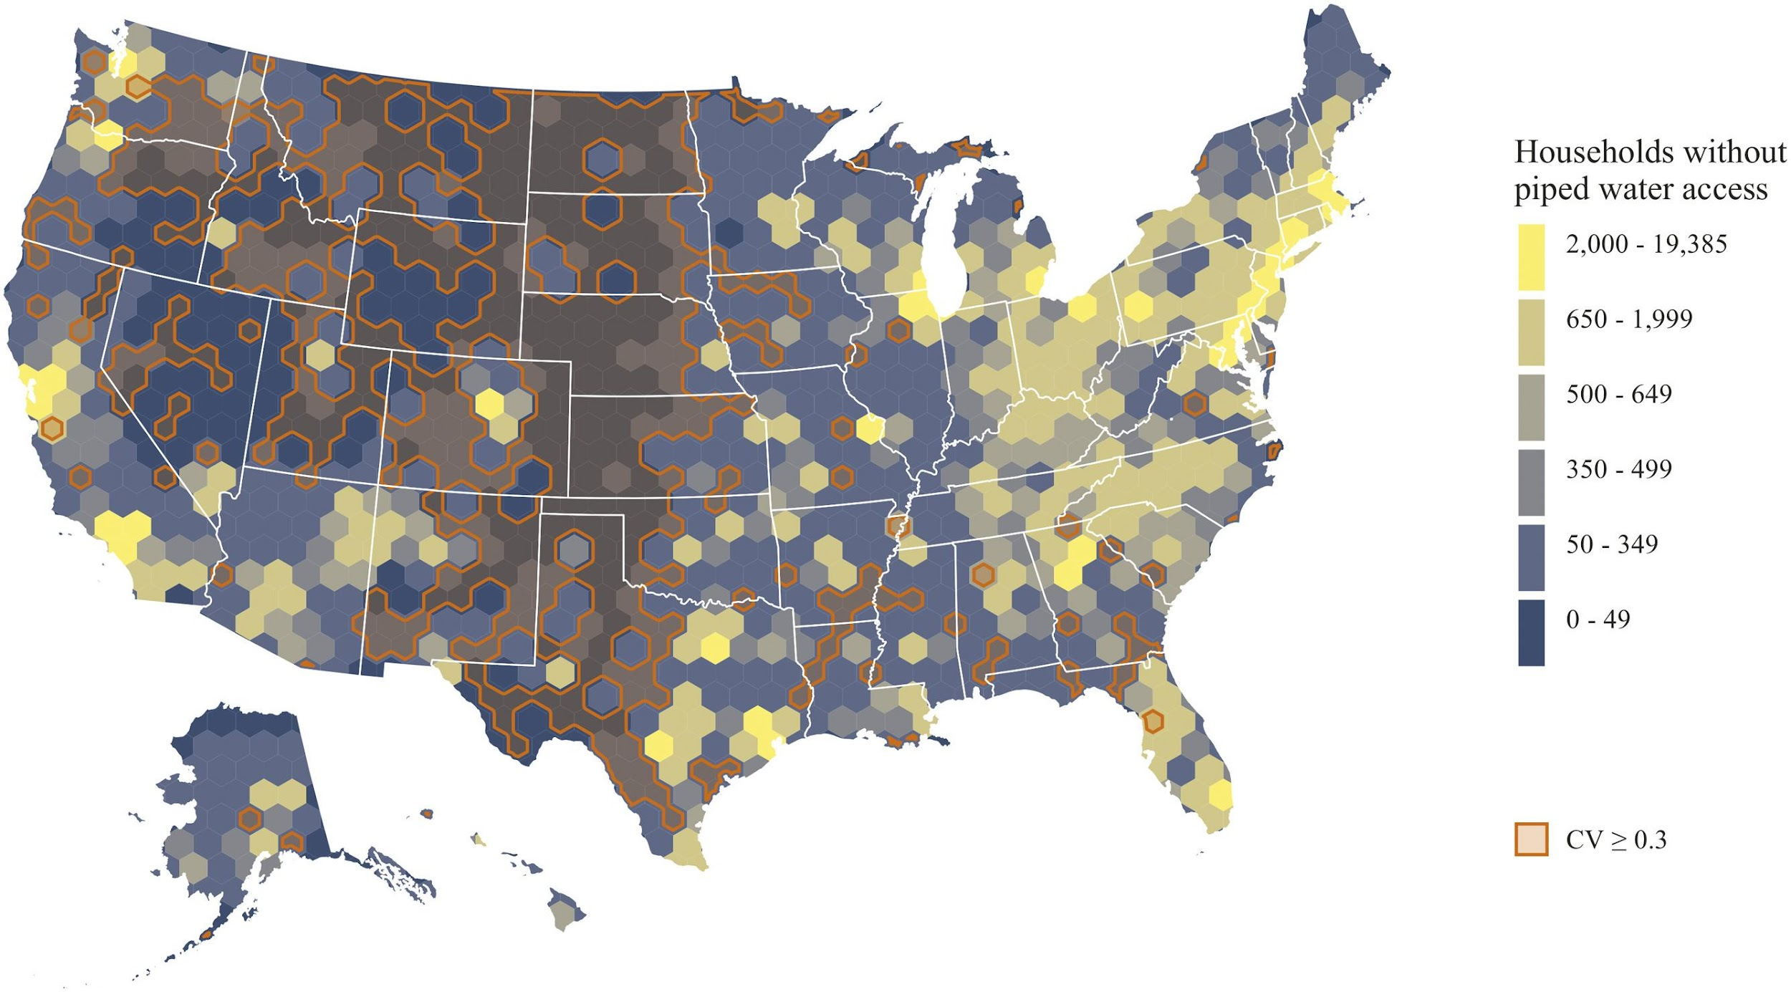
Water Inequalities and Sanitation in Low-Income Areas
- Kayla Atkins -
Hillside High School
(This graph illustrates the neglect easily done (Federally) by the deterioration of funding for housing, health, and grants as well as depicting a cut in budgets including water infrastructure due to inflation over time. This puts the beneficiaries of these grants in an area of insecurity or instability. )
In the federal budget's 13 primary block grant programs for housing, healthcare, and social services, overall spending has decreased since year 2000 by 37% after population growth and inflation adjustments, respectively. Ten of the thirteen block grants have decreased in inflation-adjusted terms since each was created in its current form, with four of them decreasing by more than half. This illustrates neglect in the fact that a budget like this can simply be cut and it not being debated media wise. (David Reich)
Introduction
Data Analysis
Access to water and sanitation is recognized by The United States as a human right, (GAUN) fundamental to all health, dignity, and prosperity(UN). However, more than four hundred thousand people in impoverished areas are deprived of this right. (Indra Khalsa) These people have been dealt these hands in these areas rooting all the way back to the late 1900s built on systematic racism, painful long periods of neglect and ignorance. (Christopher Harress)(James L. Wescoat Jr)
Research Question
How does the neglect of proper sanitation and water treatment impact low-income communities?
Thesis Statement
The neglect of proper sanitation and water treatment impacts low-income
communities through lack of proper infrastructure, the insufficiency of protective
policies, and the declining health of the inhabitants due to these non-individual
factors.
Methodology
I conducted research on low-income communities in terms of their water insecurities and water infrastructure. I gathered information from Google Scholar focused around the black belt (Southern States) and Flint, Michigan with qualitative, quantitative, and secondary data.
Based on the experiences of locals in the 17-county Black Belt region of Alabama, it has been observed that pollution in private wells and insufficient piped water infrastructure can severely restrict access to safe water. This can lead to a decline in water quality and increase the risk of waterborne illnesses. (Jessica C.Wedgeworth)
Unplumbed households are present in all major US cities, but the problem is most severe for Sunbelt cities in the South and West. For example, 19 out of the top 50 Urban areas exceed the all-metro average rate (0.3% which is about 1.1 billion people)(Christine L. Moe) for no piped water access. Out of these 19 metros, 7 are in the South, 7 are in the West, and the remaining 4 are split evenly across the Midwest and Northeast regions of the United States. (Katie Meehan)(Brett Walton)
In contrast to the case of Flint—a city with struggling finances and a low tax base—we find that some of the most affluent cities in the United States have the highest shares of plumbing poverty. (Katie Meehan)(Michael Gannon)
(This map illustrates the connections between low-income communities, poverty, water pollution/iniquities, and waterborne illnesses by identifying areas in lack of piped water.)(Katie Meehan)
In order to scrutinize the following topics which, include drinking water quality at the household level (private wells and county public supply), potential relationships between water framework elements, commercial drinking water quality, accessibility to on-site sanitation, and risk of Highly Credible Gastrointestinal Illness ( also known as HCGI)- a cross-sectional study was conducted of 305 households. In addition to completing one survey on water consumption, basic demographics, health, water system performance, and on-site sanitation, participating homes also provided one sample of drinking water for evaluation for fecal coliform (FC), opaque concentration, pH, and total chlorine. 33% of samples from piped water supplies lacked measurable free chlorine, compared to 8% of samples from public water systems and 20% of samples from private wells. Results from this study suggest that safe-water access and on-site sanitation options may be limited in this area. Residents may be at higher risk for illnesses linked to contaminated water and poor sanitation. (Jessica C.Wedgeworth)
Background
Results
The term "Black Belt" has been used in Alabama for over a century. It was first applied to the region in the late 19th century with respect to the physical, most common soil characteristics of the region. (Christopher Harress) In the mid-20th Century, the name had been defined to the large African-American population occupying the area. (Allen Tullos) After slavery was abolished, descendants of slaves in Alabama remained. They now resort to Straight Piping, where gray and black water is put directly into the ground in a nearby ditch or lawn, harming plants and wildlife by making residents sick. (Aaron Phelps / Indra Khalsa)
Hookworm, a parasitic disease, is a common issue occurring almost exclusively in the setting of rural poverty in developing tropical countries. Rural dependency reflects the precise soil and temperature requirements of the environmental lifespan of the parasite. The relationship between hookworm and poverty is based on multiple factors, including inadequate sanitation, the absence of concrete floors in home dwellings, and lack of access to essential medicines.(Ed Pilkington) Hookworm infection, like other neglected tropical diseases, not only occurs in the setting of poverty but also promotes poverty. (Peter Hotez)
In April 2014, Flint, Michigan switched its drinking water supply from Lake Huron to the Flint River, leading to problems with water quality and public health. As one of the most significant environmental contamination events in recent American history from April 2014 onward, it raised fundamental questions about water regulation, infrastructure, and environmental justice. (Benjamin J Pauli)(Stephen Gasteyer)
In 1982, the creation of the Social Services Block Grant gave states more say over social services. However, some conservative lawmakers want to put an end to the program, citing it as a "slush fund" due to its lack of accountability and excessive freedom granted to states. (David Reich)
There is a major lack in terms of plumbing poverty which is the exploration of infrastructure, space, and social inequality also covering urban and rural areas. It’s found that the most affluent cities in the United states carry these rates. Not only due to the lack of infrastructure but also through the pollution of private and public sources mostly linking to low-income communities fueling the neglect to these areas.
In these low-income areas, water inequalities are shown through concentrations in the water and on-site sanitation samples. Contaminants are common in these areas, even in varying household to household. Not being able to pass basic requirements in water quality on a County/State level illustrates the neglect in these communities. This creates limits which in return roots health issues for those who already lack access to health related sources because of income.
The government is pulling strings and preventing proper care for beneficiaries in need by depleting funds over time. With factors from inflation, population, and growth many things are considered. However, this only creates issues in other areas which can progressively worsens. Federally speaking, it's just another area of instability to those who need it.
Conclusion
Taking everything into account, there is clear information supporting the neglect surrounding low-income areas in terms of sanitation and water infrastructure. Only 0.3% of the United States struggle with water inequalities that’s still about 1.1 billion people lacking access to improved water supplies and 2.6 billion people lack adequate sanitation with 73% of households located in cities. Due to neglect, the case was overlooked and continues today. Funding for the areas needs to be initiated on a national level, and water literacy needs to be put into action. People need to know their rights and exercise it self-evidently according to the constitution.
Notes:
Cite using the authors first and last name
Come up with key points your listener will be shocked at
Write them down
- m E M O R I Z E and S U M E R I Z E

