Slide 1

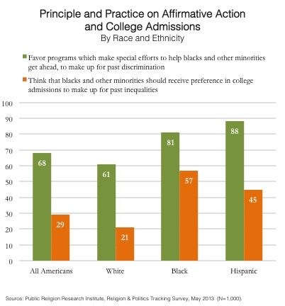

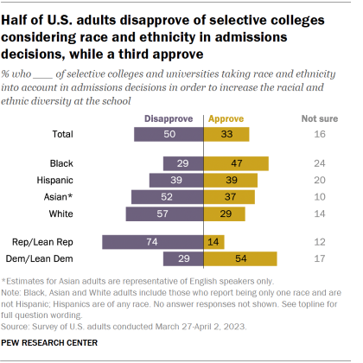
The Impact of Affirmative Action and How the Overturning of it Has Affected Students of Color
Kalyn Clark
Panther Creek High School
Introduction
Data Analysis
Results
Introduction: Affirmative action has created an acute commotion throughout colleges, particularly in California and North Carolina. According to the New England Journal of Higher Education, predictions were made in 2022 that following the appointing of the new Supreme Court Justice, Ketanji Brown Jackson, it is likely that the idea of affirmative action will be removed (Vokes 2022). This change will likely immediately affect Harvard University and the University of North Carolina, and not only would race no longer be a factor in the admissions process, but the knowledge of the applicant's race would remain unknown until meeting them in person. This resolution could make it so that the colleges must completely change their admissions process and figure out how they will have a sufficiently diverse body of students without hindering the education of others.
Research Question: How will the overturning of *Affirmative Action impact students of color in the United States?
Thesis Statement: The overturning of Affirmative Action likely will impact students of color in the United States, leading to individuals questioning the ability and likelihood of students of color to receive equal opportunities in getting accepted into the colleges of their choice.
Methodology: I researched the topic of affirmative action to better understand the result of the overturning of Affirmative Action and what it would do for students of color trying to get into college. The secondary data sources that I used to get my information were Google Scholar and Eric via the Duke Library website, ranging from the years 2020-2023. I encountered difficulty when it came to locating credible sources, yet finding qualitative data and statistics were more readily available.
*Affirmative Action, when capitalized, refers to the policy whereas, when in lowercase, refers to the concept.
This graph shows, for example, that for Black students, about 29% of United States adults do not believe that they should have access to affirmative action programs. About 47% of United States adults do believe that they should have access to affirmative action programs. There are however, a percentage of these adults who are not sure about the idea or do not understand what these programs are or what they intend to do, and for that reason they said that they weren’t sure about any race having access to the program. This data, however, was conducted in 2023, which was about 10 years later than the data in the first graph. For this reason, some of the data and statistics may vary depending on who answered it and in what time period they did.
The information provided by the graphs was reflective of the impact that affirmative
action has had on colleges in the past. Once this is implemented into even
more colleges in the future, this is when we will see a significant change in the
number of people who have opinions on affirmative action. Questions that have been
asked recently are if these affirmative action students deserve to be admitted,
especially when their test scores an overall performance is viewed as inferior to
students who weren't admitted through affirmative action. The beneficiaries of
affirmative action policies are most commonly white women. This is because they
are seen as more educated and make up a larger portion of the workforce. According
to the Manhattan Institute, “When women are included as benefiting from this policy,
its average net favorability is 26%. However, when they are not included, the average
net favorability for affirmative action drops to 14%.” This proves that there is much
less support for the idea of affirmative action when women aren’t painted as
the beneficiaries (Mukherjee p. 2,9). According to Brookings Metro, a main effect
of affirmative action will be students of color being likely to deter away from
diversity course colleges, thus resulting in more students of color applying to
Historically Black Colleges and Universities (HBCUs). These elite colleges are
exceedingly stronger performing, with better reputations, and often end up producing
more successful students. Therefore, without affirmative action being in place, it
gives students of color less confidence and motivates them to stay in their comfort
zone, which in this case, would be them applying to HBCUs. Often, they believe
this is the only college they have an opportunity of getting admitted into.
(Katharine Meyer et al. p. 2). Consideration must also be taken when it comes to
students who didn't get into the college of their choice, because someone admitted
through affirmative action "took their spot". This is especially a factor if the student
had better performance compared to the affirmative action applicant.
Background
Image 1 (PRRI): (Cox et al. 2013)
This graph shows that on average, when it comes to all Americans, about 68% believe that affirmative action programs should be enforced and that they are positive for minority groups, in the sense of making up for their past discrimination. On the other hand, about 29% of all Americans believe that affirmative action programs should not be enforced and that colleges need to find alternative methods to get these minority groups the support that they might need. However, this data was collected in 2013 and now with the overturning of affirmative action, many of these views have changed concerning the idea.
Affirmative action is a system enforced in colleges that is aimed to support students of color, with the intent of helping create a more diverse student campus. According to the University of California Los Angeles, "The average gap between Black and white student graduation rates at the top dozen public universities without affirmative action was 10.1% in 2020. By contrast, the gap was 6% at the top dozen public universities that used affirmative action" (Kohli p. 12). With this in mind, the removal of affirmative action will result in a large portion of minority students educational opportunities will suffer.
The first state to initiate the idea of eliminating Affirmative Action was California. This decision found that the incorporation of research documents and finding alternative diversity methods did not completely make up for the lack of affirmative action. There were also numerous studies that showed the decline of underrepresented minorities in colleges was due to the affirmative action bans (Colin and Cook 2023). This ultimately created a less diverse college campus, which was followed by the readjustment of enrollment policies.
According to the University of San Diego, studies show that students admitted through affirmative action programs had GPAs that were on average 0.30 points lower than non-affirmative action students. This is also seen in graduation rates, with 57% of affirmative action students graduating, in contrast to 73% of non-affirmative action students (Rose p. 1). These statistics could be due to students’ family, background, education, or even their neighborhoods. Therefore, it can be proved that because the students who are admitted through affirmative action are minorities, they have different backgrounds and it can alter the amount of academic preparation they receive.
Conclusion
Affirmative Action is a program intended to support minorities, particularly
students of color, and get into the college of their choice. This is a significant
implementation as it allows students from underrepresented groups to
have fair access to education, despite the setbacks they may face. There are
various different opinions surrounding this topic; some that may be positive
and some that may be negative. Now with affirmative action being
overturned, there have been several changes in people’s interpretations.
Many of these people are now seeing how beneficial this program was to
people of color, but just when they began to figure it out, it was overturned.
It is important to have a basic understanding of this topic as now it
is no longer a factor in the college admissions process. This raises the
question, what will the alternative be to ensure that students of color are given
an equal opportunity to get into the college of their choice? According to
Zachary Bleemer, a professor at Yale University, "States that have seen
affirmative action bans do not offer a silver bullet for universities seeking to
maintain racial diversity without race-based affirmative action"(Ordway p.
7,8). This is a common criticism that has been expressed throughout several
colleges, some of whom have suggested an alternative to affirmative
action programs. This alternative solution ensures that these policies target
students based on socio-economic status and do not only benefit minorities.
Image 2 (Pew Research Center): (Gramlich 2023)
This graph shows, for example, that for Black students, about 29% of United States adults do not believe that they should have access to affirmative action programs. About 47% of United States adults do believe that they should have access to affirmative action programs. There are however, a percentage of these adults who are not sure about the idea or do not understand what these programs are or what they intend to do, and for that reason they said that they weren’t sure about any race having access to the program. This data, however, was conducted in 2023, which was about 10 years later than the data in the first graph. For this reason, some of the data and statistics may vary depending on who answered it and in what time period they did.

