Slide 1
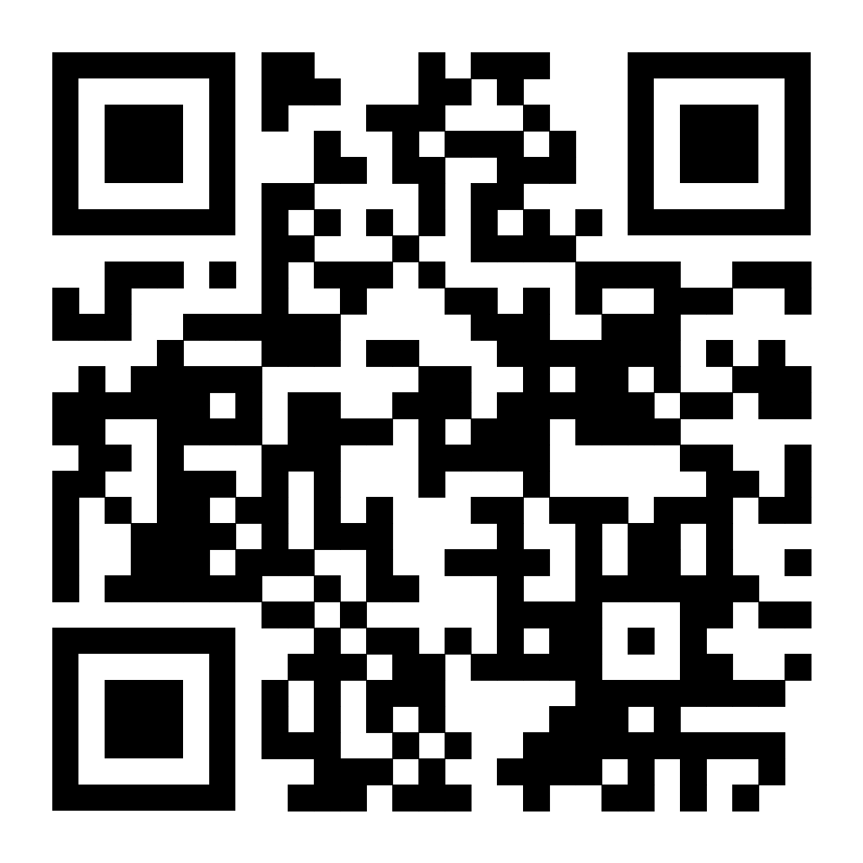

The Air They Breathe: How Stigmas and Stereotypes Impact Mental Health in Black Adolescents
Kalia West
Northern High School
Introduction
Research has found that stereotypes can cause African American teens to accept the negative stereotypes said about themselves which can lead to symptoms of depression. (William, 2006)
Findings
Introduction:
Mental health issues are prevalent within youth, but are especially noticeable within Black adolescent populations. Stigmas and stereotypes are main contributors to the decline of Black adolescence mental health.
Research Question
How can social factors impact mental health in Black adolescents?
Thesis Statement
Stress caused by social factors such as stigmas and stereotypes can have serious negative psychological effects on Black adolescents.
Methodology:
While researching I used search agents such as Google Scholar and ProQuest. I found articles using key words such as: "stigmas," "stereotypes" and "black adolescents."
Impact on Mental Health Among Black Teens
In a study by APA, non-Latino Black boys experiencing symptoms of mental illness, particularly bipolar and anxiety disorders, may be especially impacted by mental illness stigma as a barrier to help-seeking and receiving treatment, and recovery following a diagnosis.
Black adolescents indicate a fear that mental health professionals will stereotype them, provide a misdiagnosis, and/or not understand their unique ethnic-related challenges (e.g. experiencing harassment from law enforcement officials, negative interactions with school personnel) if they present for mental health care. (Lindsey, 2012)
In my research I've found that negative stereotypes and stigmas have caused Black youth to experience issues with mental health. These barriers also prevent Black youth from seeking and receiving treatment from medical professionals.
Stigmas
Black male students were often criticized for not exhibiting appropriate middle-class manners regarding body language and oral expressiveness which disproportionately singled them out as being “at risk” for failure and school punishment.(L. Trenton. S. Marshe et al
Non-African American groups pair Black adolescents with more negative things such as disobedience. (Freda F. Liu, 2022)
African American teens tend to be viewed as crazy when vocalizing their mental health struggles such as anxiety. (McLean, 2023)
Stereotypes
52% of white people believe that Black teens are violence prone . (Naomi Priest et al, 2018)
19% of white people believe that Black teens are unintelligent. (Naomi Priest et al, 2018)
Black males are thought of as a problem. (Howard, 2013)
Black males are thought of as a criminal body. (Neal, 2013)
Black male students are more subjected to be labeled as an underachiever. (Brown, 2011)
.
Data Analysis
Background
Stereotypes include notions that individuals are to blame for their mental health problems or that persons who suffer from mental illness are more likely to be harmful. (Freda F. Liu et al, 2022)
The concept of stigma states that its elements—labeling, stereotyping, separation, status loss, and discrimination—occur together. (Bruce G. Link, 2001)
The general stigma involves prejudice and misconceptions that are held by the broader public. Even before experiencing a mental illness, a person may embrace stigma and harbor unfavorable beliefs. (McLean, 2023)
Black teenagers have been identified as a group that is more vulnerable, especially when it comes to the frequency of depression. (Theda Rose, 2011)
One of the biggest factors preventing patients from using mental health services is stigma, which can take many different forms such as self-stigma and public stigma.(Moses, 2009)
Conclusion
Through my research, I found that there is an abundant amount of evidence that suggests mental health disparities among the Black adolescent communities. Stigmas and stereotypes Black adolescents face can lead to mental health issues. The stigmas and stereotypes also keep Black youth from actively seeking proper mental healthcare. One way I think can make a change is increasing access to healthcare such as counseling.
(Morr, 2020)

