Slide 1
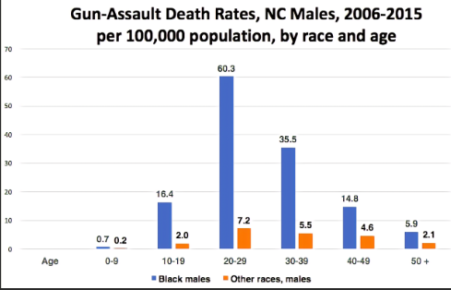
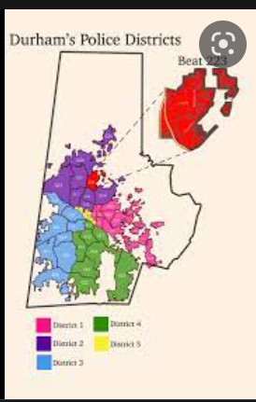

THE FALLOUT OF GUN ACCESSIBILITY IN DURHAM, AND THE REST OF OUR NATION
Kaleb Lucas || Durham School of The Arts
Introduction
Data and Findings
Does the accessibility of guns contribute to gun violence in Durham North Carolina?
The accessibility of guns in America is extremely prevalent. Unfortunately, gun violence is rapidly increasing not only in our society, but locally in Durham. Gun violence is affecting Durham and access to guns is the driving force. According to CBS News, “Only 10% of youthful male respondents who admitted to having a gun at the time of their arrest have obtained it from the store. The other 90% obtained them through a variety of ways of sharing, and other illegal ways". The goal of my research is to discover the accessibility of guns and how they affect gun violence in the Durham community.
According to gunpolicy.org 2017, North Carolina had the highest annual deaths since 1999, with a rate of 1,430 due to gun violence. Since 2017, the numbers have not substantially decreased. In 2018, the annual death rate was 1,416 and the 2019 annual death rate was 1,397.
According to “Firearms of Durham, N.C.” 662 people were shot in Durham between January 1, 2016 and December 31, 2018. During this time frame there were 363 arrests for possession of a firearm by a felon. This is an extremely large number for felons to have weapons with the increasing number of shootings. According to Living with Gun Violence in Durham, “Shooting-related deaths in Durham jumped by more than 36 percent from 2020 to 2021.” Increasing accessibility to guns
is a major contributor to the recent rise in gun violence.
Conclusions
The accessibility of guns and resulting gun violence has truly affected our Durham community, our state as well as our nation. One of the contributing factors is illegal gun trafficking. It is imperative to find solutions to fix this problem such as monitoring black market sales. For example, finding better ways of tracking illegal guns and holding legal gun owners accountable is recommended. Another contribution of easy accessibility to guns is the enactment of stricter gun laws. It is difficult to pass more gun laws due to the Second Amendment of the U.S. The Constitution states that “the right of the people to keep and bear arms, shall not be infringed”. Finally, the National Rifle Association, (NRA) influences the passing of gun laws and lobbyists connected to political officials try to block gun laws. This, in turn, makes it extremely difficult to pass any restrictive laws.
Durham’s Police Districts by Makayla Williams
The Question is: Where are they getting the guns?
Gun trafficking is one of the main ways convicted felons obtain weapons illegally. According to The National Library of Medicine J Urban Health, “Much of this serious violence is generated by guns that end up in the wrong hands. Research suggests that only about one of every six firearms used in the crime was obtained legally.” Normally, gun trafficking starts with a firearm being bought legally, meaning a person can go into a gun store, pass a background check, and successfully buy the gun. Then, that legal gun is either stolen or sold onto the black market where it becomes an “illegal” gun. Another way is after a crime, a gun can be sold, given away, or discarded. During this process the gun can be transported to a different city or state, used in another crime or the serial number can be filed off. There is no defined path of an illegal gun until it is recovered by the police. According to ATF.org North Carolina had 19,137 illegal guns recovered and traced in 2020. Notably, 572 guns were recovered in Durham alone.
Methodology
For this project, I obtained articles from Google Scholar and JSTOR for my research. Also, reputable organizations such as the ATF (Bureau of Alcohol, Tobacco, Firearms, and Explosives), Gunpolicy.org, NIH.gov, Durhamnc.gov, and IndyWeek. I examined statistics on gun accessibility and how this affects gun violence in Durham and North Carolina. In addition, I compared gun accessibility in other states.
References
Alpers, P.Bureau of Alcohol, Tobacco, Firearms and Explosives. Firearms Data: North Carolina - 2020 | Bureau of Alcohol, Tobacco, Firearms and Explosives. (n.d.). Retrieved July 19, 2022, from https://www.atf.gov/resource-center/firearms-trace-data-north-carolina-2020#recovery-cities
(n.d.). Guns in North Carolina - fTrace irearms, gun law and gun control. Gun Law and Policy: Firearms and armed violence, country by country. Retrieved July 19, 2022, from https://www.gunpolicy.org/firearms/region/north-carolina
Gavcovich, A. (2017). Punishing Illegal Firearm Possession in Durham (thesis).
MediaHub. (2022, March 9). Living with gun violence in Durham. UNC Media Hub. Retrieved July 19, 2022, from https://mediahub.unc.edu/living-with-gun-violence-in-durham/
Centers for Disease Control and Prevention. (2022, March 1). Stats of the States - Firearm Mortality. Centers for Disease Control and Prevention. Retrieved July 19, 2022, from https://www.cdc.gov/nchs/pressroom/sosmap/firearm_mortality/firearm.htm
Gun Laws Restrictions, state comparisons
Gun Laws are also a solution to stopping gun violence as well as preventing legal guns from becoming illegal guns. According to the Criminal Defense Report, the total firearms homicides depended upon their gun permit carrying laws. The state of Texas allowed its citizens to purchase long guns without a permit, and only issued permits for carrying a handgun, resulting in gun-related homicides of 6,030 from 2015 to 2019. The state of Florida, which had the same type of laws as Texas had 4,809 homicides from 2015 to 2019. When states have stricter gun laws, they have fewer deaths. North Carolina mandates that their citizens must obtain a permit for handguns and long guns, just like New York and Massachusetts. Massachusetts had 477 deaths, New York had 1,792 deaths and North Carolina had 2,548 deaths, which is significantly less than Florida and Texas. However, it is not low enough, more can be done.
Background
Gun violence is tragic, and all too familiar now. In our community countless shootings have disrupted our society leaving families mourning yet another indescribable loss. We ask ourselves constantly how these dangerous weapons are in the wrong hands. One of those reasons is the accessibility of guns.

