Slide 1

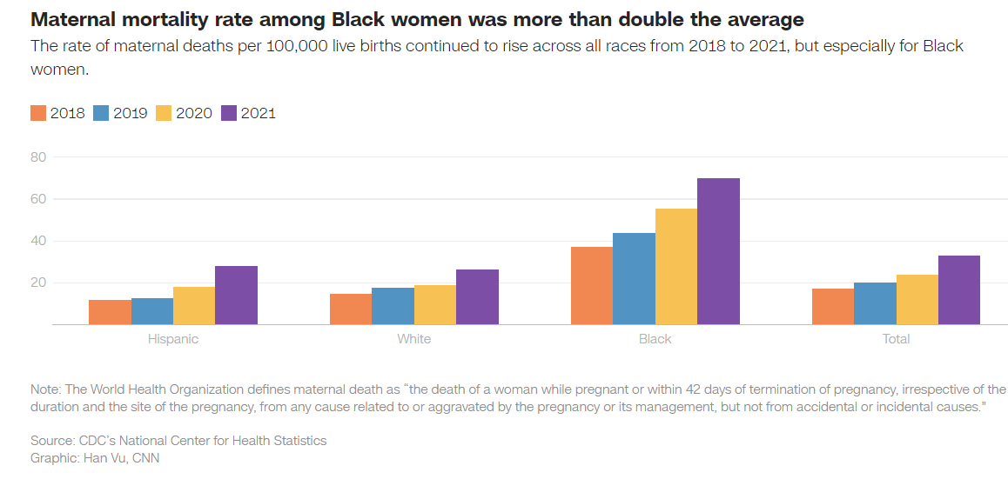
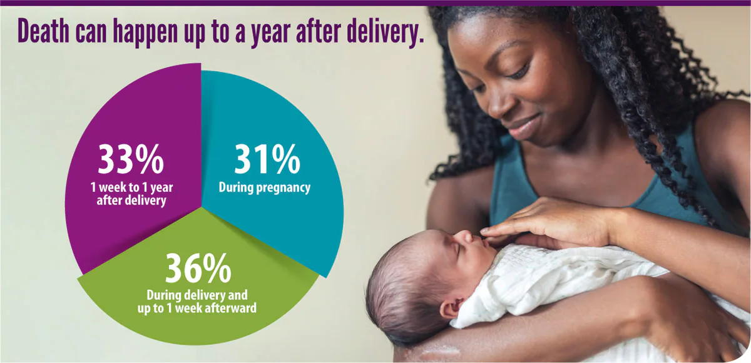
Decreasing Black Maternal Mortality in the U.S.
Kaila Kissi | City of Medicine Academy
Introduction
Data & Statistics
Findings
Maternal mortality is rising in the U.S. and the effect it has on black mothers is alarming. Some of the reasons behind this disparity are racial health inequities, structural racism, and bias. High rates of c-sections, poor prenatal care, and chronic illnesses are all factors adding to the high U.S. maternal mortality rate. Black women are three to four times more likely to die during childbirth or the first year of their child’s life than white women. In 2021, the mortality rate for black women was 69.9 deaths per 100,000 live births, which is 2.6 times the rate for white women.
Research Question: How effective have new medical practices been in decreasing maternal mortality in black mothers?
Thesis Statement: Medical practices like the expansion of Medicaid insurance coverage, virtual medical assistance programs, and access to doulas are effective ways to solve the mortality rate in black mothers
Doula care is a strategy that can help decrease the mortality rate in black women. This is because doulas are advocates for mothers before, during, and after their pregnancy.
Doulas spend as much as six to eleven times caring for their clients compared to clinical providers and hospital staff.
In 2021 there was a 40 percent increase in preventable deaths compared to the prior year.
The American College of Obstetricians and Gynecologists and Maternal-Fetal Medicine reported that the presence of a doula during pregnancy is one of the most effective ways to improve labor and delivery outcomes.
Telemedicine has been proven to improve maternal morbidity and mortality. It is used for prenatal and postpartum care, at-home monitoring for conditions such as diabetes and hypertension, and consultations with specialists.
Medicaid provides maternal-related services paying for almost half of all births in the U.S., but the current postpartum coverage from Medicaid is inadequate for mothers and infants. There have been several bills aimed at expanding Medicaid postpartum coverage to 12 months with some success.
Hispanic White Black Total
Source: CDC’s National Center for Health Statistics
Graphic: Han Vu, CNN
Background Information
In 2018, Olympic Sprinter Allyson Felix was diagnosed with preeclampsia which is high blood pressure that usually happens after the 20th week of pregnancy. She had to undergo an emergency C- section and her daughter was in the neonatal intensive care unit. Felix wished that she would have been better informed about possible warning signs. Black women are more likely to have pre-existing cardiovascular illnesses, which increases the risk of maternal mortality.
Racial bias affects black mothers because there is underrepresentation for people of color in healthcare.
This bias specifically implicit bias contributes to maternal mortality, with healthcare providers having positive attitudes toward white people and negative attitudes toward people of color.
Furthermore the mental health crisis in the U.S. is crucial for black women, as they have higher postpartum depression rates and are twice as likely to develop severe depression after early pregnancy loss.
Source: CDC
Methodology
Conclusion
My method of research is a literature review. The resources that I used for my research are a variety of sources that all focused on the black maternal mortality crisis. For instance, the majority of my findings were found through nih.gov and articles that explain the causes, trends, and solutions of the problem facing black women. I also used a publication that I found through Google Scholar that helped me construct my background information. My sources presented solutions to my question which helped me gather information about doula care, telemedicine, and Medicaid coverage.
Despite the U.S. having one of the most modern healthcare systems the U.S. has the highest rate of mortality among developed nations and the rate has slowly grown for nearly 40 years. Expanding Medicaid and increasing Medicaid coverage for doula care will be significantly beneficial for black maternal health outcomes. Over half of all states have provided access to twelve months of Medicaid and Children Health Insurance Program postpartum coverage. These are promising new developments but there is much more progress to be made for doula care to be accessible and affordable for anyone who requires of additional support for their pregnancy, childbirth, or postpartum period.

