Slide 1
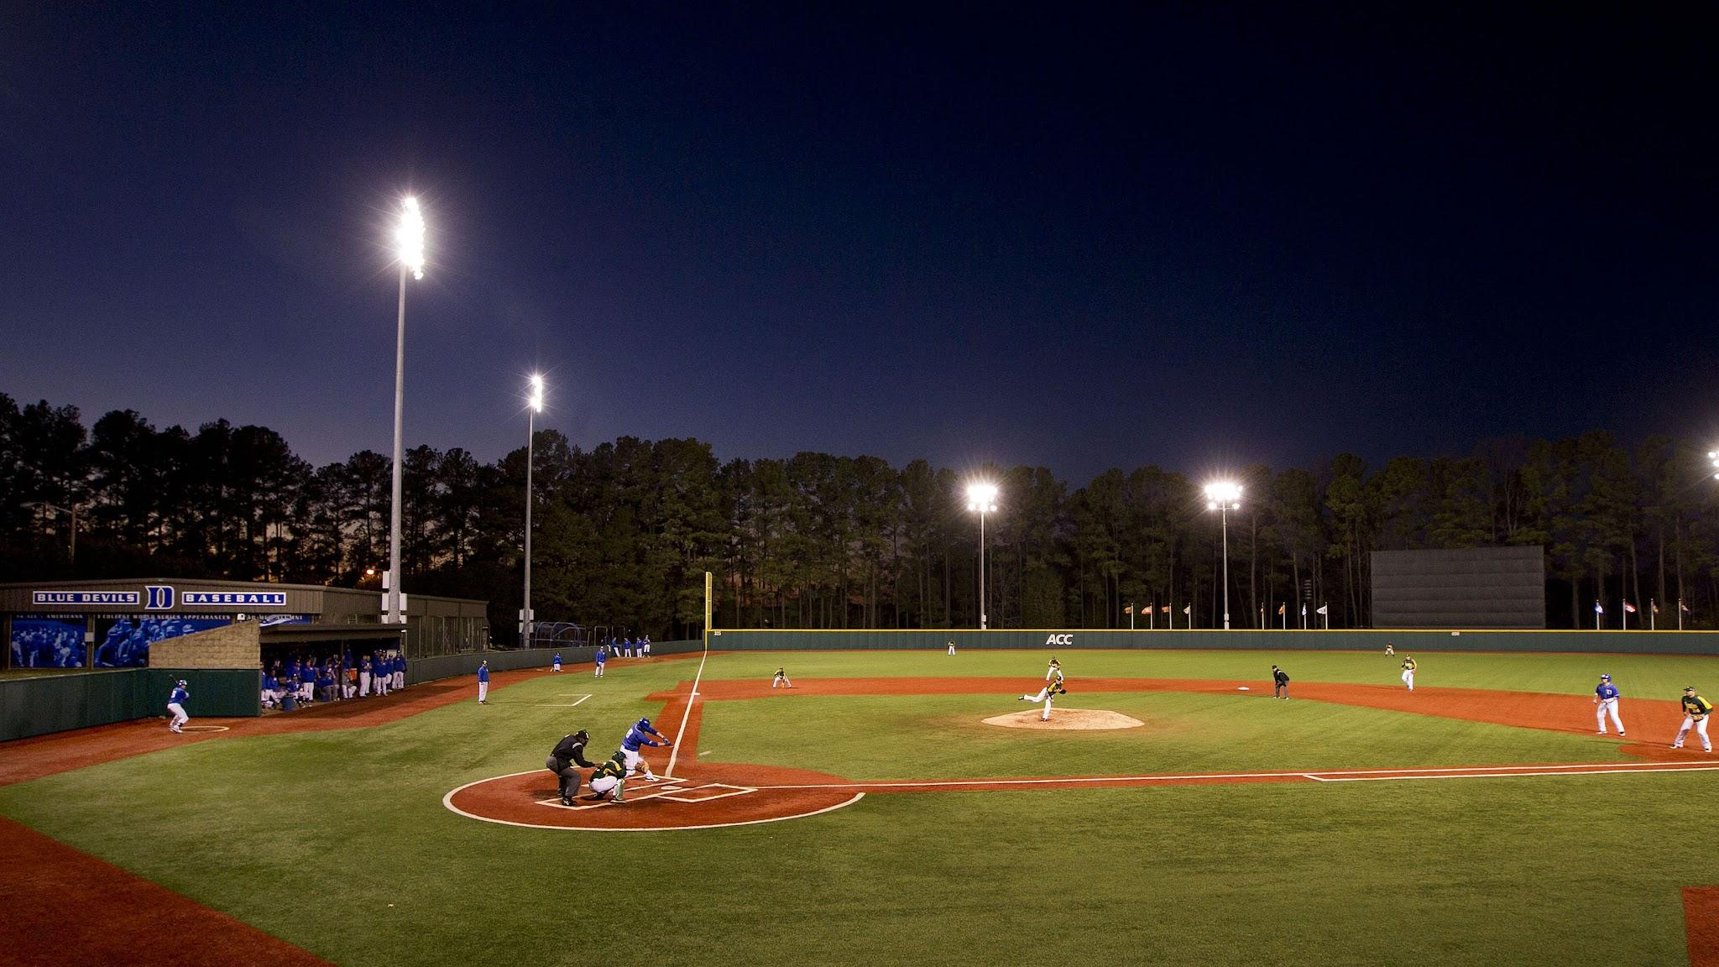
Black Baseball Players Matter
Judah Ulysses Lamont Cannon
Hank & Billye Suber Aaron Young Scholars Summer Research Institute – July 25, 2022

Slide 2
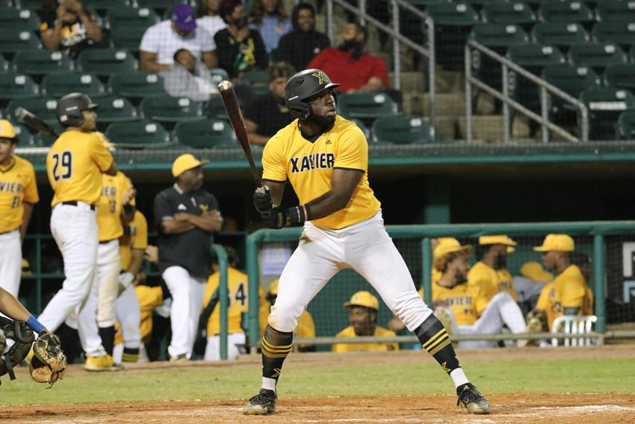
RESEARCH FOCUS
Research Question
What barriers work against African Americans' progress in their professional baseball journeys, transitioning from high school to college?
Thesis Statement
Lack of representation, financial accessibility, and limited funded collegiate opportunities contribute to underrepresentation in Major league baseball.
Reference: Xavier University of Louisiana

Slide 3
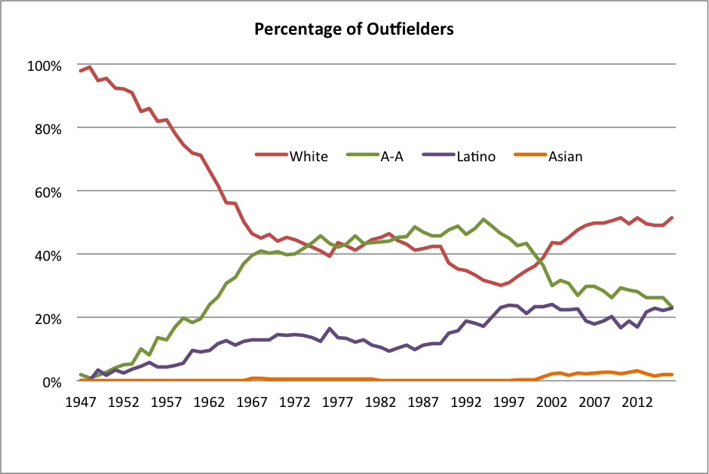
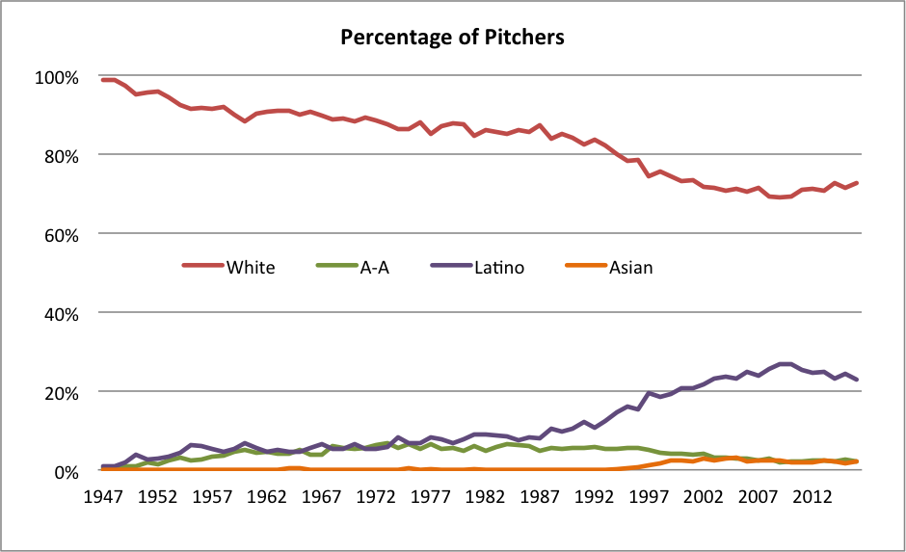
INTRODUCTION
Jackie Robinson broke the color barrier in 1947 changing the Negro League and Major League Baseball (MLB) forever!
  The percentage of Black players grew every year through 1968, peaked in the 1980s and remained steady through the late 1990s.
  The percentage of Black players began a steady decline in the late 1990s.
Today, Black players makeup only 8% of the MLB, while white players are 78%.
Armour, Mark, Levitt, Daniel. “Baseball Demographics, 1947-2016”. Society for American Baseball Research (SABR), 2022, https://sabr.org/bioproj/topic/baseball-demographics-1947-2016/
Notes:
Armour, Mark, Levitt, Daniel. “Baseball Demographics, 1947-2016”. Society for American Baseball Research (SABR), 2022, https://sabr.org/bioproj/topic/baseball-demographics-1947-2016/

Slide 4

KEY FINDINGS
Limited Funded Collegiate Opportunities
Lack of Representation
Financial Accessibility
… contributes to the underrepresentation of Black players at the collegiate level and in the MLB.

Slide 5
KEY FINDINGS
Few Black players (Travel Ball, High School, and College)
Less support and lonelier experience on majority white teams versus football, basketball, or running track.
Few Black Coaches (Travel Ball, High School, and College)
Less support to get mentoring and development opportunities-“reps and experience playing key positions” majority white teams.
Cultural Mismatch!
Baseball is not a common sport among black athletes.
Lack of Representation

Slide 6

KEY FINDINGS
Baseball is NCAA “Equivalency” Sport
Scholarships Partial Awards versus Headcount.
Most college baseball programs divide 11.7 scholarships into 5-6 Full scholarships and 5.7-6.7 partial scholarships.
“Full” scholarships are given to the best and most important players on the team (Black or white)
Majority of college baseball players families pay part or all of the player's tuition and fees, some player play for "free".
Paying for college after years of time and investment
is far less appealing for Black families.
Financial Accessibility
Nation Collegiate Athletic Association (NCAA)

Slide 7
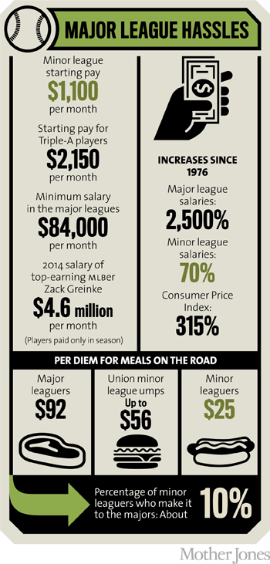
KEY FINDINGS
Limited Funded Collegiate Opportunities
Travel Ball Expenses
Team Fees $2,000-$5,000 per year
Variable Travel Costs
Equipment Costs
Helmet(s), Bat(s), glove(s), Footwear,
Protective Gear, Bag
Additional Costs
Athletic Training
(Strength and Conditioning, Mobility)
Private Lessons upward of $60 per hour
(Pitching, Hitting, Defense)
Showcase Events upward of $800- $1,000 per event
(Prep Baseball Report, Perfect Game)
Minor League Players Make Poverty Level Wages

Slide 8
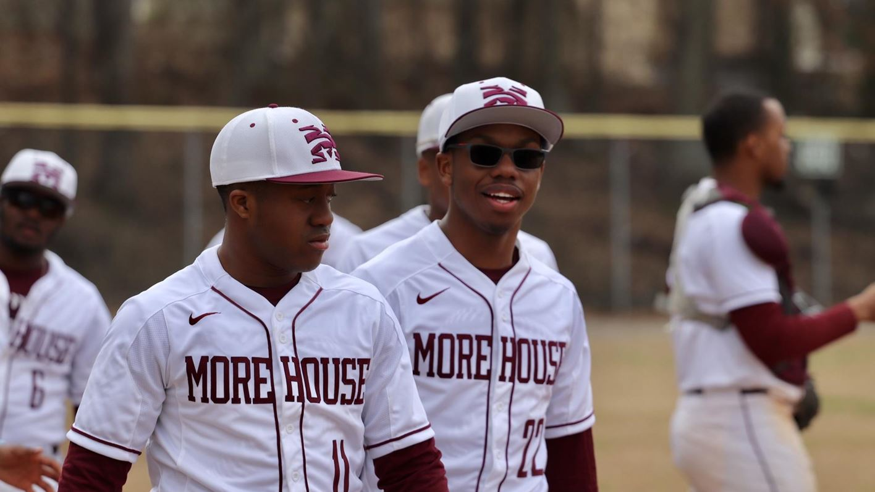
ADDITIONAL FINDINGS
Since 1990 MLB Draft Selects College players at the expense of High School and Junior College prospects
Signals that Black players who want to play in
the MLB will need to play college baseball.
Many HBCUs Discontinue Baseball Programs
Due to a lack of revenue, funding, or budgetary issues, for
eexample, Winston Salem State University (WSSU)
and North Carolina Central (NCCU)
REFERENCE: Morehouse University Baseball
In addition, the path to the Major Leagues is longer (Minor Leagues A, AA, AAA)

Slide 9
CONCLUSION
Despite the success of Black baseball players, the number of players
has declined steadily over the last twenty years.
More Black athletes pursue “headcount sports” like football and basketball,
where there are significantly higher representations of Black players.
Football and basketball are popular and costs less than baseball (participating, equipment, and training).
Baseball has a very limited number of scholarships — increases the likelihood that families will have to pay some or all of the college expenses, for their player.
Possible Solutions
Use social media to promote baseball to Black youth
and help them connect to one another.
Increasing support of baseball in Black communities,
to help young players connect more with the game
Foster the development of more Black coaches, to develop and provide opportunities for Black players (Travel Ball, High School, and College levels)
Facilitate a pipeline and support Black players
(Little League to MLB)

Slide 10
Thank You
“My motto was always to keep swinging. Whether I was in a slump or feeling badly or having trouble off the field, the only thing to do was keep swinging.” Hank Aaron

