Slide 1
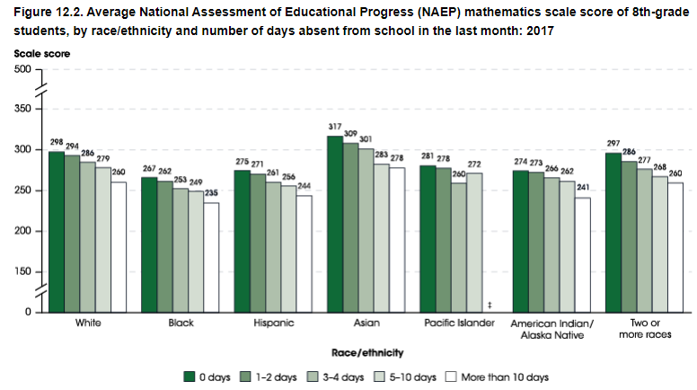
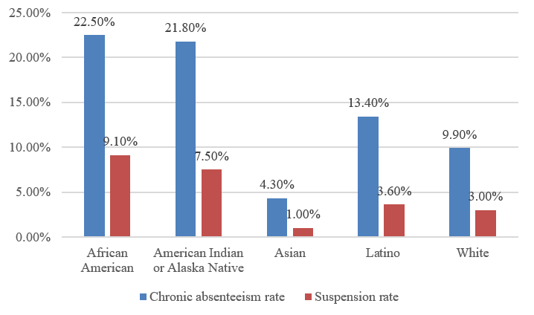
Not Going To School: Truancy and How It Impacts Students in the U.S.
Joshua Uba
Voyager Academy High School
Introduction
Data Analysis
Results
Introduction:
Education is important for kids and their lifelong development. As a result, not attending school can have adverse consequences for a child. Truancy refers to the deliberate and unauthorized absence from school, whether it be for valid reasons or not. It can have short term affects like low achievement and long term affects like incarceration.
Research Question:
How does truancy among students of color affect their rates of discipline and achievement?
Thesis Statement:
Students of color experiencing truancy have lower academic performance, fewer hours of instruction, and higher rates of discipline, which can lead to unemployment and incarceration.
Methodology:
I chose my subject because I have a passion for it. I hate to see some students of color not achieving as much as their white peers. I conducted secondary research to gather my information. I mainly used Google Scholar, ERIC, JSTOR, and government sites.
Black students missed an average of 13.2 days of school in 2018-19 compared to 9.1 days among white students (The Journal of Blacks in Higher Education, 2021).
52.7% of black students' absences were unexcused, 29.4% of the white students absences were unexcused (EdSource, 2023).
In the U.S., 10-15% of K-12 students are chronically absent.
Students are more chronically absent in districts that serve large proportions of students of color (U.S. Department of Education, 2016).
This graph shows that students who are chronically absent get suspended more often than students who attend school regularly (California Courts, 2022). This mainly affects students of color, with chronic absenteeism and suspension being significantly higher among African Americans and indigenous populations.
Truancy can cause short and long term effects.
Some short term effects are involvement in gangs and dropping out. Some long term effects are adult violence, not being able to get a job, poor mental health, and poverty (ChalkyPapers, 2022).
(National Center of Education Statistics, 2019)
This graph shows the scores among different races in the National Assessment of Educational Progress. Students who attended school regularly did better on their assessment. Students of color did not perform as well as white and Asian students even if they attended school regularly.
Background
Truancy refers to a child frequently missing school without a valid reason
Chronic Absenteeism implies a student misses school for any reason (excused, unexcused, suspension)
Students are chronically absent when they miss at least 15 days of school in a year
Examples of school discipline include suspension, expulsion, and detention
Besides race, some reasons for truancy could be missing the bus, sleeping through an alarm, and family problems
Truancy and chronic absenteeism can both lead to being suspended, expelled, and getting detention.
Conclusion
Truancy negatively affects students in different ways. Truancy can be prevented in schools by creating a welcoming and positive culture, monitoring attendance properly, providing support to students, and more. Parents can focus on keeping attendance records, checking in with the school your child is attending, talking to guidance counselors, asking your child what they learn in school, monitoring your child's friendships, relationships, etc., and encouraging your child to take part in extracurricular activities. (Tioga, 2022)
(California Courts, 2022)

