Slide 1
Catching Before They Fall: Using School Counseling mechanisms to Uplift Black Males
Jordan Vereen
Durham School of Technology High School
Incoming Freshman at UNC-Greensboro

Slide 2
Agenda
Motivation
Background
Terminology
Research Question
Methodology & Limitations
Findings
Conclusion & Future Directions
Acknowledgements
Notes:
Everyone should have these items in their agenda!

Slide 3
Motivation
My motivation for this research project is to get a headstart on my research regarding black boys in education and career development. I will be studying Communication Studies and Sociology at UNC-Greensboro with the goals of going on to graduate school to study School Counseling.

Slide 4
Background
Only 2% of all counselors are black men, My research will so how having more black men in schools as counselors will be correlating a benefit in academic and career success for young black adolescents. Despite having barriers of entering the field and for young black males societal expectations.
Source: Mental Health Disparities: African-Americans, American Psychiatric Association, 2017

Slide 5

Terminology
ASCA: American School Counselor Association
Collaboration: ASCA context: Ensuring partnerships with the public, students, teachers, school administrators, parents, and social service government organizations.
SWOT Analysis: A strategic planning technique used in business and career counseling used to help people in organizations find Strengths, Weaknesses, Opportunities, and Threats

Slide 6
Terminology
Cultural Development: interest in exploring, improving understanding of and showing respect for different faiths and cultural diversity and the extent to which they understand, accept, respect and celebrate diversity as shown by their tolerance and attitudes towards different religious, ethnic and socio-economic groups in the local, national and global communities.
Intercultural Communication: The study of communication across different cultures and social groups, or how culture affects communication. It describes the wide range of communication processes and problems that naturally appear within an organization or social context
Socio-Emotional Learning: The process of developing the self-awareness, self-control, and interpersonal skills that are vital for school, work, and life success.

Slide 7
Research Question
What strategies can secondary school counselors take to improve mental health and career development, and educational outcomes for black male adolescents?

Slide 8
Thesis Statement
Cultural competency strategies and addressing the historical barriers of schools can help improve mental health, career, and educational development for black male adolescents.

Slide 9
Methodology
In my research, I analyzed different journals that are focused in Education, Psychology, and Sociology. Those journals include Professional School Counseling volume 6, US-China Education Review Volume 9, The Journal of Humanistic Counseling, Education and Development Volume 49, American School Counseling Association, Journal of African American Men, Vol. 6, and Psychology Today. 13 total sources are used in this literature review.
Keywords: “Career Development”, “Black Student Success”, “Communication in Males”, “School Counseling Outcomes, “Licensed Professional Counseling”, “Communication Studies in Counseling”.

Slide 10
Limitations
The impact of Communication in Counseling practices
The importance of career counseling starting in middle school
Societal impacts of black males going utilizing school counseling resources

Slide 11

Education and Training
Educational requirements for school counselors:
A Master's degree school counseling
Between 700 and 1000 hours of clinical practicum and internship hours
Many counselors undergo additional professional development on conceptualizing diverse student populations outside of their degree program
Cost on average $20k per year, which can be a financial barrier to those entering the profession. Especially with the high cost of undergrad
Hickman, A, (2010). History of School Counseling. American School Counseling Association

Slide 12
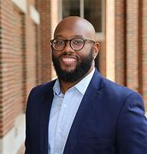
Health and Wellness
Black males have the highest rate of ADHD and Anxiety and Depression
Black males have the lowest participation rate in therapy
According to the African-American Journal for Health, Stress-Related responses and impulsive behaviors are 62% more likely to happen having a school authority member not listen to them.
Integrating Wellness Into Black Male Initiative Programs, 2020, Morton

Slide 13
Communication
Studies from the National Association for the Education of Young Children Voice 2019 Edition show that Black boys are more likely to be seen as “problem” children than their peers
Communication training in Social-Emotional learning will examine the breakdowns of conversation that goes on between authority and students and how it can affect trust in student relationships.
Communication and understanding of culture play crucial roles in the way black male students have a sense of belonging in educational spaces.
Source: African-American Men Journal, Bowen 2018

Slide 14
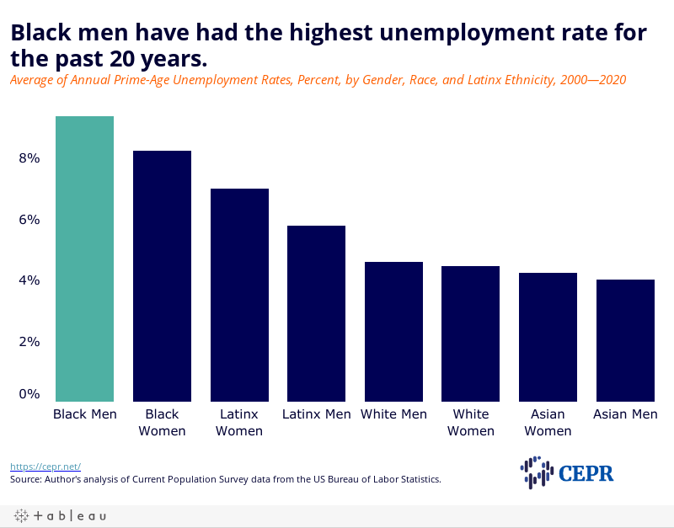
Career Development
Some strategies for career counseling include holland codes and personality test, having black males examine their SWOT analysis which accesses Strengths and Weaknesses and Threats in relation of finding work.
According to the Journal of African-American Men, Long-term career outcomes are heavily dependent on the generational influences of the trades. Reporting that 56% of black male 18 year olds that want to attend college felt the gendered pressure of being “fit” to complete college work
Austin, A. (2021) The jobs crisis for black men is a lot worse than you think. The Center for Economic and Policy Research (CEPR).

Slide 15
Conclusion and Future Directions
The social and emotional well-being of Black boys must be our highest priority. Making sure we see them, hear them, and know them is the starting place for providing them with schooling that is humane, culturally responsive, equitable, and strengths-based.
Culturally responsive practices and strategies such as having small group counseling sessions, introducing successful black men into classroom, prioritizing reading strategies that incorporate black boys in our books, and ensuring that all students complete an internship shadow experience in whatever field they are interested in.
Future Research: My future research is in the well-being and culturally responsive school curriculum for black adolescents

Slide 16

Acknowledgements
jpvereen@uncg.edu
The Samuel DuBois Cook Center and Duke University
Cohort 2 Teachers
Hank Billye Suber Aaron Young Scholars Research Institute Staff

