Slide 1
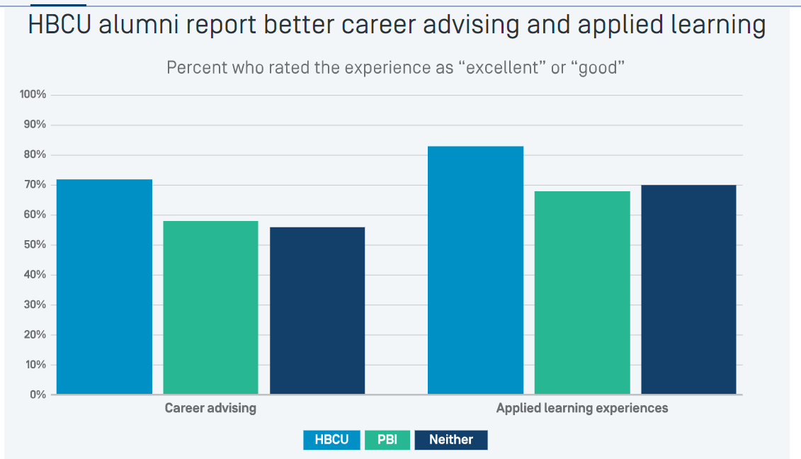
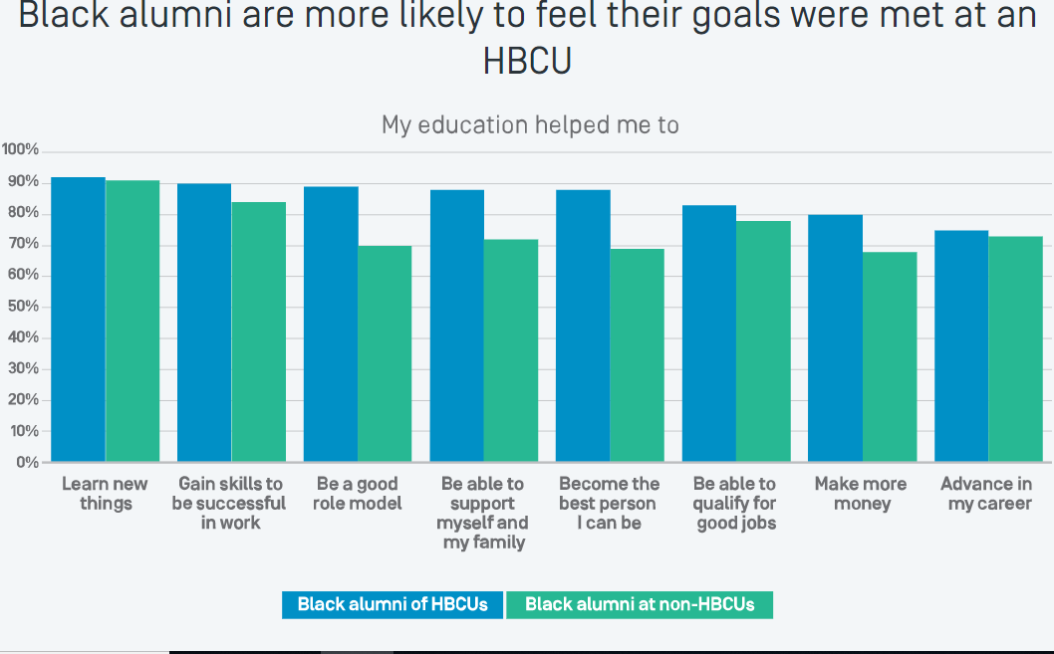

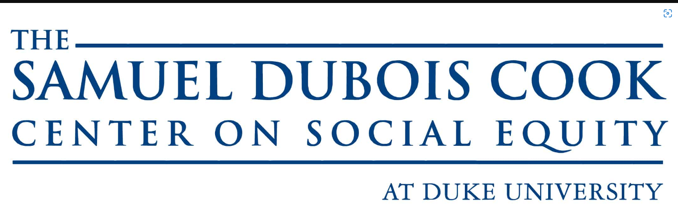

Historically Black Colleges and Career Development
Jordan Vereen New Tech High School
How do Historically Black Colleges and Universities (HBCUs) support their students in preparing for jobs and internship opportunities?
INTRODUCTION
DATA ANALYSIS
JOB PREPARATION
Popular advice for getting ahead in career most times does not highlight the importance of networking. The most successful employees in their study spend 70% more time engaged in people based activities and 10% more likely to be in routine-based communication activities. Networking from a college student perspective includes attending career fairs, resume review sections, seeking professor endorsements, and participating in mock interviews.
From a personal development perspective, internship experiences can boost students’ self- confidence in their abilities to do their work and bond with their passions. The basis of this study is from research and data collected from the career services departments at North Carolina Agricultural and Technical State University and North Carolina Central University.
The ongoing underrepresentation of administrators of color in higher education suggests that traditional career pathways make racial equities in administrative leadership elusive. This analysis explores educational, career preparation, and career experiences from the recruiting aspect. Some people overlook aspects of higher education administration and the universities’ public relations department on how they are responsible for holding a good image for the university. Using leadership and career development theories, I drew on qualitative approaches to examine people’s career journeys. Through an inductive approach for analyzing data in career narratives, emergent themes, incorporating data references, "cold calling," citizenship, and cultural change in academic affairs administration.
Another tool is the Handshake app which is a wonderful tool for college students and university recruiters to leverage job and networking opportunities.
North Carolina Agricultural and Technical State University had the largest career fair among the University of North Carolina system bringing over 276 employers virtually and in-person for career development opportunities such as networking and interview prep. Work-based learning opportunities are expanding among black colleges and universities for students specifically go to HBCUs are able to apply for mentorship programs. New-grad mentorship programs now are able to access on-the-job training which is an aspect of human resources development.
Common programs of study at North Carolina Central University include Liberal Arts programs such as their Teacher Preparation and their Pre-Law program. North Carolina A&T is widely known for producing the largest amount of Black engineering and computer science professionals. North Carolina A&T also produces the largest amount of Black students majoring in Psychology, Journalism and Mass Communications, and Biology programs. Both schools offer exemplary job preparation programs.
Underemployment is 10% higher for Black new grads than white graduates.
Black recent graduates are twice as likely to be unemployed.
North Carolina Central University had 61.5% success rate in their 2020 class. 49% of the class were employed three months after graduation, 10% of the class went on to graduate or professional schools, and 37% were still seeking opportunities in 2020.
North Carolina A&T University had a 76% success rate in their 2020 class. 66% of their 2020 class was employed three months after graduation, 14% of the class went on to graduate or professional schools, and 20% were still searching for opportunities in 2020.
The Washington Post stated,”A&T Master of Business Administration program boasts 94% of its graduates employed both at graduation and three months after graduation, with an average starting salary and bonus of $77,857”. This is a higher employment rate than Harvard and Stanford Business Schools.
Durham Public Schools employees are made up of 47% of North Carolina Central Alumni from programs such as the school administration, school counseling, and educational technology programs to name a few.
Black students accessing good internships in undergrad prepared them to have a 40% return on investment three years into their careers.
ANALYSIS:
My data analysis conveys that most students that graduate from historically black universities are able to gain workforce preparation skills, have more self-confidence, make more money, and professional advances in their careers. These students credit career development for providing them with resume reviews and applied learning experiences.
Source for Data Below: Strada Education: “The Significant Value of Historically Black Colleges”
HISTORY
Historically Black Colleges and Universities (HBCUs) have rich histories.
North Carolina Agricultural and Technical State University (Greensboro, North Carolina)
North Carolina A&T also known as NC A&T, Aggieland, and A&T has been the largest HBCU in the country since 2014. N.C. A&T currently has a total of over 13,000 students. It is one of the schools that came from passing the 1890 Morrill Act; which was an act passed by Congress to build land-grant institutions for Black students to attend.
The school was founded in 1891 by John Oliver Crosby to educate African-American students in Agricultural and Mechanic Arts. Many influential people have been a part of A&T’s legacy such as Ron E. McNair, The Greensboro Four, and Rev. Jesse Jackson. N.C. A & T has also had visits from many political figures such as the Obamas and Hillary Clinton.
North Carolina Central University (Durham, North Carolina)
North Carolina Central University known as NCCU was founded in 1910 by James E. Shepard. The purpose of NCCU was to educate African-American students in the Liberal Arts. According to a NCCU Heritage article, James E. Shepard boldly declared that his purpose for NCCU was to cultivate “the development in young men and women of the character and sound academic training requisite for real service to the nation”. North Carolina Central is known today for their Science department, Education Department and School of Law.
CONCLUSION
Historically Black Colleges and Universities such as North Carolina Central and North Carolina Agricultural and Technical State are succeeding in preparing their students for undergraduate, graduate, and post college-graduation plans. Even with the pandemic, these schools have been able to adapt and gain sponsorships from different companies to invest in new technology, new university infrastructure, and access to job shadowing programs as early as freshman year. The North Carolina A&T Career Fair was sold out this past year with over 280+ employers present. My research has substantiated the fact that North Carolina Central University and North Carolina Agricultural and Technical State University are doing their job in supporting students with their career development journeys.
REFERENCES
METHODOLOGY
National Science Foundation, National Center for Science and Engineering Statistics. 2017. Women, Minorities, and Persons with Disabilities in Science and Engineering: 2017, Special Report NSF 17-310. Arlington, VA
Gay, Gale Horton. “WHAT’S IN AN INTERNSHIP?: HBCU Grads Tell All.” US Black Engineer and Information Technology, vol. 43, no. 3, 2019, pp. 12–14. JSTOR
North Carolina A&T State University. (2021). Career Fairs. Https://Www.Ncat.Edu/Provost/Career-Services/Student-Cflist.Php. Retrieved July 20, 2022, from https://www.ncat.edu/provost/career-services/student-cflist.php
Ashburn, E. (2021, October 28). Career development partnerships with HBCUs on the rise. Work Shift.https://workshift.open campus media.org/career-development-partnerships-with-hbcus-on-the-rise/
Seibert, S. E., Kraimer, M. L., & Liden, R. C. (2001). A Social Capital Theory of Career Success. The Academy of Management Journal, 44(2), 219–237. https://doi.org/10.2307/3069452
Campbell, Cecil Dean, C. D. (2018). EBSCOhost | 130997668 | Leadership from the Middle Pays It Forward: An Academic Administrator of Color’s Career Development Narrative in Postsecondary Education. Leadership from the Middle Pays It Forward: An Academic Administrator of Color’s Career Development Narrative in Postsecondary Education. Retrieved July 17, 2022, from https://web.p.ebscohost.com/abstract?direct=true&profile=ehost&scope=site&authtype=crawler&jrnl=10520147&AN=130997668&h=T8dKykLjTkQTzmBLWLLq%2fXncz7td8gXXw5qxCVO960cUquwfq%2bWZBiU95Fflq9pL1Cw7KI0UG6eVIE4IfGKgEA%3d%3d&crl=c&resultNs=AdminWebAuth&resultLocal=ErrCrlNotAuth&crlhashurl=login.aspx%3fdirect%3dtrue%26profile%3dehost%26scope%3dsite%26authtype%3dcrawler%26jrnl%3d10520147%26AN%3d130997668
Strong, F., MA. (2019, January 29). 3 Creative Ways Public Relations can Partner with Human Resources and Recruiting to Attract Talent. Sword and Script | How Is Public Relations and Human Resources Play into Recruiting Efforts. Retrieved July 20, 2022, from https://www.swordandthescript.com/2019/01/creative-public-relations-human-resources/
My methodology included researching various methods of career advising, the importance of communication and networking, and sourcing for internship opportunities.My research was qualitative. The majority of my resources came from the annual reports provided by both schools’ Career Development Centers respectively, the Robert Lindens: Management Academic Journal from the University of Illinois Urbana-Champaign Organizational Psychology Department and the Robert C. Lidens Academic Journal for Social Capital Theory of Career Success.
It was difficult to find empirical company data on new graduate hires and mentorship programs. I would have also liked to have discovered how donations for diversity initiatives impacted HBCU students in their job hunting process.

