Slide 1

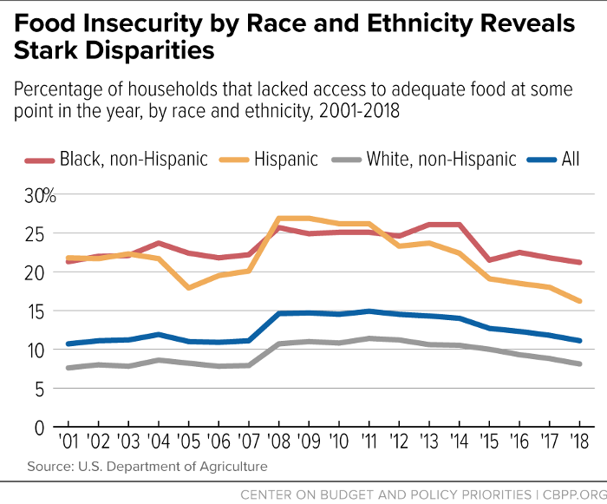
Fried Food, Fried Brain: How Food Deserts Impact Academic Achievement Among Low-Income Americans
Jenesis Twitty
Southern School of Energy and Sustainability
Introduction
Data Analysis
Results
An adolescent living in a food desert is 40 percent less likely to graduate from high school and more than 60 percent are less likely to achieve a professional degree. My research shows that a lack of access to healthy food can contribute to these disparities.
Research Question: How does living in food deserts impact the academic achievement of low-income adolescents in the United States?
Thesis Statement: Food deserts decrease the nutrient intake of adolescents, resulting in greater academic struggles, lower learning capacity, and increased impulsivity.
Methodology: I chose this topic because a couple of years back I watched a video about children living in food deserts, and it inspired me now to illuminate the children in those food deserts
and their academic struggles. I started researching with Google Scholar where I found articles relating to my topic on ProQuest.com and Duke Library.
Food Deserts in Low-Income Communities
This graph shows the percent of households that are food insecure from 2001 to 2018 by race. As shown in the graph people of color are more food insecure than the white people.
Majority-Black neighborhoods are more than twice as likely as majority-White neighborhoods not to have a supermarket. (Ney,2022)
Food Desert and Academic Achievement
In a study done in the New York State school district showed a correlation between living in food deserts and poor academic achievement. (Frndak, 2014)
There are significant negative correlations between achievement scores and the percentage of people that are at low access and are of low income. (Frndak, 2014)
Several studies have reported that breakfast habits and general diet quality among children were related to academic achievement and cognitive functioning.(Frndak, 2014)
Living in a low-income neighborhood located in a food desert caused the probability of food insecurity to increase. (University of Colorado Environmental Center,2020)
When children become food insecure, they can develop a variety of physical and mental conditions that can affect their ability to concentrate in school.( Rowe, 2022)
Students from food-insecure households were 43 percent less likely to graduate from college, including with an associate’s degree; 43 percent less likely to attain a bachelor’s degree; and 61 percent less likely to attain a graduate or professional degree, compared to non-food-insecure students.(Johns Hopkins Bloomberg School of Public Health,2021)
According to my research, food deserts affect an adolescent's life in more ways than just their weight. A food desert has a powerful effect on a child's mind causing then to be unfocused and hazy resulting in GPA scores to plummet during their time in school. Healthy food access is necessary to child
development and achievement, particularly
concerning education and test scores.
Background
Conclusion
Food-Desert
A Food-Desert is an urban area where it is very challenging to purchase low-priced and high-quality healthy food .
More than 15 million American children living in poverty face immediate and life-long risk to health, growth, and school achievement (University of Colorado Environmental Center,2020)
Food insecurities
Food insecurity refers to the state of not being able to obtain food of a sufficient quality to meet basic needs.

