Slide 1

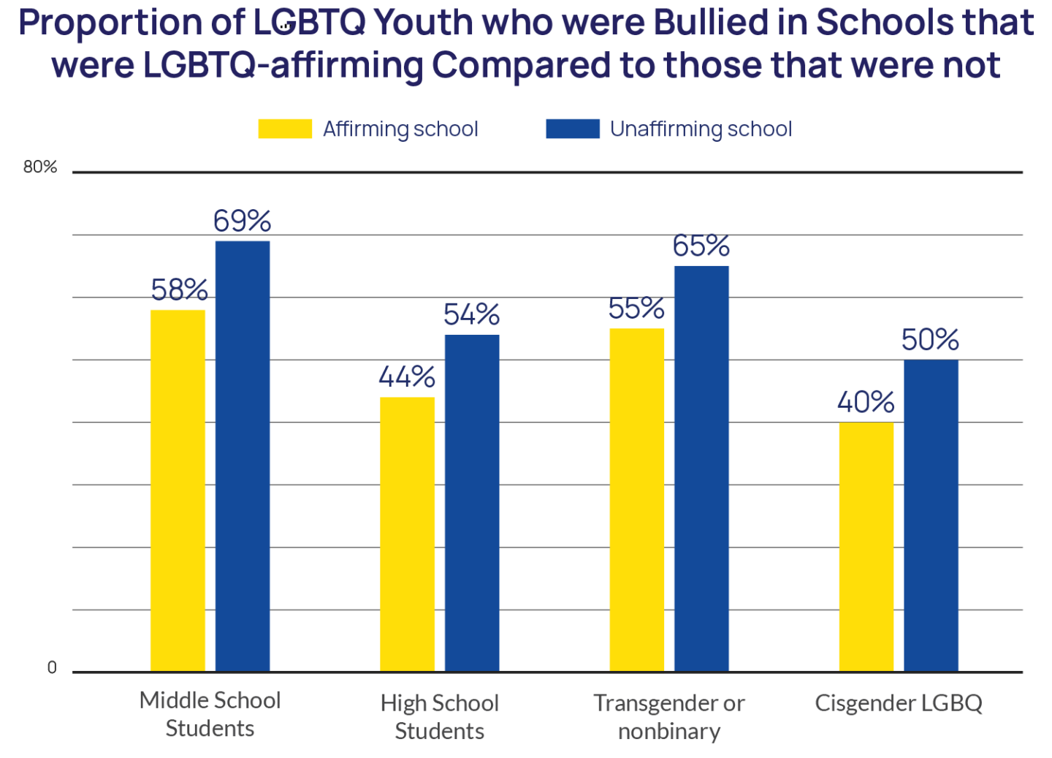
Rainbows In The Storm: The Positive Impacts of School on Mental Health in LGBTQ+ Youth
Hana Sato
Durham School of the Arts
Introduction
Common Adolescent Stressors
The most commonly reported sources of teen stress are academic stress, social stress, family conflict, world events, traumatic events, and significant life changes. (American Institute of Stress, 2018)
According to the Journal of School Health, “GSAs have been found to reduce mental health and substance abuse issues, including suicide, depression, alcohol use, and smoking.”
School climates that promote healthy growth and development of students have been linked to lower levels of violence, bullying, and a greater perceived safety among LGBTQ+ students.(Ancheta, 2021)
Counseling
In 2022, 48% of LGBTQ+ youth reported they wanted counseling from a mental health professional but were unable to receive it.(2022, The Trevor Project)
Only 27% of LGBTQ+ students feel comfortable talking to school counselors about their identity.(Human Rights Campaign, 2020)
Supportive Peers
LGBTQ+ students can find supportive peers with similar identities within safe spaces like GSAs.
Being connected with students and teachers contributes to a positive school climate.(Porta, 2017)
In the aftermath of the Covid-19 pandemic, unsupportive homes, anti-LGBTQ+ victimization, and common adolescent stressors have increased rates of depression, anxiety, and suicidality in LGBTQ+ students. Schools can exacerbate these issues but can also provide a nurturing environment.
Research Question: How have school climates impacted the mental health of LGBTQ+ high schoolers following the Covid-19 pandemic?
Thesis: While the LGBTQ+ mental health crisis is acute, school-based programs such as gender-sexuality alliances, available counseling, and supportive peers can help improve mental health. In LGBTQ+ adolescents.
Methodology: I chose this topic because it relates to me as a highschooler, a member of the LGBTQ+ community, and as someone who has struggled with depression and anxiety. While researching, I used search engines like Google Scholar and the online library ERIC (Education Resources Information Center) to find articles and graphs on the pandemic, LGBTQ+ mental health and suicide rates, and positive/negative school climates.
Data Analysis
Covid-19 and the LGBTQ+ Mental Health Crisis
Unsupportive Homes
According to The Trevor Project’s 2022 mental health survey, over 80% of LGBTQ+ youth stated that the pandemic made their living situation more stressful
Additionally, only 1 in 3 LGBTQ+ youth live in LGBTQ+-affirming homes.
Some LGBTQ+ adolescents that received counseling at school before the pandemic were unable to continue due to fear of being overheard by their parents.(Journal of Adolescent Health, 2020)
Anti-LGBTQ+ Victimization
75% of LGBTQ+ youth reported that they had experienced discrimination because of their sexual orientation or gender identity at least once in their lifetime.(The Trevor Project, 2022)
34% of LGB students report being bullied at school compared to 19% of heterosexual students.(Youth Behavioral Surveillance System, 2015)
Common Adolescent Stressors
In the Trevor Project’s 2022 survey, 94% of LGBTQ+ youth reported that recent politics (ie. anti-abortion, conservative extremism, anti-LGBTQ+) negatively impacted their mental health.
Since the pandemic, mental health has worsened in all young people. In a 2021 survey conducted by the CDC, it was found that 37% of high school students reported that their overall mental health was not good
83% of teens report that school is their greatest source of stress. (Smith, 2019)
How Schools Can Make an Impact
Safe Spaces
LGBTQ+ youth who had access to spaces that affirmed their sexual orientation and gender identity reported lower rates of attempting suicide.(Porta, 2017)
Results
Background
Due to the pandemic, mental health in all young people, especially LGBTQ+ teens, deteriorated. The state of the world at the time, coupled with common adolescent stressors, difficult home life, and victimization at school contributed to increases in depression and anxiety. Students found it difficult to cope with isolation in the absence of friends, extracurricular clubs, and supportive adults that they may not have had at home.
Despite these challenges, schools with initiative can help eleviate these stressors. For example, Gender Sexuality Alliances (GSAs) are proven to help reduce depression and anxiety symptoms. Students can make new friends and form bonds with supportive adults, knowing they all have something in common. Additionally, GSAs serve as a resource for struggling students and, can help them find counseling, support groups, and academic help.(Porta, 2017)
LGBTQ+
As of 2022, approximately 20% of Generation Z (Americans born 1997-2012) identified as LGBTQ (lesbian, gay, bisexual, transgender, and questioning/queer)
42% of LGBTQ+ youth seriously considered attempting suicide in the past year, including more than half of transgender and nonbinary youth.(The Trevor Project,2022)
The CDC found that 32% of LGB students faced poly victimization - exposure to multiple types of violence or victimization - compared to 13% of heterosexual students
LGBTQ+ affirmation refers to the support of LGBTQ+ individuals and their rights
Victimization refers to the act of singling someone out for cruel or unjust treatment
Covid-19 Pandemic
In March 2020, the World Health Organization declared a global pandemic
This quickly resulted in lockdowns, quarantines, social distancing, school and work closures, and the decline of the US economy
70% of LGBTQ+ youth stated that their mental health was "poor" most of the time or always during COVID-19.(2022, The Trevor Project)
School Safe Spaces
Safe and supportive communities within schools such as Gender Sexuality Alliances (GSA) provide mental health resources, positive student-teacher relationships, and a safe place for students facing victimization. (Porta, 2017)
Conclusion
Schools that make safe, supportive spaces available have had positive impacts on LGBTQ+ highschoolers struggling with mental health after the Covid-19 pandemic. While schools can become a breeding ground for victimization, they can also be the only safe place LGBTQ+ kids have to express themselves freely. Teachers, counselors, and administrators should be educated on inclusivity and visibility and make efforts to create a safe space for LGBTQ+ students.

