Slide 1
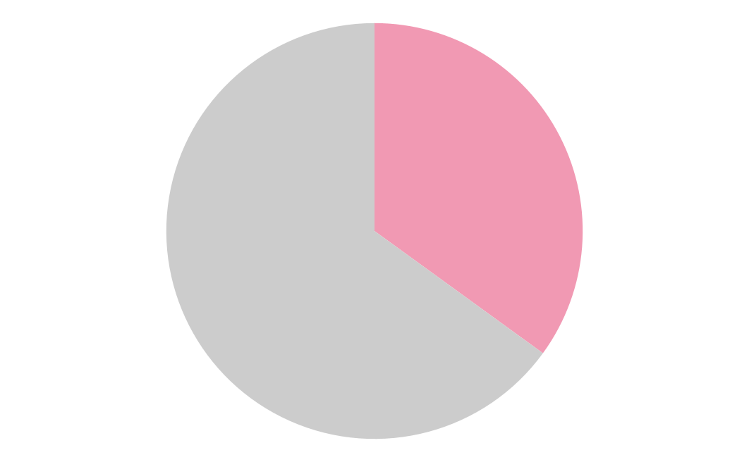

The Effects Of Sexual Exploitation On The African American Community
Giovanni Giagnacova | Hillside New Tech High School
Introduction
Methodology
Silence of Sexual assault Victims
Enslaved african people were exposed to many atrocities such as sexual explotaiton. Sexual Exploitation is defined as sexual abuse used in order to gain profit or power. According to the Sexual Expliotation of Black Women from the year 1619-2020, “58% of all enslaved women from the ages of 15-30 were sexually assaulted by their slave owners and other white men.” The objective of my research is to anyalize and explain sexual explotation, its role in black history, and how it still impacts the African American community today.
How does historical sexual exploitation impact the African American community?
In doing the research, I found all of the sources and evidence on JSTOR and Google Scholar. Most articles I found were published in the 1990s-2020s. The majority of my sources were qualitative research. A lot of the research I found was analyzing historical documents. A few of the keywords that I used were: ‘sexual exploitation’, ‘abuse’, ‘African American’, ‘sexuality’, and ‘women’. Some other terms I used were ‘post-slavery’, and ‘slave’. wh
As a result of the demonization of black sexuality, both internal and external, doesn't only impact those in the LGBT+ community but also affects those who are sexually assaulted. They may struggle with fear of being deserted by their family or community and feeling ashamed for what they may feel like is playing into a stereotype.
35% of Black women experienced some form of contact sexual violence during their lifetime.
Data and Findings
Stereotypes
The sexualization of black people, especially black women, led to stereotypes such as the Jezebel, the mulatto, and the Brutish Black man. The Jezebel is the stereotype of Black women meant to frame them as promiscuous, lewd, and even predatory. The Jezebel stereotype was used to excuse the rape of Black women because they were perceived as unable to deny a man because of their own ‘impulse’. The tragic mulatto is a myth of a mixed-race person who despises being black and wishes to live as a white person by seducing one. This caused a larger problem of colorism within the black community. Finally, the Black brute was used as a fearmongering tactic against black men potraying them as sex-crazed animals who wanted to defile white women. This stereotype was used to rationalize the lynching of Black men.
Suppression of Black sexuality
The marginalization of black sexuality led many of the black community to attempt to dissociate themselves from sexuality. In addition, many black churches, which are a large staple of African American community, have adopted conservative and sex-negative views. These coupled ideas can cause alienation of individuals in the black community such as queer Black people.
Conclusions
Background
My research has shown that the sexual exploitation of African Americans has made a huge impact in the community. My research conveys that historically, it has been used to dehumanize, humiliate, and justify physical violence against freed and enslaved African Americans during slavery and post-slavery era. My findings also illustrate that silence and fear is still prevalent today. There are resources and organizations taking action today to combat sexual violence such as Rape, Abuse & Incest National Network (RAINN) and National Sexual Violence Resource Center (NSVRC).
The sexual exploitation of some African Americans has taken place since slavery until today. Due to the stereotypical belief that African Americans are hyper-sexual, they are animalistic. This sexual abuse and exploitation was about the abuser exhibiting power over their victims.
During slavery, African American women were sexually exploited by their slave owners and other white men at a greater length than their white counterparts. According to Sexual Exploitation of Black Woman from the years 1619-2020, “the treatment of black females who were slaves has contributed to the disparities in sexual and reproductive health today.” Unfortunately, this wasn’t exclusive to black women; while overlooked there have been several recorded instances of sexual assault and rape of enslaved men and boys.
In post-slavery, according to the EJI Reports, Sexual Violence Targeting Black Woman, during the reconstruction, post-reconstruction, and Jim Crow Era things such as rape and lynchings were justified by the villainization and hypersexualization of African American individuals.
References
Blair, C. M. (2014). African American Women’s Sexuality. Frontiers: A Journal of Women Studies, 35(1), 4–10. https://doi.org/10.5250/fronjwomestud.35.1.0004
Brown, D. L., White-Johnson, R. L., & Griffin-Fennell, F. D. (2013). Breaking the chains: examining the endorsement of modern Jezebel images and racial-ethnic esteem among African American women. Culture, Health & Sexuality, 15(5/6), 525–539. http://www.jstor.org/stable/23524698
Elia, J. P., Farrington, J., Powell,& N. W., Graham, G.(2019). Some Notes on the History of Black Sexuality in the United States. In Slavery to liberation: The african american experience (pp. 74–98). essay, Encompass Digital Archive.
Foster, T. A. (2011). The Sexual Abuse of Black Men under American Slavery. Journal of the History of Sexuality, 20(3), 445–464. http://www.jstor.org/stable/41305880
Leverette, T. (2015). [Review of Mixed Race Stereotypes in South African and American Literature, by Diana Adesola Mafe]. Research in African Literatures, 46(2), 166–168. https://doi.org/10.2979/reseafrilite.46.2.166
Russell, T. (2008). The Color of Discipline: Civil Rights and Black Sexuality. American Quarterly, 60(1), 101–128. http://www.jstor.org/stable/40068501
Sexual violence targeting black women. EJI Reports. (2020, July 8). Retrieved July 19, 2022, from https://eji.org/report/reconstruction-in-america/the-danger-of-freedom/sidebar/sexual-violence-targeting-black-women/
The National Intimate Partner and Sexual Violence Survey: 2010-2012 ... (n.d.). Retrieved July 20, 2022, from https://www.cdc.gov/violenceprevention/pdf/NISVS-StateReportBook.pdf
Wilson, D. R. (n.d.). Sexual exploitation of black women from the years ... - digital commons. Retrieved July 20, 2022, from https://digitalcommons.tourolaw.edu/cgi/viewcontent.cgi?article=1079&amp;context=jrge

