Slide 1
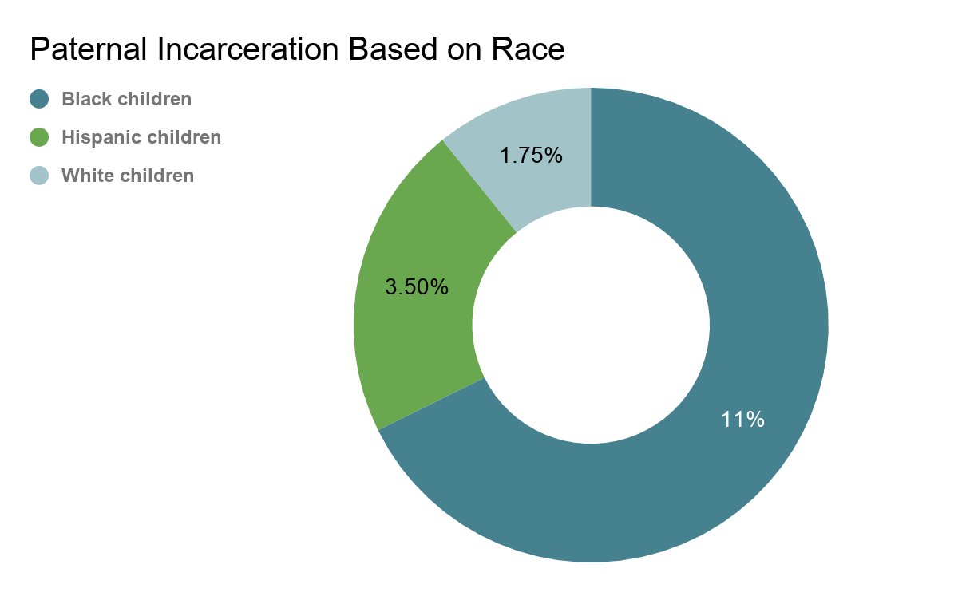
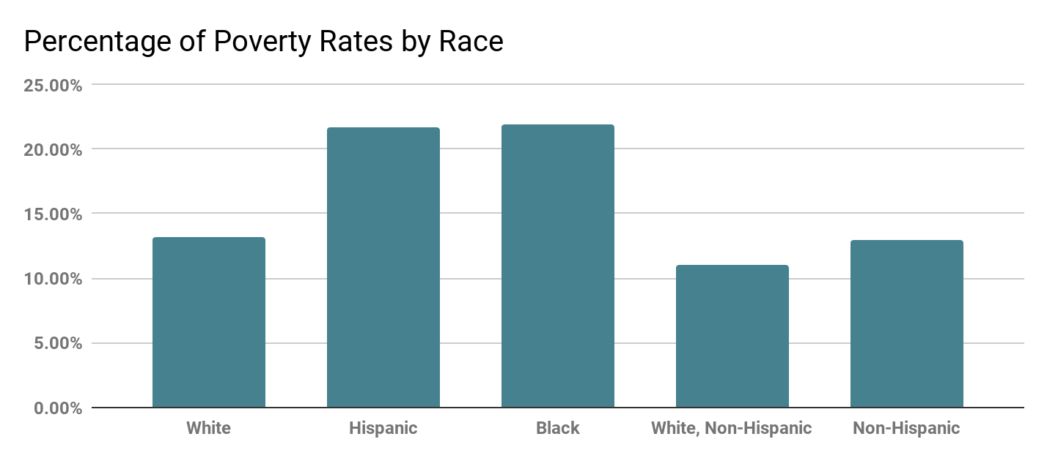
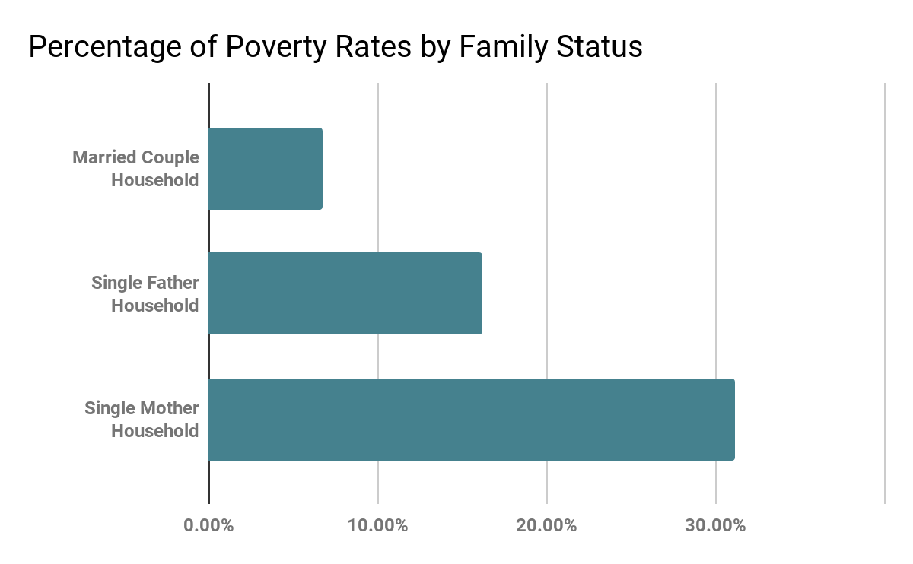
Fractured Families:The Effects of Paternal Incarceration
Genevieve Furges || C. E. Jordan High School
Introduction
Data/Results
As incarceration rates grow, the number of children exposed to paternal incarceration increases. The United States has the highest prison population in the world. Unfortunately, African American men are significantly more likely to be imprisoned compared to other marginalized groups. Child Trends, a national nonprofit, found that one out of nine children has had a parent in prison. How does the incarnation of a Black father impact their children and their family structure?
Paternal incarceration greatly impacts a child and their family's well being. It can affect them socially, financially, mentally, and emotionally.
Social Impacts
Affects their relationships with friends and family because of the social stigma related to incarceration in the US.
It is more difficult to trust people-impacting relationships
Social exclusion from being homeless or in foster care.
Caregivers can feel burdened with the responsibility of the child.
Often become withdrawn, anxious or isolated.
Financial Impacts
Children experience food insecurity and poverty because of their fathers’ financial hardships.
Fathers will have difficulty providing financially because of the strain of finding employment and paying for legal fees and fines to defend themselves in court.
Mental/Emotional Impacts
Children will tend to struggle with feelings of:
  Anger
  Disappointment
  Worry or anxiety
  Guilt
  Emotional withdraw
  Depression
  Abusing alcohol and drugs
Background
The term Parental Incarceration “refers to any kind of custodial confinement of a parent by the criminal justice system.”
According to a study done at Texas A and M University and Northeastern University, incarceration is steadily increasing in the US population compared to the 1970s, when incarceration was rare. Men make up 93% of the prison population. The rate of incarceration for Black men is seven times more likely than white men. Similarly, Black women are three times more likely to become incarcerated than white women. In 2011, about half of the prison population left behind at least one child. These rates are proportionately distributed by race and ethnicity. Paternal incarceration is experienced by 6.7–11% of Black children.
Methodology
When I was researching this topic, I used sources from Proquest, found through the Duke Library database. There was a large number of studies about parental incarceration, but very little specifically about Black fathers incarcerated. The majority of the studies I've found consisted of qualitative data through interviews and observation. Many of the sources I reviewed described the effects of paternal incarceration and maternal incarceration, the incarceration of a child's mother. Throughout the process of collecting sources, many articles addressed certain limitations. One of the main limitations is the difficulty of measuring the lasting effects of parental incarceration. A study from the University of Chicago addressed that many children in a data pool were living in stressful living environments. This made it difficult to determine if impacts were coming from their environment or paternal incarceration.
Conclusion
Although many children are negatively impacted by paternal incarceration, this does not mean these children can not succeed. Most children in this situation turn to extra-curricular activities like sports, theatre, and the church as coping mechanisms. Children with incarcerated parents have found active support systems in their life. Many organizations provide resources to help these families combat these hardships. Some may argue that these effects are the fault of the fathers and their poor actions. But the high incarceration rates of Black fathers show the fruits of an unjust, biased, and racist system that disproportionately punishes Black fathers and their descendants for generations.

