Slide 1

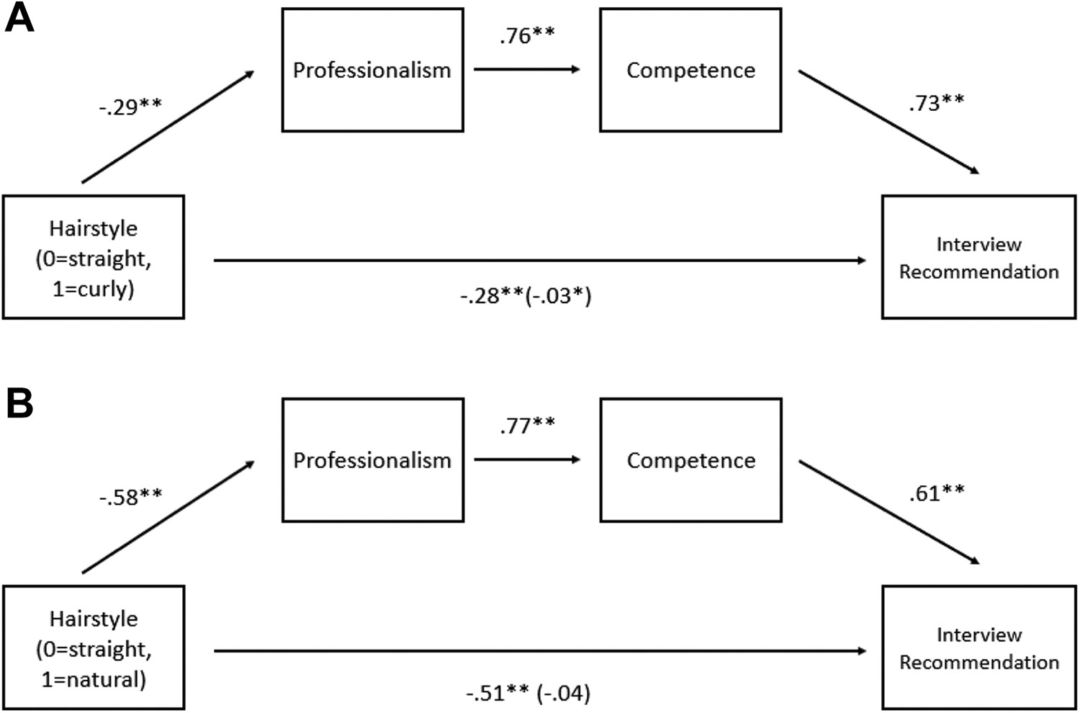


The Impact of Hair Discrimination on Black Women’s Experience in the Workplace
Genesis Crawford
Riverside High School
Introduction
Data Analysis
Chart
Introduction:
Hair discrimination is deeply rooted in systematic racism and exists to protect white places. Employers utilize regulations that pick out people with textured hairstyles in order to confine the number of open positions to one race.
Research Question:
How does hair discrimination in the workplace negatively affect black women?
Thesis Statement:
Hair discrimination in the workplace can negatively affect black women and cause them to experience negative internal conflict and push conformity to Euro-centric norms.
Methodology:
For my project, I gathered my information from secondary sources such as, The Duke Law Journal Library, Google Scholar and JSTOR.org. I had a difficult time locating material on the Crown Act. Whereas, locating information on hair discrimination presented less of a challenge. During my research I focused on the following keywords: hair discrimination, Crown Act, and the history of hair relaxers. In all, I was able to find many sources that would help build my research.
because of their hair, which is even higher for women under 34 (⅓)
A study done by Sage Journals demonstrated an experiment across four studies that showed a bias against black women with natural hairstyles in job recruitment. Study one had participants evaluate different profiles between black and white female job applicants across a variety of different hairstyles. The results of study one showed that black women with natural hairstyles were perceived to be less competent, less professional, and less likely to be selected for the job interview than black women with straightened hair and white women with curly or straight styles. (Koval, Christy Zhou, and Ashleigh Shelby Rosette. August 19, 2023) .
Background
Variable | Black Applicant |  | White Applicant
 | Natural Hair | Straight Hair | Curly Hair | Straight Hair
Professionalism | 4.08 (.82) a | 4.67 (.65) b | 4.25 (.69) c | 4.54 (.66) b
Competence | 4.13 (.80) a | 4.56 (.67) b | 4.30 (.69) c | 4.53 (.65) b
Interview | 4.11 (.91) a | 4.62 (.73) b | 4.29 (.74) c | 4.58 (.69) b
The highlighted sections show the probability of a white woman with straight hair being sent to an interview, vs a black woman with curly hair being sent to an interview. The findings of Study 1 initially supported a bias against Black women applicants because of their natural hair. According to the exhibit made by Sage journals, evidence showed that white women with curly (as opposed to straight) hair received less favorable assessments, possibly indicating a preference for straight hair. Nevertheless, that across all comparison groups, Black women with natural hairstyles were seen as the least professional, least competent, and least likely to be suggested for an interview.
White applicant: straight hair vs Black applicant: Straight hair4.54/6 = .756 4.67/6= 0.77834.53/6= 0.755 4.56/6 = 0.764.58/6= 0.763 4.62/6= 0.77
Background
Due to the preconceived bias against Black women from employers of corporations, black hair discrimination frequently takes shape in the form of publicly using policies that single out, shame, racially profile, and unfairly punish black women for embracing natural or protective hairstyles that are closely linked to black identity and culture (NAAC Legal Defense team) . Employers have used the terms ``Professional", and "Acceptable", to group their employees to fit the standard of European characteristics and mannerisms. This means that in order to be accepted by professionals, black women who don’t naturally conform to Eurocentric norms must undergo drastic and frequently irreparable alterations to their appearance. Black women have long utilized hair relaxers to conform to Eurocentric ideals. Black women who want straight hair temporarily change the texture of their natural hair with the use of hair relaxers. However, because hair relaxers are only temporary, they might return to their original state if exposed to humidity or washed. As a result, many black women frequently return to the salon to continue the chemical process. (Perception Institute, February, 2017).
The Crown Act is a law that was recently passed by several states and the House of Representatives that prohibits any race-based hair discrimination. CROWN stands for "Create a Respectful and Open World for Natural Hair." Race-based hair discrimination negatively affects Black women who have been sent home from school (Perry, Andre M., 9 Mar, 2022) or dismissed from the workplace for certain hairstyles, such as braids, Bantu Knots, Locs, Twists, Cornrows, and Afros. One recent study found that over 20% of Black women ages 25–34 have been sent home from work because of their hair. (Asare, Janice Gassam.,10 May,2023) )
Conclusion
White applicant: straight hair vs Black applicant: Straight hair
4.54/6 = .756 4.67/6= 0.7783
4.53/6= 0.755 4.56/6 = 0.76
4.58/6= 0.763 4.62/6= 0.77
Results: After comparing the two data sets between black applicant with straight hair vs white applicant with straight hair. The higher percentages shows that white women are more likely to be perceived as more professional, competent, polished, qualified, and more worthy of interviews, vs black women with natural hair.
Hair discrimination in the workplace is still not well understood in society. The topic of hair discrimination should be brought up in any discussion on racial equity. Not only should the debate cover how hair discrimination harms black women, but it should also cover how to stop it from happening in the workplace. Managers, leaders, and anyone with the ability to make decisions should regularly get training on hair bias and how it affects Black women's experiences at work. Additionally, continual education about hair discrimination should be given to staff members. Employers should push for creating a safe and positive working environment that wouldn’t single out, harm, or unfairly punish black women for embracing themselves in the workplace. Everyone should be able to express themselves freely and come to work as their best selves in a positive, productive environment. Employers should take the time to not only educate themselves but their team as well. A good starting point would be by researching the legislation and laws that were created to help combat this issue. Employers could learn about the Crown Act. Advocating for this bill could be the first step for pushing for more diversity and inclusion in the workplace.

