Slide 1
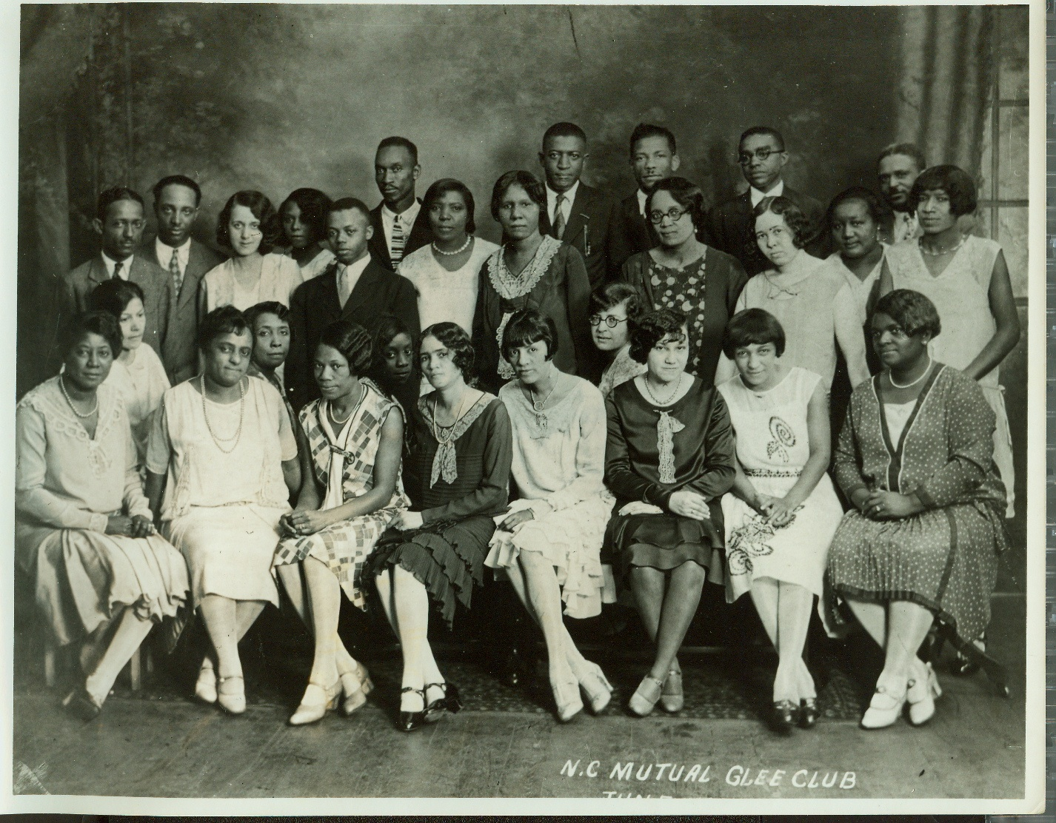
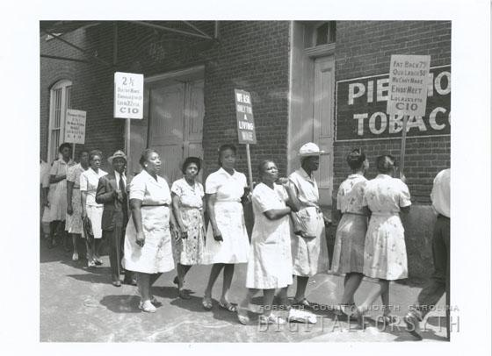
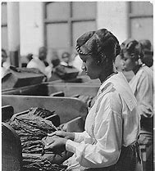
Black Women In The Shadows Of History
By Francy Rawls , Hillside New Tech Scholar
INTRODUCTION
Historical Photos
Historical Events & Black Women in Durham
How has the marginalization of the history of black women in Durham, NC altered their perception of their identity?
Identity crisis: a period of uncertainty and confusion in which a person's sense of identity becomes insecure, typically due to a change in their expected aims or role in society.
Marginalization : treatment of a person, group, or concept as insignificant or peripheral.
During the Civil Rights Movement there were alot of black leads but most of those leaders were males. The only black women leader we commonly know is Rosa Park because she was a lighter skin tone leader. During the civil rights era Durham , North Carolina had its only Civil Rights Movement called the Black Freedom Movement. Were a lot of Local Black Women leaders played important roles by achieving equal education, economic opportunity, and a political voice in their neighborhoods and communities.
Low-income Black women impacted our communities by being the organizing their neighborhoods. From 1965 through 1968, they became more militant in demanding economic reforms, higher wages, and adequate housing. Operation Breakthrough was Durham's anti-poverty agency, partially funded by federal grants from President Lyndon B. Johnson's War on Poverty. The neighborhood councils that grew out of these efforts gave Durham's women, first black and later white, a forum for expressing their demands and priorities. One agency of low-income women as in the case of Joyce Thorpe, a woman facing eviction who later became a successful litigant for fair housing and shows how state and federal anti-poverty programs and previous anti-discrimination court decisions were direct catalysts for these women's bold actions. Bringing their people to life in Durham, a fitting urbanizing The New South.
METHODOLOGY
Throughout my research I had the challenges of finding articles based off my topic because there is not a lot of research on comparing black women today and historical black women. A book called Our Separate Ways was where I got information about Freedom Movements with Black Women in Durham. This book also sparked the interest of comparing black women’s roles from the 1950’s to the present time. The Library For Medicine helped me talk about the identity difference with black women today compared to the 50’s. Information I also obtained was how televisions depictions of Black Women affect how they think of themselves.
Women on Black Wall Street Exhibit Home . 1929, paulimurrayproject.org/durhamstories/bwswomen/bessiewhitted.html.
BACKGROUND
Appreciation for Black women has changed over time based on the beauty standards today. Despite the implicit biases, movements such as the self care/self love practices has ignited the spark for confidence and to continue having that Black Girl Magic. During the 1950’s it was frowned upon by society for women to be mothers and try to get their doctorate (History of Black Women in Hayti). African American Women in the 50’s didn’t fit that social norm to be the typical stay at home mom. They had to go out and find jobs in white women’s homes, etc. just to provide for their family. Women today now are exceeding these expectations from excelling in their profession, more women getting higher degrees.
Powell, William S. Civil Rights Movement. 2006, www.ncpedia.org/civil-rights-movement.
CONCLUSION
Movement, Cultural Appropriations of Black Women on Social Media, and the mentality about what black women should be. But over time the empowerment and confidence that has been building up overtime has helped bring more success. I want to continue my research about black women being the backbone, establishers, and organizers of Hayti Durham , NC.
Francois, Tiffany S. “How the Portrayal of Black Women Has Shifted from Slavery Times to Blaxploitation Films in American Society.” HighPoint, www.highpoint.edu/communication/files/2264_francois1.pdf.
Greene, Christina. “ Our Separate Ways: Women and the Black Freedom Movement in Durham, North Carolina University of North Carolina Press.” H-Net , Sept. 2006, www.h-net.org/reviews/showrev.php?id=12278.

