Slide 1
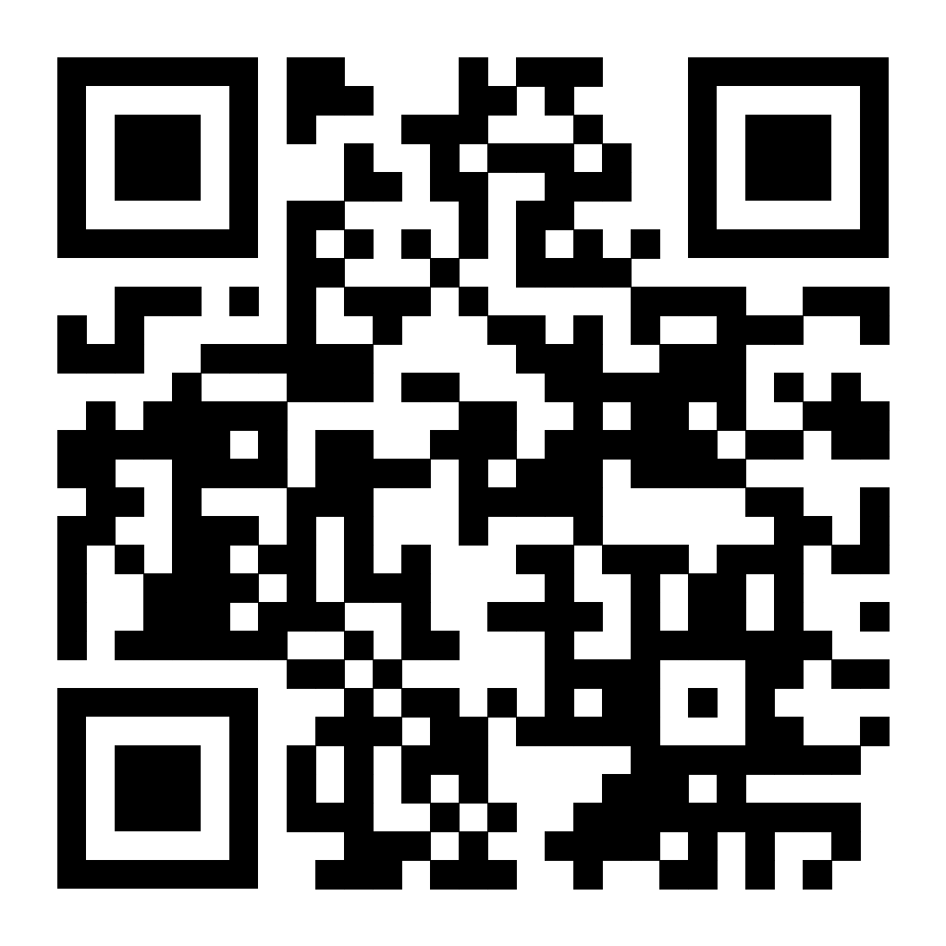
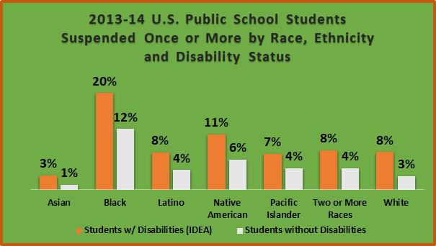
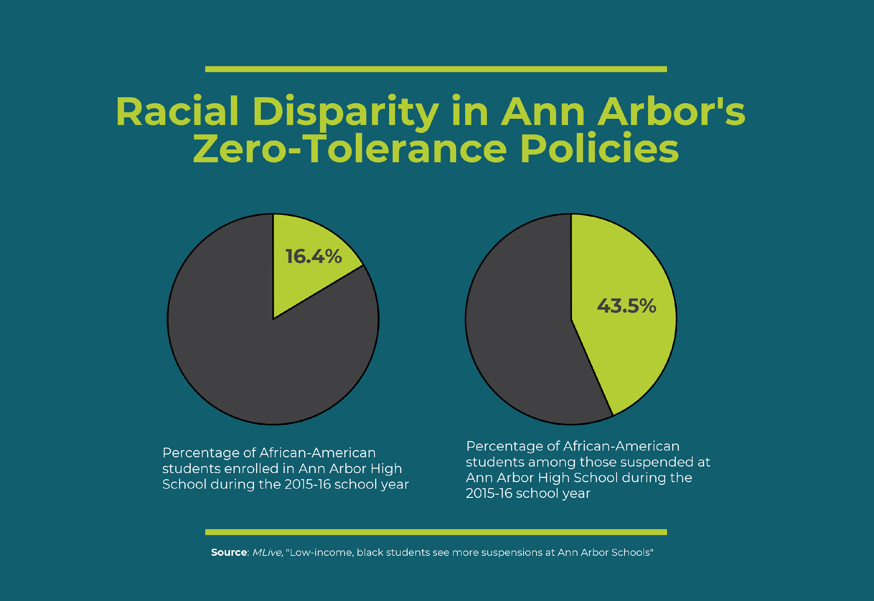
Racial Disparities of Discipline on Students of Color With Disabilities
Faith Yon
Durham School of the Arts
Introduction
Data Analysis
Results
Students of color with disabilities are being treated unfairly through disciplinary actions. 33-60% of students that get sent to correctional facilities and programs are students that are diagnosed with intellectual and emotional disabilities ( Bell) These actions acted on students of color with and without disabilities can affect them as a student and later on in life.
Research Question: How can school policies impact the rate of discipline among black adolescents and black students with disabilities?
Thesis Statement: Policies such as zero-tolerance can lead to long-term negative impacts on the mental and emotional health, and achievement levels of black students, and rising dropout rates.
Methodology: I did secondary research. Through Google scholar, I found journals and google books to find information on the school-to-prison pipeline, non-tolerance policy, and the disparities of discipline on students of color diagnosed with disabilities. I chose this topic because I've seen this inequity first hand and how black students have been treated unfairly.
Research from the ACLU, states that “Black students with disabilities are 3 times more likely to receive a short-term suspension than their white counterparts" (ACLU) Also, they are 4 times more likely to end up in a correctional facilities" (Citation). This issue can also be found at a local level. They found that Black students made up around 24.8% of students in North Carolina public schools, they received 54.9% of all short-term suspensions during the 2019-2020 school year (MacSuga- Gage et al.).
2013-14 U.S. Public school students suspended once or more by race, ethnicity, and disability status. (n.d.).
Students of color represent about 17% of students in public schools, however, they account for 34% of suspensions in public schools (MacSuga-Gage et al.). Students with disabilities represented 12% of the school population but accounted for about 26% suspended and 24% of students expelled, students with disabilities accounted for 28% of students referred to law enforcement, while black students accounted for 31% (MacSuga-Gage et al.). Among black students with disabilities, one out of four get suspended at least once a year (U.S. Department of Education Office for Civil Rights).
(Michigan Virtual, 2018)
Study showed that state laws that were requiring schools to have zero tolerance policies increased suspension rates for all students. Also, suspension rates increased at a higher rate for African-American students, potentially contributing to racial disparities in discipline (Curran ).
I found out that the discipline and rules set were highly unfair for students of color, and those who have learning and emotional disabilities. The non-tolerance rule on students of color, showed increases in suspension, expulsion, and dropouts (Hall & Karanxha 4).
Zero-tolerance policies make it hard for students to maintain good grades and a good mental health status. The policy sends students with "problematic" behavior to correctional programs and contributes to the school-to-prison pipeline.
The research that I found was that most of the students of color in the school-to-prison pipeline were black students dealing with disabilities, where their emotions were unstable and also had learning disabilities (Bell, 2016). I found that the students with disabilities had a higher chance of getting suspended compared to their white classmates that were not dealing with disabilities (Bell, 2016).
Research Gate stated that Zero tolerance policies implemented in public schools "is a pathway from school to jail for many youth of color deemed outcasts" (Hall & Karanxha 3)
Background
The zero-tolerance policies are a set of strict rules set where administrators don’t accept disturbances by using expulsion and suspensions as a punishment (Hall & Karanxka 3). The policy has substantially increased the expulsion of students of color and the upbringing of the school-to-prison pipeline and later incarceration.
The school-to-prison pipeline is a phenomenon which contains aggressive rules, increase in school security officers, and harsher punishments for schools in low socio-economic communities and students with emotional and intellectual disabilities (ACLU). The pipeline penalizes people who may grow to do future criminal activities and later incarceration. The school-to- prison pipeline usually contains at-risk and vulnerable kids (ACLU).
Some teachers and administrators are implicitly biased meaning that they have discretion usually with people of color, disability status, gender, and other characteristics (Rynders 462). This can be a reason why students of color with and without disabilities can suffer harsh discipline and treatment.
Conclusion
Students of color with and without disabilities get disciplined unfairly in schools, and most of the black students affected have disabilities. Many students drop out because of these policies, which can negatively affect their grades and emotional state. Zero-tolerance policies contribute to suspension, expulsion, and dropout rates for students of color and lead to the school-to-prison pipeline.

