Slide 1

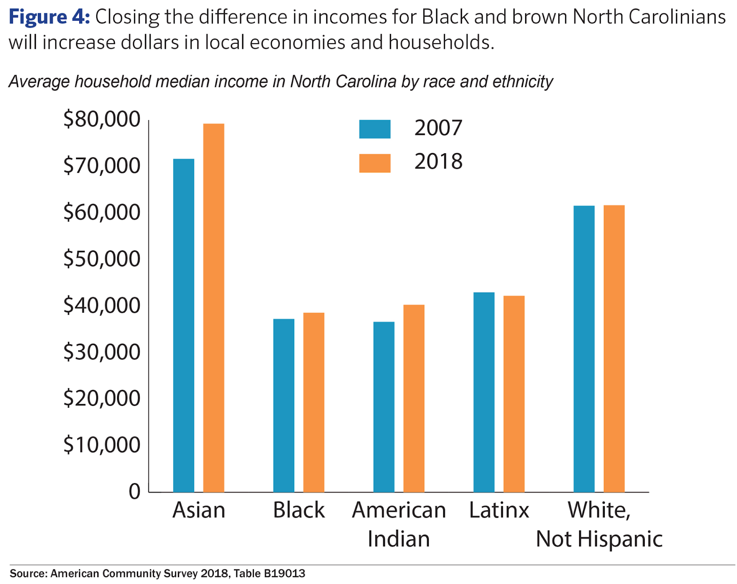
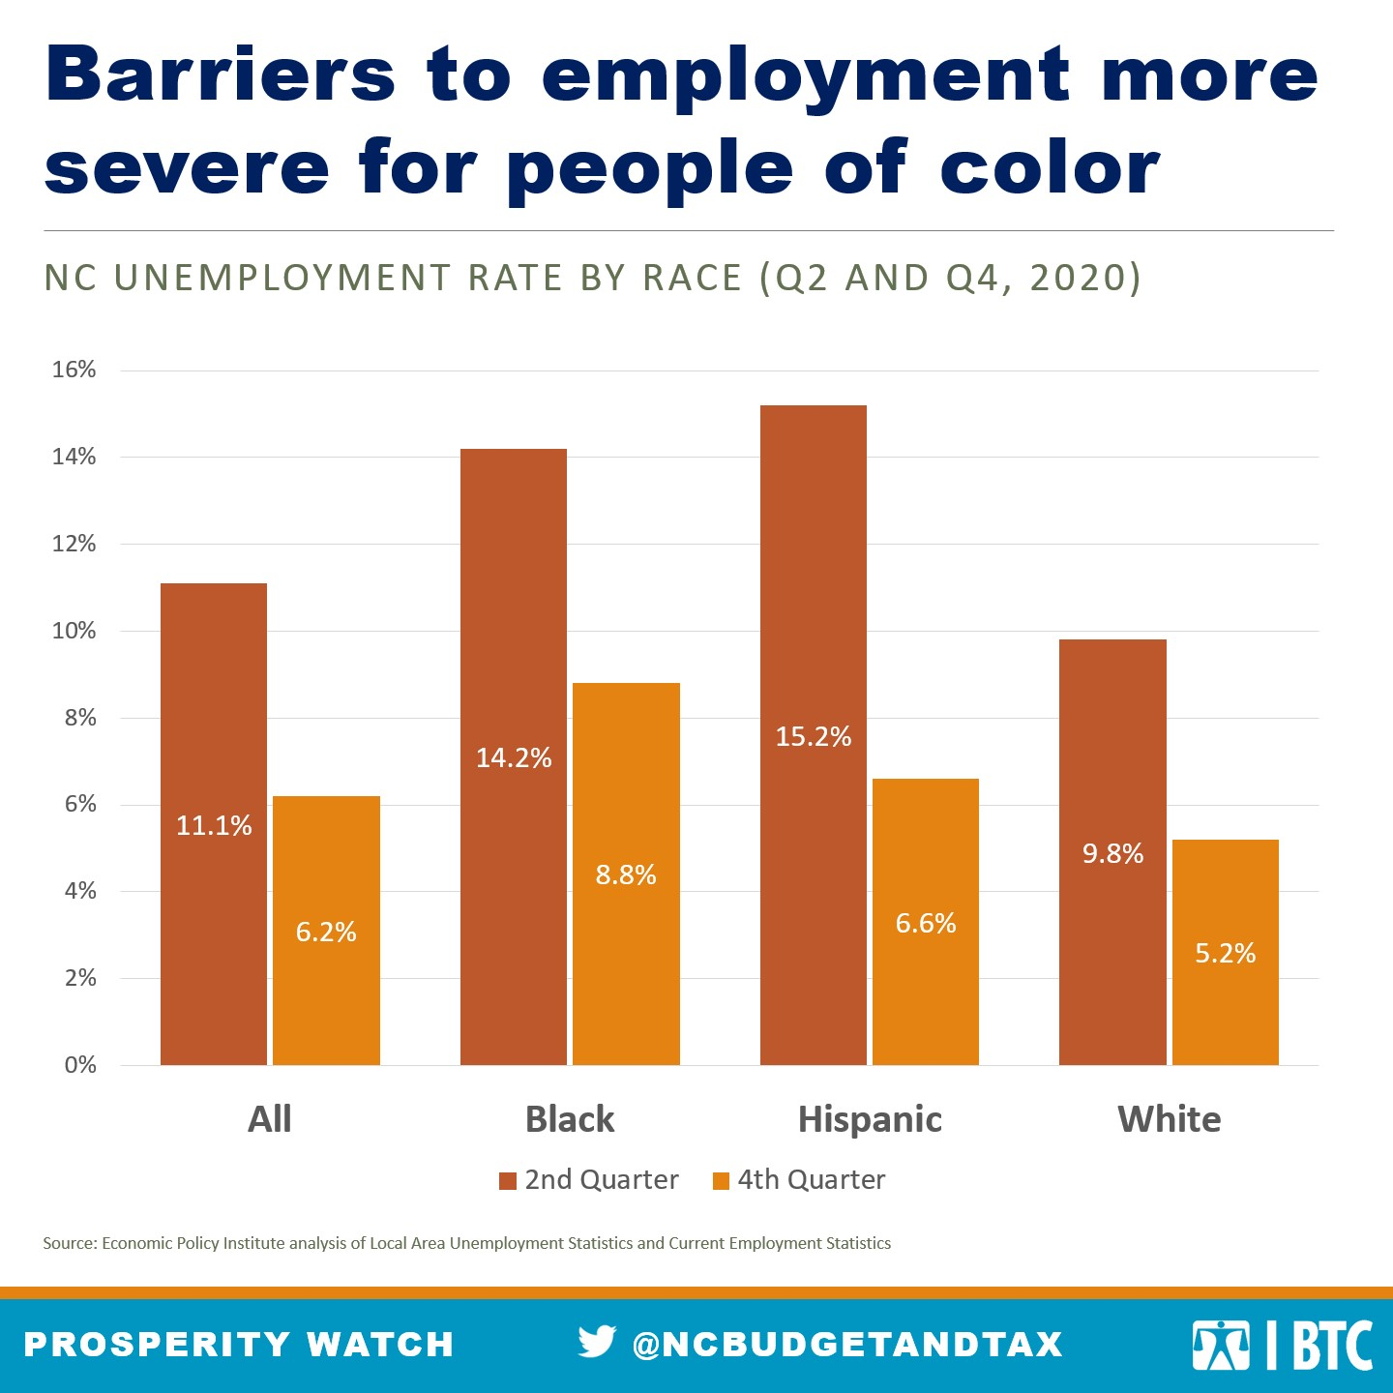
Income Inequality in North Carolina
Ethan Chandler
Research Triangle High School
Introduction
Data Analysis
Governmental policies and racial income inequality are major factors that contribute to the income wealth gap in the United States. The lack of access to education is also a key factor that promotes the racial income inequality.
Research Question
What factors contribute to the racial income gap in the United
States?
Thesis Statement
The racial income gap in North Carolina is largely due to government policies, unemployment, and level of education.
Methodology
I examined a variety of academic and policy-oriented sources to gain a broad understanding of income inequality in the United States. I focused on identifying factors that have contributed to income inequality. I reviewed a range of information from Harvard.edu, ProQuest, JSTOR, and Google Scholar to better understand the impact of these factors.
Government Policies and Racial income inequality
Income inequality is caused by federal, state, and local governmental tax policies and governmental regulations which neglect fair employment policies, and redistribution of wealth. According to Jacobs, “Public policies can and do shape the distribution of private income, and there seems little question that they are implicated in the rise in the inequality of private income.” (Jacobs,2007)
Income Inequality
Income inequality is how unevenly income is distributed throughout a population. “The average Black and Hispanic or Latino households earn about half as much as the average White household and own only about 15 to 20 percent as much net wealth.” (Forde,2021)
Education​
Another reason why there is a large wealth gap in North Carolina is mainly due to the lack of access to quality education. Investing in education and job training programs can also help people have the skills and knowledge they need to succeed in their jobs. While many factors contribute to income and wealth inequality, the role of education is a key piece of the puzzle. (Wolla,2017)
This chart is showing the average median income in North Carolina by race and ethnicity. Black households in 2007 (blue column) earned approximately $31,000. American Indians also earned a little over $30,000 and Hispanic or Latinx, earned a little over $40,000. Where as White earned $60,000 and Asians earned $70,000. As the chart conveys little has changed in 2018 (the orange column) for Blacks, American Indians, and Hispanics (Latinx)
Unemployment
This chart conveys that the unemployment rate in North Carolina was 14.2% for Black people, 15.2% for Latinos, and 9.8% for White people in 2020.
(McHugh, 2021)
Results
My research shows that income inequality is problematic in the
United States. Government policies that neglect fair employment
policies and redistribution of wealth which promotes income
inequality. Therefore, it is imperative to adopt equitable
governmental policies. In addition, the lack of access to quality
education and job training programs has had a huge effect on
the income of marginalized people of color. Research shows
that quality education is important to obtain income that is
suitable for the cost-of-living.
Background
Conclusion
In conclusion, income inequality is a growing problem that
threatens the fabric of our society. The growing gap
between the rich and the poor can lead to social unrest
and political instability. We must take steps to address
this issue and work towards creating a more equal
society. There are several ways that we can work
towards reducing income inequality. One approach is to
increase the minimum wage and ensure that workers are
paid a fair wage for their labor. Another approach is to
strengthen labor unions and give workers more power to
negotiate for better pay and benefits. Finally, we need to
reform our tax policies and government regulations to
ensure that they are fair and do not favor the wealthy
over the middle class and poor. By taking these steps,
we can work towards creating a more equal society that
benefits everyone. Additionally, implementing
progressive tax policies ensure that the wealthy pay their
fair share of taxes so that their money goes into funding
programs that benefit the poor and middle class.
Notes:
:D

