Slide 1

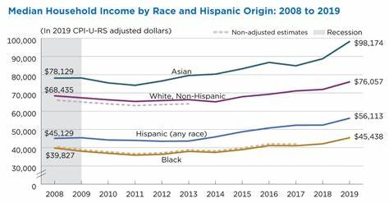
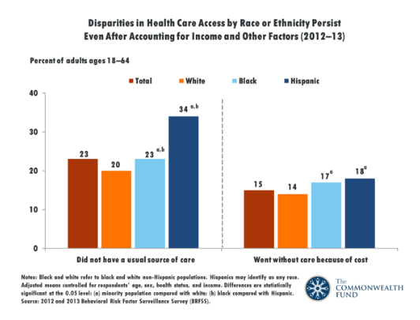
Wealth Is Health: How Racial Wealth Disparities Affect Access and Quality of Health Care
Chance Thomas
Hillside High School
Introduction
Data Analysis
Results
There is a correlation between the racial wealth gap and access to quality healthcare. Due to the financial gaps that persist in this country between Black and white families, Black families suffer from a lack of access to quality healthcare.
Research Question: How do the wealth disparities in the U.S affect the access to healthcare? ​
Thesis Statement: Black families in the U.S​
lack access to quality hospitals, employment with benefits, and experience racial bias among health professionals.​
Methodology: I chose this topic due to my interest in gaining knowledge about the access to healthcare in the United States. I conducted secondary research and used Google Scholar to obtain articles about wealth inequality and access to healthcare.
In racially segregated neighborhoods, African Americans are disproportionately likely to undergo surgery in low-quality hospitals, whereas in areas with low degrees of racial segregation, African Americans and Caucasians are likely to undergo surgery at low-quality hospitals at the same rate.
(Yearby, 2018)
Research has long indicated that poor persons and racial minorities are not viewed as desirable patients and health care providers deliver inferior care to low income patients.
(Williams, 2000)
Blacks and Latinos are more likely to have jobs that include core employer-provided benefits such as health coverage. Without these benefits black and Latino patients are subject to worse health outcomes.
(Sullivan, 2015)
Nearly one in three Hispanic Americans and one in five Black Americans were uninsured, compared to one in eight white Americans.
(Young, 2020)
Black people are more likely to work at low income jobs such as fast food & hosts. Studies say that low-income jobs pay too much to qualify for public assistance but pay too little to be able to afford private insurance policies leaving individuals and families to live without coverage.(Pew Research Center, 2016)
Background
Black and Latino families have lower incomes than White families. As of 2016, the typical white family makes $68,435 a year, while the typical black family has an annual income of only $39,827, the typical Latino family makes just $45,129. (Pew Research Center, 2016)
The net worth of Caucasian households was $144,200 in 2013, approximately 13 times the net worth of African American households
People of color
People of color in this poster refer to non-whites
Access to healthcare
The ability to obtain healthcare services such as prevention, diagnosis, treatment, and management of diseases, illness, disorders, and other health-impacting conditions.
Conclusion
In conclusion, compared to whites, people of color
have lower levels of access to medical care in the
United States. This is due to lower-paying jobs with
no benefits causing insufficient savings for
health as households tend to prioritize basic needs
such as food, water, and shelter, and clothing
leaving little space in their budget for health care.
Additionally, people of color are systematically
discriminated by health establishments as they are
seen as undesirable patients.
17% of Black Americans are
unable to afford or don’t have
access to health care.

