Slide 1

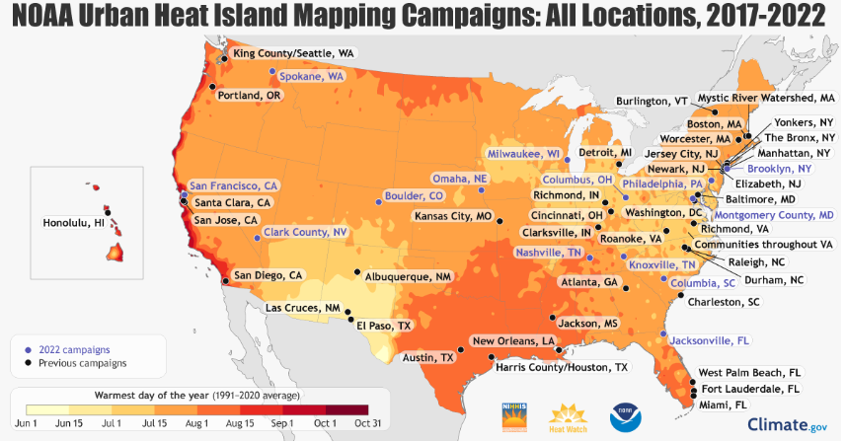
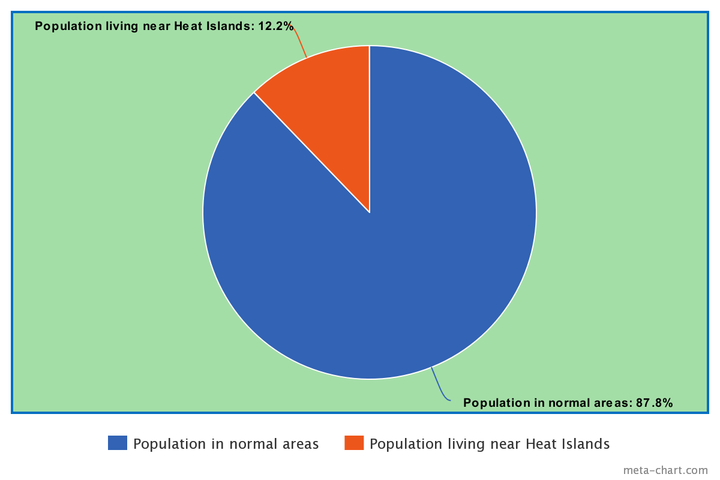
Heat Islands Been Fakin' Me Out: How Heat Islands Effect Low-Income Communities
Catalina Sanchez-Toloza
City of Medicine Academy
Introduction
Data Analysis
Results
A large portion of the US population, mainly low-income communities of color, reside in heat islands, which occur when the concrete, asphalt, and buildings absorb sunlight during the day and emit it at night, resulting in higher temperatures compared to other areas. This constant heat can have detrimental impacts on the physical and mental well-being of the individuals residing in these areas.
Research Question: How do heat islands in the US impact the physical and mental wellness of low-income families and minorities?
Thesis Statement: Heat islands occur at a higher rate in low-income communities of color and this can lead to health problems such as heat-related illnesses, respiratory difficulties, and fatalities.
Methodology: I selected this subject after learning about it
in class and realizing it is a significant issue in many areas
of Durham. Intrigued, I decided to delve deeper into the
topic to understand why it is such a major problem. To
conduct my research, I used Google Scholar and
government documents are available online. I came across
articles discussing heat islands, the correlation between heat
and fatalities, and the impact of heat islands on individuals'
physical and mental well-being.
Multiple studies have shown:
Evidence that low-income communities of color face significantly higher temperatures compared to wealthier and mostly non-minority areas. During heat events, this can lead to problems in physical and mental wellness (Heaviside 2017, Lazar 2022, Brenner 2023.).
High temperatures can cause dehydration, heat stroke, and respiratory problems, which mostly affect children, the elderly, and people with pre-existing health conditions. Exposure to heat for too long can also worsen air pollution, leading to respiratory issues such as asthma and allergies (“Durham County.” 2023, EPA 2023, Rodriguez 2023).
People in these conditions often face constant stress due to thermal discomfort, lack of appropriate cooling infrastructure, and worrying about extreme heat events, intensifying mental health issues. Constant exposure to urban heat can create anxiety, depression, and feelings of helplessness among the community (Huang2022).
Low-income communities of color often don’t have access to parks and green spaces, since they help keep areas cooler, which amplifies heat island intensity and restricts community engagement and outdoor activities (Lazar 2022, Pine 2023).
Cool infrastructure, such as air conditioning, tree cover, and reflective surfaces, is usually not available for everyone. This leaves people in low-income communities at a disadvantage and augments heat burdens (Lazar 2022, Pine 2023).
This map illustrates the average hottest days of the years 2017-2022. A total of 69 communities were carefully selected to participate in a program aimed at mapping heat islands across the entire United States. Through this initiative, it was discovered that certain communities can experience temperatures up to 20 degrees higher than their surrounding areas, which can be attributed to the heat island effect (EPA 2023).
Background
An urban heat island occurs when a city experiences much warmer temperatures than nearby rural areas. The difference in temperature between urban and less-developed rural areas has to do with how well the surfaces in each environment absorb and hold heat.
Urban heat islands are metropolitan areas that are hotter than their outlying regions, with the impacts felt most during summer months. About 85% of the U.S. population lives in metropolitan areas. Neighborhoods in a highly-developed city can experience peak temperatures that are 15°F to 20°F hotter than nearby areas with more trees and less pavement (Climate Central 2023).
A recent nationwide study found that 94% of formerly redlined areas, which remain mostly lower income communities of color, are exposed to higher temperatures than non-redlined, affluent areas. This is because these lower income communities typically lack green space and suffer most from urban heat islands (Bannin 2021).
Environmental justice is a movement that aims to tackle the unfair exposure of disadvantaged communities to harmful environmental factors, such as hazardous waste and resource extraction, without receiving any benefits. Environmental justice is based on the belief that all individuals, regardless of their race, color, national origin, or income, should receive fair and equal protection against environmental dangers and hazards.
Conclusion
In conclusion, individuals residing in heat islands may be adversely affected by the extreme heat, which can have detrimental effects on their mental and physical well-being. These heat islands have the potential to induce feelings of anxiety, depression, and despair when conditions become uncomfortable. Individuals residing in such circumstances experience persistent stress, which can significantly impact their mental well-being. Furthermore, heat islands can give rise to heat-related illnesses and respiratory problems, particularly among vulnerable groups such as children, the elderly, and individuals with pre-existing health conditions. If left unaddressed, it is likely that heat islands will worsen, leading to increased mortality rates and heat-related ailments. Implementing certain measures, such as increasing tree coverage in barren areas, creating green spaces, adopting lighter roof colors, installing cool roofs, and utilizing titanium dioxide spray on roads to reflect sunlight instead of absorbing it. Heat islands and who they affect the most is an environmental justice issue that we need to work on (Pine 2023). By taking measures to eliminate heat islands, we are also working towards promoting environmental justice. It is not fair to let a certain group of individuals suffer from extreme heat simply because they reside in low-income regions, don't you agree?
I created this graph by determining the number of individuals residing in or near heat islands and comparing it to the total population of the United States. I used data provided by the US Census, which estimates that the US population is at about 334,233,854 people in 2023. Other sources (Climate Central 2023) indicate that approximately 41 million individuals live in or near heat islands in the US. By conducting calculations based on this information, I estimate that approximately 12.2% of the US population resides in these heat island areas.

