Slide 1
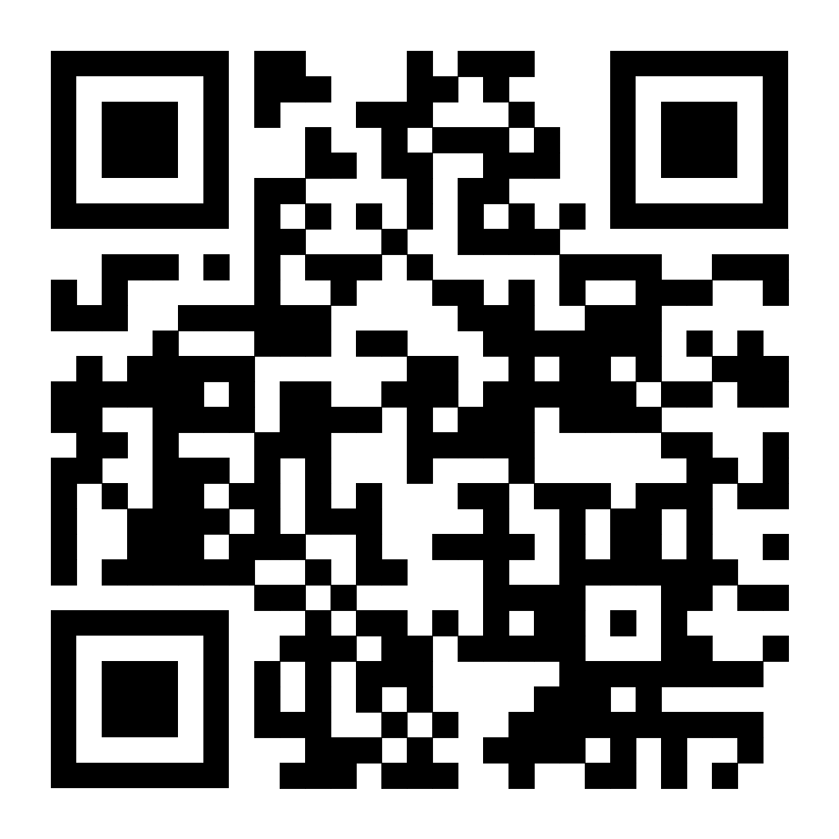
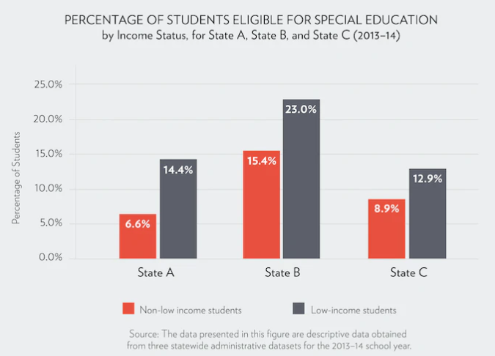
Money Over Mind: How Family Income Determines Learning Disorder Diagnosis & Treatment
Camille Vereen
J.D. Clement Early College High School
Introduction
Data Analysis
Results
Learning disabilities affect 1 in 10 American children. While low-income students are far more likely to be diagnosed with a disability, the lack of treatment and stigmas around diagnosis can lead to poor academic achievement.
Research Question: How does family socioeconomic status affect the early detection and treatment of students with learning disorders?
Thesis Statement: Students of lower socioeconomic status experience higher rates of diagnosis of learning disorders; however, those diagnoses do not translate to adequate treatment and can also lead to stigmatization and lower academic expectations.
Methodology: I chose to research the effect of socio economics on learning disabilities because of my peers' and my own journeys navigating the school system with these disabilities. The sources I have used to create this project are Google Scholar, DPS Statics and Duke Libraries. The source the I found most helpful was Google Scholar.
Income Level & Learning Disabilities
According to the National Survey of Children's Health children living below the federal poverty line are more than twice as likely to be identified with specific learning disabilities (SLD).
Living with a learning disability like ADHD poses a significant economic burden. A recent study estimated the cost of raising a child with ADHD over a 12-year period to be $15,036, not including direct treatment and/or medication. (Barkley, 2020)
(In)adequate Treatment
Students from low-income backgrounds are more likely to be placed in special education settings, and research shows that students placed in "substantially separate" settings have worse academic outcomes than their peers. (Schifter, 2019)
Stigma Around Learning Disability Diagnosis
Low-income students are more likely to be identified as needing special education settings than their higher income peers. While the reasons for this are not fully known, researchers said that behavior issues or lacking certain skills can be misdiagnosed as a learning disability. (Tatter, 2019) Even if students are not assigned to special education settings, they can be passed over for gifted programs due to their IQ test scores and other factors. (Baum, 2023)
Based on my research, many people are either falsely diagnosed with learning disorders or are not diagnosed at all.
Lower-income students are affected the most, due to the higher rate of early detection (Tatter, 2019)
Children of lower income families who have learning disorders have a lower possibility of getting adequate treatment for these learning disorders.
Students of lower-income households are also affected because of the lack of proper testing for learning disorders. (Ferguson, 2007)
Some students may be falsely diagnosed. More financially affluent students are affected by their income status because the rate of diagnosis is lower in their communities. If a student has a learning disability it could be masked with access to more. (Ferguson. 2007)
Background
Learning Disorder (LD) - A disability that affects the acquisition of knowledge or skills, in particular any of various neurodevelopmental conditions affecting the learning and use of specific academic skills such as reading, writing, or mathematics
Neurodevelopmental - Categories of disorders that affect neurological development and brain function, impairing social, cognitive, and emotional functioning.
Most common learning disabilities in the US are Dyslexia, ADHD, Dyscalculia, Dyscalculia, Dyspraxia
Socio Economic - Students of lower income may not have access to testing or may not get the treatment to help with the disorder.
Research shows that 8 to 10 percent of American children under 18 years of age have some type of learning disability.
75% – 80% of special education students identified as LD have basic deficits in language and reading.
60% of adults with severe literacy problems have undetected or untreated learning disabilities
Conclusion
To conclude my research shows that there is a
positive correlation between lower-income students
and the likelihood of being diagnosed with a learning
disability. These diagnoses, while meant to be helpful,
can be expensive to manage, be treated inadequately, and lead to stigmas and lower academic expectations.
Recommendations
To close learning gaps for students with learning disabilities, researchers recommend that school districts increase the capacity of teachers to support all learners, spend federal funds from programs like ESSA (Every Student Succeeds Act) to work with students in need, and partner with families to make sure students get support both at school and at home. (Schifter, 2019)
(Schifter, 2019)

