Slide 1

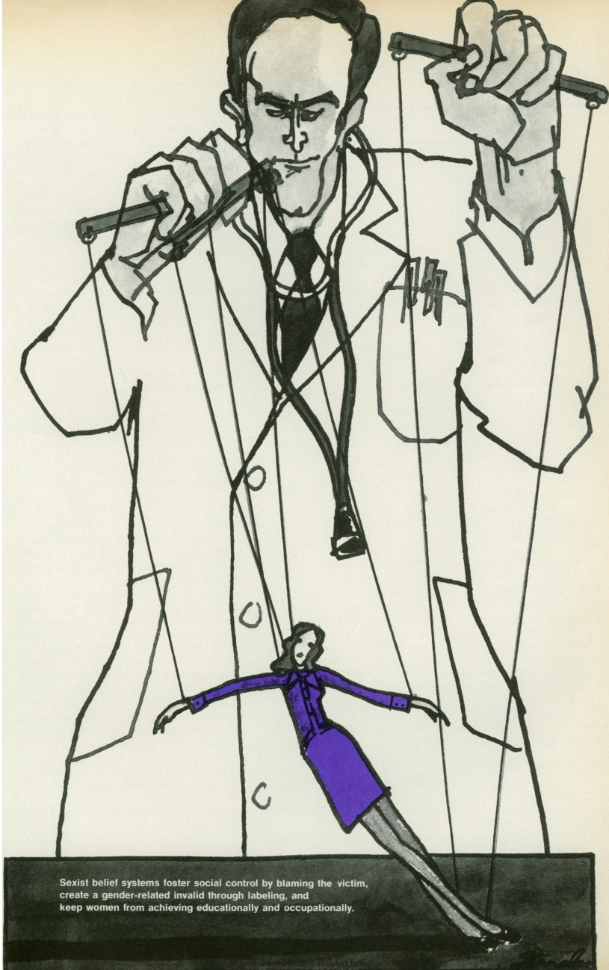
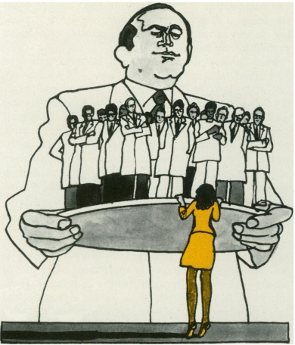
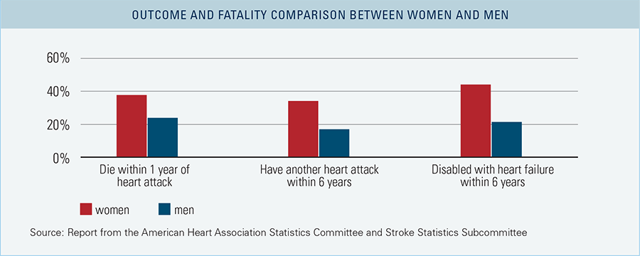


Gender Bias And Women's Health
Camila Lamas Suarez
Northern High School
Introduction
Data Analysis
Findings
Historical gender bias in healthcare has led to poorer health outcomes for women than men. The 1985 US Public Health Service Task Force report warned that “the lack of research focus on women's health concerns had compromised the healthcare quality available to women”. The contemporary belief of gender roles worsens this inequality, which perpetuates gender discrepancies in healthcare that need to be recognized, addressed, and prioritized to create an equitable system.
Research Question
What is the impact of historical gender bias in medicine on women's health outcomes?
Thesis Statement
The historical and ongoing gender bias in the medical field has significantly affected women's health outcomes, perpetuating health disparities and hindering progress toward fair healthcare.
Key terms: Gender bias, gender roles, women's health outcomes, disparities, implicit bias, stereotype, prejudice, health equity.
Misrepresentation in research:
A 1986 pilot study at Rockefeller University looked at how obesity affected breast and uterine cancer. Did not enroll any women.
The Physicians Health study from 1982 analyzed the effect of daily aspirins on heart disease evaluated 22, 071 men and zero women.
The Baltimore Longitudinal Study researching “normal human aging” did not include women for 20 years.
A Harvard School of Public Health study investigating the possible link between caffeine consumption and heart disease involved over 45,000 men and no women. (Laurence, 1994)
A 2011 Australian study conducted during 2009 found out that there was clear gender bias in eight out of ten disciplines in medical and biomedical research done in mammals, with neuroscience being the most predominantly biased. It also found out that studies done in male animals outnumbered those on female by 5.5 to 1. (McCullough, 2014)
The historical dominance of men in medicine has systematically excluded women
from the field, leading to health outcomes for women lagging compared to men and a
lack of access to healthcare. Gender-based biases in research, diagnoses, and
treatments have also emerged as a result of women’s lack of representation in the
field. Contemporary beliefs of gender roles, such as women as caregivers and
emotional, have encouraged physicians to view women's health concerns as less
important, leading to underdiagnosis and mistreatment. Furthermore, historical
experimentation and cruel medical treatments have contributed to the mistrust and
suspicion of the healthcare system among women, leading to women avoiding
medical care altogether, afraid of systematic mistreatment.
Solutions
Increase representation of women in healthcare leadership and decision-making roles
Address unconscious bias in medical education
Implement culturally competent care
Increase access to reproductive healthcare
Conduct research on women's health
Implement policies to prevent gender discrimination
Encouraging women’s participation in clinical trials and research
Background
Biological differences:
A 2022 article from Cambridge discusses the potential bias in the diagnosis of autism spectrum disorder (ASD) and other psychiatric conditions, because the diagnostic criteria is likely being tailored to the typical male presentations of the disorder, leading to an under-recognition of ASD among females.(Dell’Osso, 2023)
A 2018 study at Alicante University General Hospital explored the gender-specific diagnostic delay in spondylarthritis and analyzed whether the delay depends on the patients' clinical manifestations or a potential misdiagnosis bias by doctors. The study involved 96 men and 54 women with spondylarthritis, and the findings showed that women had a longer diagnostic delay of 7.5 years compared to men with a 4 years delay, and a higher probability of misdiagnosis. Patients’ self-reported manifestations and medical records also showed more axial pain reported in men and more peripheral pain in women. (Jovani, 2018)
A 2017 Scandinavian study found that women with paroxysmal supraventricular tachycardia (PSVT) had a longer history of symptomatic arrhythmia before ablation compared to men. This symptom is more often incorrectly interpreted in women as anxiety, stress, panic attacks, or depression compared to men, delaying referral for ablation. It additionally shows that women also had more symptoms after ablation than men. (Carnlof, 2017)
A 2010 Netherlands scientific article states that "cardiovascular disease develops 7-10 years later in women than men and is still the major cause of death for women". The paper also discusses the gender difference in coronary heart disease and highlights how the under recognition of heart disease and differences in clinical presentation in women lead to lower representation of women in clinical trials. (Maas, 2010)
Cruel/Harmful/Unethical treatments, procedures and experimentation:
Forced sterilization (Fujimoto, 2006)
Forced hysterectomies (Namdan,1994)
Birth control trials (Delgado, 2014)
Hysteria treatments (Potenza, 2018)
Obstetric violence (Farah, 2016)
Drug testing
Diseases development (Saidel, 2006)
Methodology
Literature Review: The study conducted a comprehensive literature review drawing on research papers and articles seeking to analyze existing data. The review was guided by the research question and will look to find key themes and gaps in the literature on the impact of historical gender bias in medicine on women's health outcomes.
Synthesis and Interpretation: The study synthesized the qualitative and quantitative data to develop an overall understanding of the impact of historical gender bias in medicine on women's health outcomes. The findings was interpreted considering the study's social constructivist ontology and interpretivist epistemology. Results will be presented with the consideration of the limitations and biases
Sexism in medicine by Richard Levinson, The American Journal of Nursing , Mar.,
1976, Vol. 76, No. 3 (Mar., 1976), pp. 426-431
Conclusion
In conclusion, historical gender biases in medicine continue to significantly affect
women’s health outcomes, perpetuating healthcare disparities. However, a
multipronged solution that includes increasing representation in the field, education
on gender-based biases, and addressing historical and ongoing systemic
mistreatments, could significantly improve women's health outcomes and healthcare
equality.
Report from the American Heart Association Statistics Committee and Stroke Statistics Subcommittee, 2015

