Slide 1

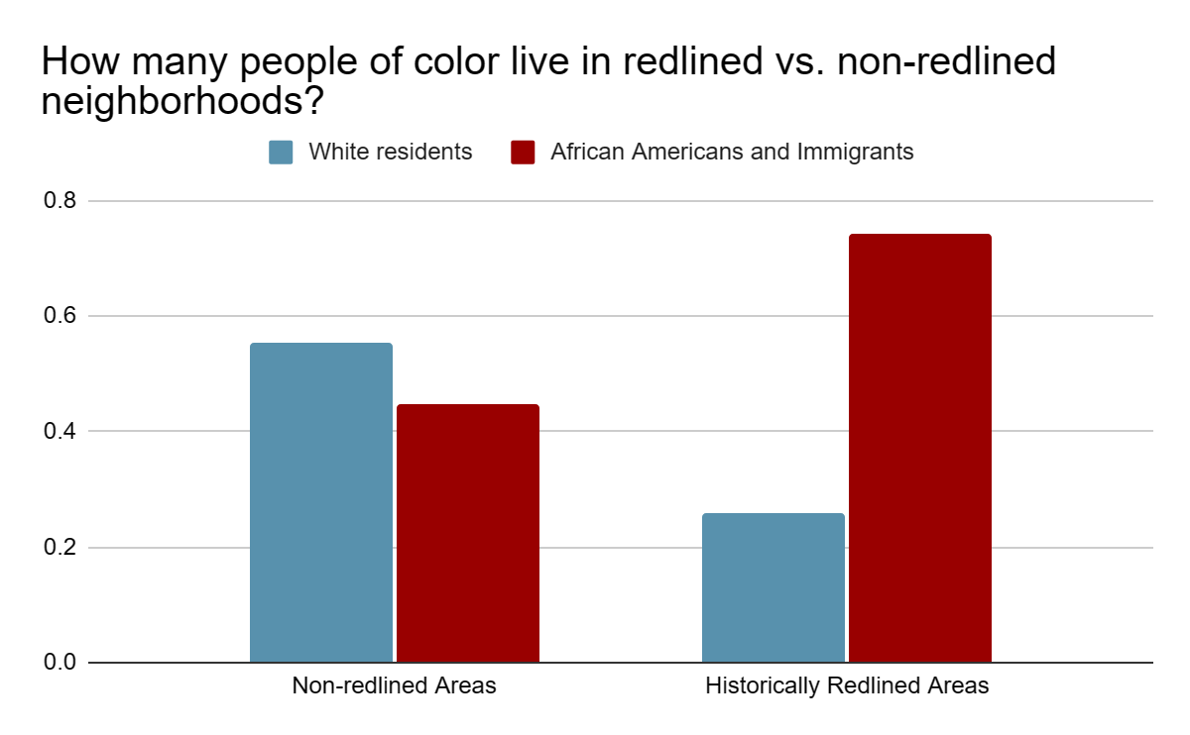
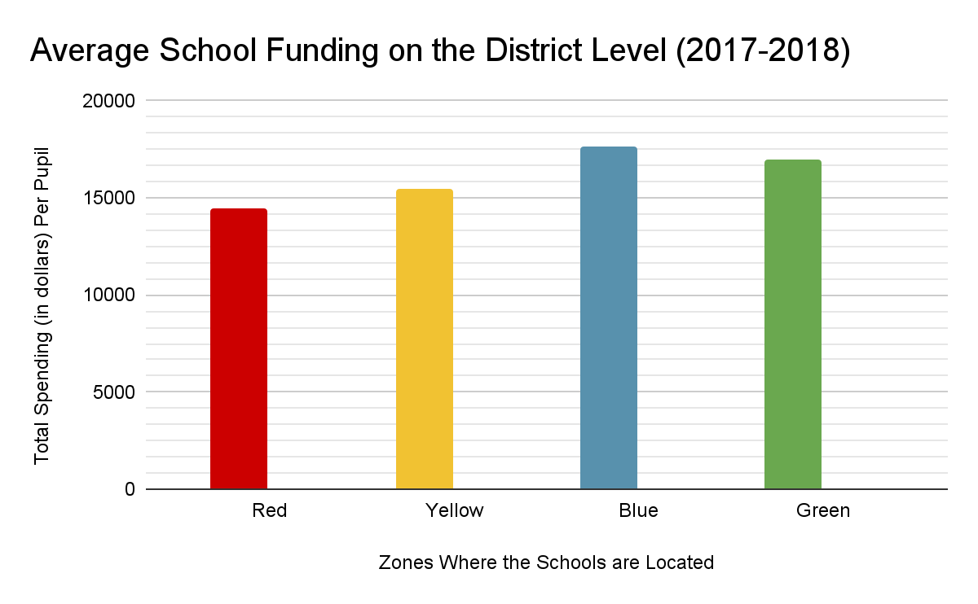
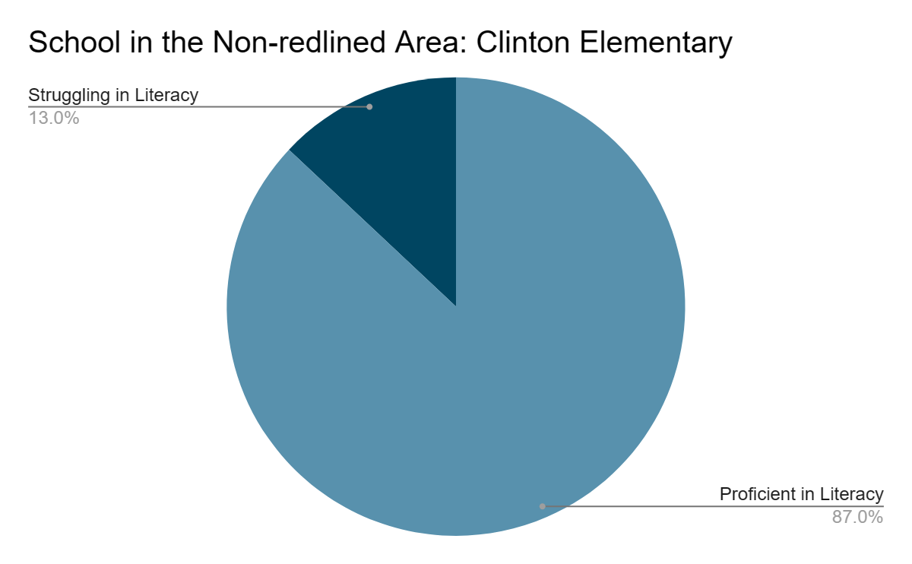
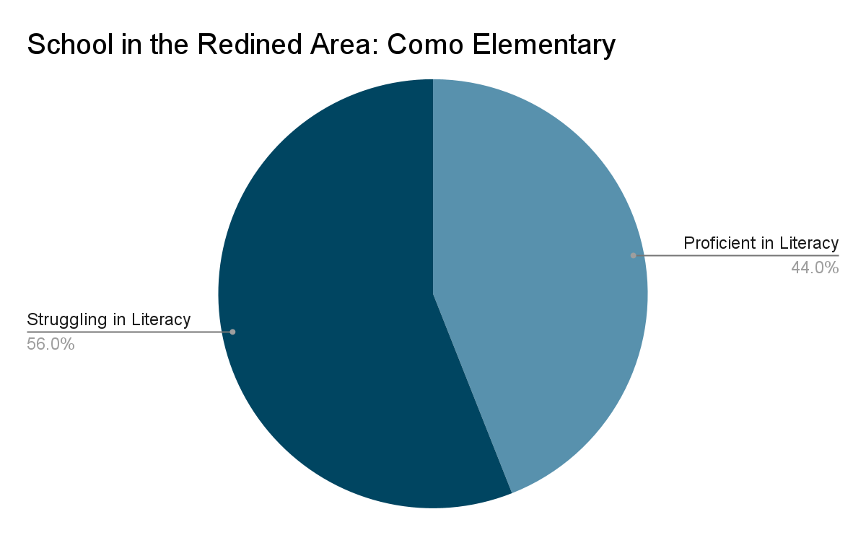
Consequences of Redlining: Access to Education and Racial Demographics Today
Avery Patterson
C.E. Jordan High School
Introduction
Data Analysis
Redlining is defined as “the practice of ranking neighborhoods as hazardous and credit-unworthy” (Swope, et al., 2022). It often involved labeling the communities from A to D; D being the most “hazardous” and A being the “least hazardous.” The practice originated during the great depression as an attempt by housing associations to stabilize the economy and housing market after the Great Depression.
Research Question:
To what extent does redlining affect the academic resources and racial demographics in communities?
Thesis Statement:
Historical redlining has impacted the academic resources and racial demographics by restricting school funding, using calculated school zoning, and perpetuating segregation in neighborhoods.
Methodology:
This poster was conducted as a literary review. I used Google Scholar for all my sources. I struggled to find specific statistics about the link between overall school grades/test scores and redlining. However, there is an explicit connection between higher literacy scores and non-redlined areas, so the impact of getting sufficient reading resources is inferred. Most of the statistics I found were state specific, and it was challenging to find actual statistics about the general American population. However, several scholars addressed that the issues I identified were consistent across the country. My purpose is to educate the general American audience, specifically African Americans, about the impact of systemic racism, and to serve as an explanation between the racial wealth gap.
(Shkembi, et al., 2022)
This data from the City of Detroit, shows that the segregation caused by redlining, is still evident in US communities today.
(Cleveland & Lukes, 2022)
The significant difference between the average district spending per pupil in schools located in red and blue neighborhoods is $2,485.
Results
I found that redlining has a direct link to a lack of access in education because “property tax represents a primary source of funding disparities between [school] districts” (Bowling, et al., 2019). For that reason, previously redlined areas, likely to be poorer communities, receive limited district funding. This can have an impact on the educational resources, like technology and textbooks, available to the students in those communities. Consequently, schools that are located on historically redlined land are more likely to struggle with important skills, like literacy. Struggles in this essential skill can affect a student’s probability of receiving and being successful in higher education. Finally, despite redlining having roots in the early 20th century, it is also an indicator of the racial makeup of communities today. It Illustrates that historically redlined areas, are more likely to be made up of black and brown people today.
Background
Conclusion
After the Great Depression, housing associations began using redlining to restrict African Americans from living in the wealthy areas and perpetuating segregated neighborhoods. The result: a massive wealth gap between black and white communities. Although this subject is often looked at through a historical lens, the ramifications of redlining are apparent today. “For example, children who grew up in D-graded neighborhoods had about an 11 percent chance of reaching the top income quintile while the comparable statistic for children who grew up in A-graded neighborhoods is 23 percent” (Aronson, 2020). Meaning, the consequences from living in lower-income communities can have a significant impact on the individual’s future.
The consequences of historical redlining are visible in many aspects of everyday life. Specifically, the ramifications serve as an explanation of the racial wealth gap in the United States, educational achievement gap, and the continued segregation of neighborhoods today. My data analysis can be used by local, state, and federal government officials when they are considering new school zoning laws. Specifically, school zoning laws aimed to give black and brown students access to quality education. In addition, my analysis could be used as a call to action for legislation that acknowledges the historical housing practices that have historically denied black and brown people access to housing and resources.
“In Columbus, Ohio, two elementary schools — Clinton Elementary and Como Elementary — are just over a mile apart. Clinton Elementary students perform very well, with 87 percent proficient in reading. At Como Elementary, however, that figure falls to 44 percent. Due to school attendance zones, if a child lives east of I-71, they would attend Como Elementary. A child living further west would attend Clinton Elementary” (Burke & Schwalbach, 2021).

