Slide 1
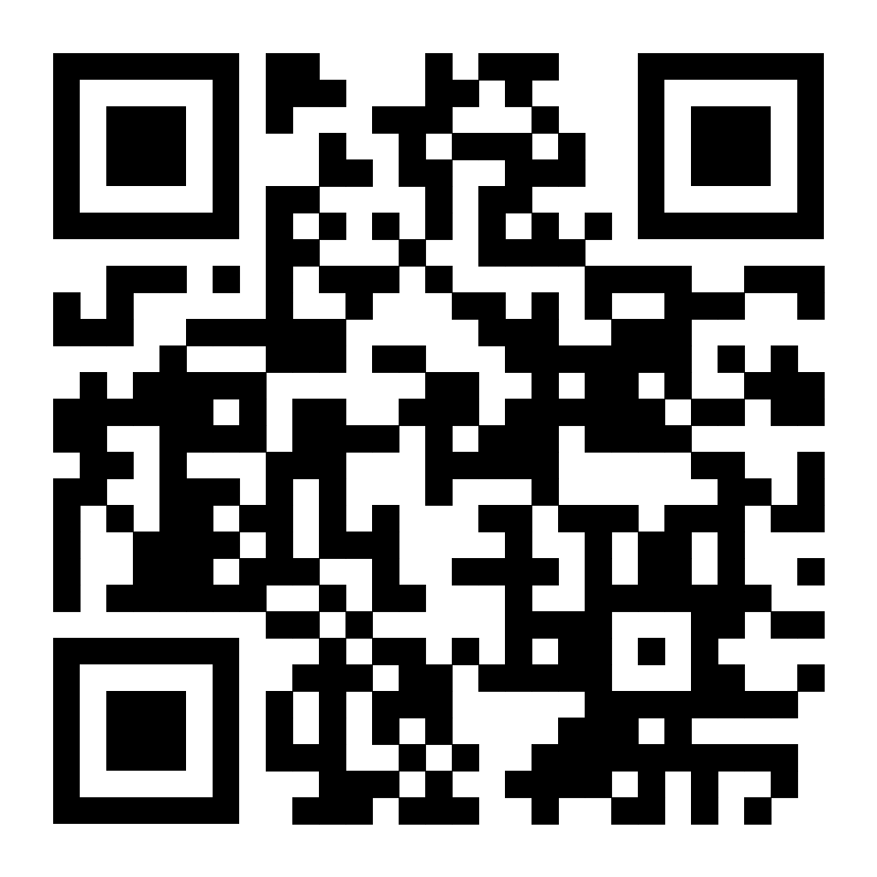
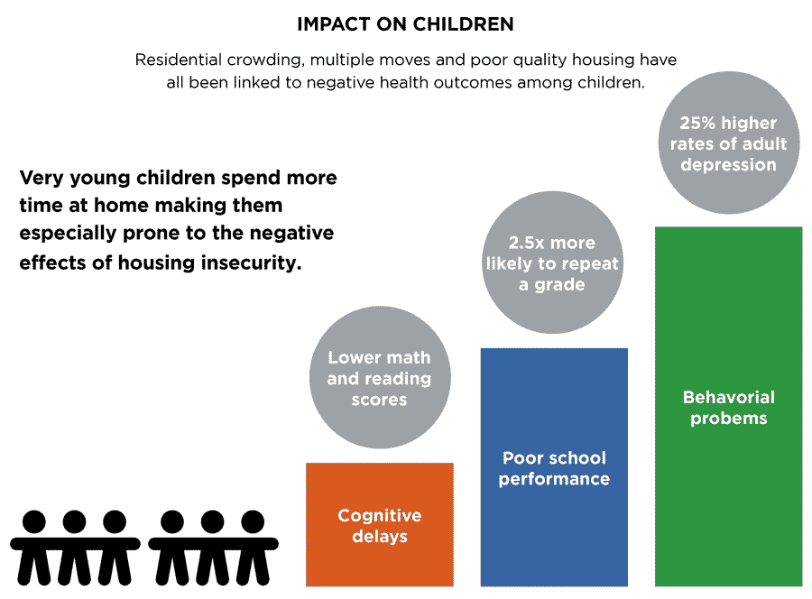
The Unspoken Facts: Adolescent Mental and Academic Progression due to Public Housing
Ashli Rose
C.E Jordan High
Introduction
Trauma: Trauma can be associated as a psychiatric condition known as posttraumatic stress disorder (PTSD) is brought on by experiencing or seeing severe or life-threatening situations. Significant psychobiological correlates of PTSD exist, and if untreated, they can have crippling effects on an adolescent quality of life.
Adolescence: Adolescence, which is defined as the period between the ages of 10 and 19, is a crucial time when fast changes in health, social development, and well-being have significant and long-lasting effects on people's opportunities and life progressions, as well as how they impact their communities and the following generation.
School Shuffle: Dr. Charles Beeker stated in 2011 that a child's risk of repeating a grade increases by a factor of 2.5 after more than two school changes during elementary school as a result of a move to a new home. A teen who changes schools has a 50% increased likelihood of not completing high school.
According to the Department of Health and Human Services, behavioral issues, poor mental health, being unable to handle stress and bad academic performance are all common with adolescents living in public housing.
The Homeownership and Opportunity for People Everywhere (HOPE) states that adolescents who switch schools due to change of public housing, have a 50% higher chance of not finishing high school.
African-American kids who encounter a “constellation” of neighborhood-level dangers, such as drug and gang activity and violence, have rising rates of PTSD symptoms, according to research. This also results in the active crime that occurs in public housing neighborhoods. Journal racial ethic group health disparities states exposure to community violence is linked to PTSD clinical diagnoses and increased risk for PTSD symptoms in these young people.
According to research, young people who live in unstable housing are more likely to face a range of negative physical, emotional, developmental, and behavioral impacts.
According to Von E. Nebbitt, the majority of adolescents who moved into public housing mature faster than adolescents being raised in public housing. It’s stated that this only happens when an adolescent realizes the dramatic change in their lifestyle.
The government provides public housing for persons who cannot afford private housing. Adolescents in school can be distracted by the environments surrounding such regions, which can have a severe impact on their mental health and academic development.
Research Question: How does public housing affect the mental health and academic performance of adolescents?
Thesis: Due to a lack of proper resources, adolescents raised in public housing require greater academic and mental support, battle with traumatic effects of crime, and at a young age must assume more responsibility at a young age than their peers.
Methodology: I used Google Scholar for all my research. I wanted to research this because environmental health risks associated with inadequate living conditions can be particularly dangerous for growing children and adolescents. Children and teenagers are at risk for developing long-term health issues because of these dangers. Also mentioning that growing up in “poverty” can deeply affect the mental and academic process of many adolescents.
(Von E. Nebbitt. 2016)
This research continues to increase our understanding of the impacts of living in public housing, leaving public housing, and moving to a new neighborhood on youth risk behaviors, such as general crime/delinquency, substance use, sexual risk behavior, behavioral issues, and binge drinking.
This study also shows four themes are used to by adolescent living in public housing: stress, drug abuse, trauma, and mental health.
These findings emphasize the need for mental and academic support for young people who have been relocated into public housing, or have been raised there.
Public housing: The "housing of last resort" in the country is now public housing. In accordance with federal education law, children and teens that live in public housing are those "who lack a fixed, regular, and adequate nighttime residence." The term covers people who live in government housing with other households due to financial difficulties. Public money is used to provide low-income individuals with homes, but also has low security mechanisms, high crime rates, etc
Adolescent mental health: Adolescent mental state in which mental function is successfully carried out, leading to useful tasks, satisfying relationships with others, and the capacity to adjust to change and deal with adversity, which is harder to accomplish when living in poverty. Struggling with hormonal emotions. Undiagnosed mental disorders
Data Analysis
Background
Results
In conclusion, adolescents experience a variety of things that
have an impact on their daily lives. traumatic experiences, drug
  usage, scholastic difficulty, and a lack of familiarity with certain subjects are a few examples. In public housing, there is an opportunity gap for adolescents, which encourages them to engage in distractions.
Conclusion
Notes:
Hi my names ashli, im a rising senior at Jordan high school. I decided to research
How adolescents that grow up in public housing are affected mentally and
Academically. Through my childhood there was a season where I went to a different school every year,
and that gave me the experience of different socioeconomic groups. Out of every group I was in, the one
That stood out to me the most was the lower class. I saw how kids under the age of 13 had to carry thereself,
And navigate through life because of where and how they were raised. I soon met a set of twins that lived in
Macdougal terrace. While getting to know them I soon realized that they were the smartest people I know but they didn’t know
How to apply that knowledge in school. After getting pretty close to them I saw that they had bigger responsibilities
At there home. They couldn’t fully focus on school because they had younger sliblings to take care of, and were worried about there living.
One of the things they continued to come to be about was how I got to be a “stress free” kid. At the time I would laugh it off and continue to ask what they meant. They further explained it and summed it up to not having any support in and out of school. 62% of kids in public housing aren’t givin the opportunity to seek help and have the support they need to balance school and home life.

