Slide 1
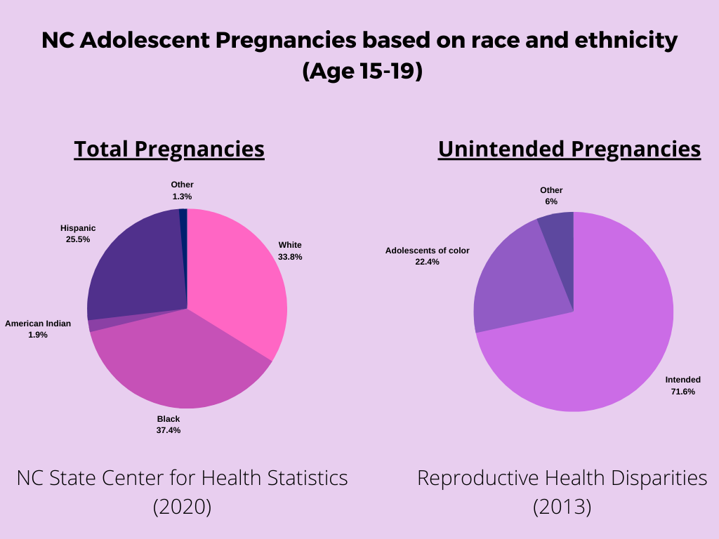
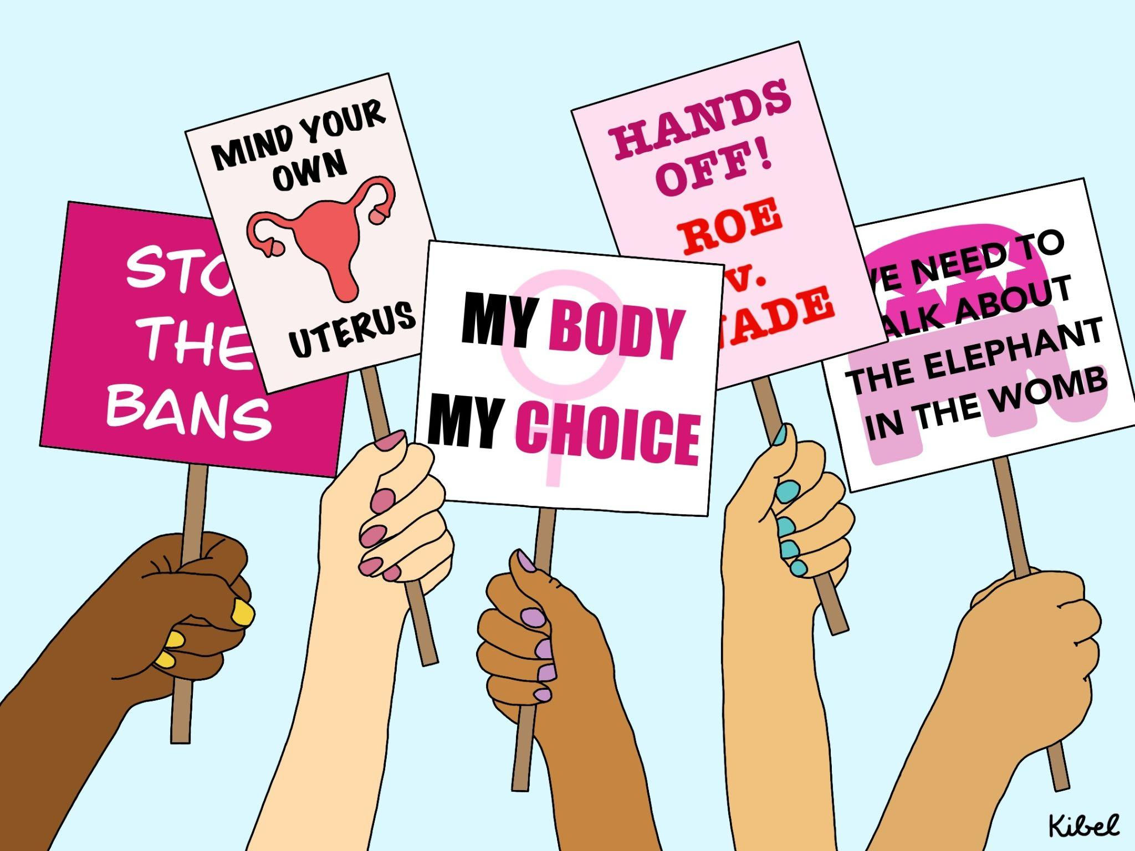
The Impact of Restrictive Abortion laws for Low-Income Adolescents of Color
Ashely Romero-Love | Durham School of the Arts | 11th Grade
Introduction
Since “race” is a societal aspect that determines what opportunities are open to a person, most people of color are likely to get discriminated against which can impact their income and educational opportunities. As a result adolescents of color are most likely to be on the poverty line.
Data
Roe v. Wade (1972) ruled that restrictive abortion laws in states are unconstitutional because they violated women’s constitutional rights to privacy. In Planned Parenthood of Southeastern Pennsylvania v. Casey (1992) established that restricting abortion rights are unconstitutional if they place an “undue burden” on a woman seeking an abortion before the fetus is viable. On June 24, 2022 the U.S Supreme Court overturned Roe v. Wade and Planned Parenthood of Southeastern Pennsylvania v. Casey, which pressures state government to maintain the legalization of abortion or remove women’s constitutional right to obtain an abortion in their state. Texas, Wyoming, Tennessee, Kentucky, Arkansas, Louisiana, Mississippi, North Dakota, South Dakota, Utah, Idaho, Oklahoma, and Missouri automatically illegalized abortion rights when the supreme court declared abortions unconstitutional. My question throughout my research was, “How will restrictive abortion laws impact low-income adolescents of color’s health and financial stability?”
The chart shows that more than half of pregnant adolescents in 2020 were people of color. Over 28% of pregnancies in 2013 were unintended,
What are the Impacts?
Restrictive abortion laws are already having impacts on maternal and pediatric healthcare. Dr. Judette Louis told CNN that she had to ask permission in order for a mother to get an abortion procedure performed. While she was asking permission the mothers blood pressure was dropping. She said: “I was standing there watching her hemorrhage out, waiting for permission to do the termination. It is a disgusting [and] sad feeling. And you’re sitting there watching her blood pressure going down while you’re waiting for permission.” There was another case when a parent had to take their 10 year old daughter, who got pregnant from rape, out of state in order for her to get a safe abortion. In 2018 there was a recorded number of 318 pregnancies resulting from rape. Rape puts a lot of psychological and physical harm to the surviver. Brazil has a “guarantee of legal abortion [for rape victims which] allows the [abortion] procedure to be performed under safe conditions, without women having to be exposed to high-risk situations that can jeopardize their health and even result in their death.” (Acceso de aborto en Brasil). Countries that have anti-abortion laws pressure women to hide their pregnancy and get unsafe abortion. Those who have unsafe abortions can be impacted with short and long term health consequences: “infections, bleeding, trauma to the genital tract, septic shock, renal failure, perforation of the intestines and peritonitis, chronic pain, inflammation of the reproductive tract and pelvic inflammatory disease” (Unsafe abortion).
and over 22% of those unintended were adolescents of color. If the data in 2013 were true in 2020 that would
mean that adolescents of color will have twice the risk of unintended pregnancy and twice the risk on relying on unsafe abortion than white adolescents.
Conclusion
Defining the Problem
Low-income adolescent women who live in the states where abortion is illegal will have a hard time finding a way to get a safe abortion. They will most likely turn to unsafe abortion, which can have negative health consequences and result to death. They don’t have the financial stability to provide for themselves, so they won’t be able to provide for a child, have the money to pay hospital bills after childbirth, or travel to get a safe abortion. When are they going to see and realize the harm they are doing to women, and the mistake for throwing away over 50 years of abortion rights precedent? Possible solutions to this problem is advocating for abortion rights by politically voicing your opinions, and help provide women with safe health procedures. You can also support organizations like Planned Parenthood, National Black Women's Reproductive Agenda, and National Latina Institute for Reproductive Justice.
Adolescents, ages 10-19, are still developing mentally and physically. Pregnancy and childbirth can put a lot of psychological and physical stress to the adolescent mother. Low-income adolescent of color will have an increase risk of deaths and illnesses than a wealthy white adult woman. Low-income adolescent of color won’t be able to provide the healthy living environment that a child needs, can die due to childbirth, and have an increase risk of illness. (American Psychological) “Minority women and adolescent females of all races and ethnicities are disproportionately affected by unintended pregnancy in the United States.” (Reproductive Health Disparities): ½ of unintended pregnancy; “refers to pregnancies that are undesired at the time of conception as well as those that are mistimed” (Reproductive Health Disparities), end in abortion; if they don’t have the appropriate resources, such as financial needs and transportation, they might turn to unsafe abortion; an inexperience person who performs abortion or when the living environment doesn’t have the appropriate medical supplies to perform the procedure: “Women with financial means can always find a way to travel or find a doctor who will be able to provide a safe legal/illegal abortion, whereas women who live in poverty have a greater risk of resorting to unsafe abortion” (Unsafe abortion).
Methodology
I used Google Scholar and databases via The Duke Library for my research. It was difficult finding statistics on the number of women who got unsafe abortions considering that they got it “illegally,” but I did manage to find a lot of info about unsafe abortions. During my research I was focused on finding resources that mentioned adolescents, women of colors, rape, abortions, and unsafe abortions.
Notes:
Image: https://images.app.goo.gl/q6Hor3vK5BqZCiMy8

